Slide 1
Chancellor’s Forum 2023-2024
Gregory Smith| Acting Chancellor

Slide 2
Agenda
District Overview, Vision, and Strategic Action
Educational Services
Institutional Innovation and Effectiveness
Finance and Business Services
Operations, Enterprise Services, and Facilities
Districtwide Communication and Public Relations
Development and Entrepreneurship
Planning Map for 2023-2024

Slide 3
SDCCD Mission
The mission of the San Diego Community College District (SDCCD) is to provide accessible, high-quality learning experiences, and undergraduate education at an affordable price to meet the educational needs of the San Diego community and the state.

Slide 4
The San Diego Community College District

Slide 5
Ethnicity of Credit College Students Fall 2022

Slide 6
Ethnicity of College of Continuing Students Fall 2022

Slide 7
Gender of Credit College and Continuing Education Students Fall 2022
Credit Colleges
College of Continuing Education

Slide 8
2022-2023 Enrollment
Full-Time Equivalent Students
Students Served
Fall 2022: 48,340 unique students
Spring 2023: 47,211 unique students

Slide 9
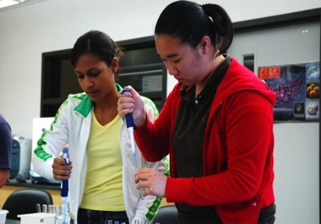
2023-2024 FTES Targets
4% increase in resident FTES over 22-23
City College | 8,120
Mesa College | 12,012
Miramar College | 8,250
Continuing Education | 8,827
District Total | 37,209
9

Slide 10
Strategic Plan: Vision
The San Diego Community College District provides its diverse student communities with access, belonging, and success through innovative and culturally responsive teaching, learning, services, and engagement in all aspects of its operations.

Slide 11
Guiding Principles
Every student is capable of achieving their educational goals.

Slide 12
Guiding Principles
As an open access higher education institution, we must continue to expand access, inclusion, opportunity, and engagement for students of diverse racial, gender, ability, social, and economic communities intentionally and systemically.

Slide 13
Guiding Principles
The individual identity of our students, faculty, employees, and community members encompasses many intersecting characteristics which shape their individual lived experiences.

Slide 14
Guiding Principles
We are responsible for serving our students, faculty, employees, and community members in a manner which creates belonging and facilitates their success within the context of their lived experiences.

Slide 15
Guiding Principles
The success of our institution is measured by individual outcomes in individual interactions.

Slide 16
Guiding Principles
We will fail forward, learn, and improve continuously.

Slide 17
Strategic Action
Learn
About the diverse, fluid, and intersectional racial, cultural, and social identities of our students, employees, and local communities
How legal, cultural, and social structures within and outside our colleges and district oppress and marginalize individuals from diverse racial, cultural, and social communities

Slide 18
Strategic Action
Learn
How individual biases develop and lead to behaviors which exclude, oppress, and/or marginalize individuals from diverse racial, cultural, and social identities
About race-conscious and culturally-affirming instruction, counseling, services, interpersonal communications, relationships, and behaviors

Slide 19
Strategic Action
Assess
Review data on student and employee outcomes, engagement, experiences, and concerns disaggregated by racial, cultural, and social identities

Slide 20
Strategic Action
Assess
Review current policies, procedures, resources, practices, and behaviors from diverse racial, cultural, and social perspectives to identify negative impacts on individuals
Reflect on individual behaviors and actions which negatively impact individuals from diverse racial, cultural, and social identities

Slide 21
Strategic Action
Act
Understand and value the lived experiences, strengths, and abilities of individuals from diverse racial, cultural, and social identities as essential to the mission of our colleges and district
Apply asset-based, student-centered, racially-conscious, and culturally-responsive practices and behaviors within our interpersonal relationships and work

Slide 22
Strategic Action
Act
Develop and implement asset-based, student-centered, race-conscious, and culturally-affirming pedagogy, curriculum, activities, service models, resources, practices, and behaviors in college and district instruction, services, events, and activities

Slide 23
Strategic Action
Reassess and Refine
Ask for feedback on how we communicate, teach, provide services, and interact
Use data and feedback to evolve policies, procedures, resources, practices, and behaviors to improve experiences and success outcomes for individuals from diverse racial, cultural, and social identities

Slide 24
District Overview
Q and A

Slide 25
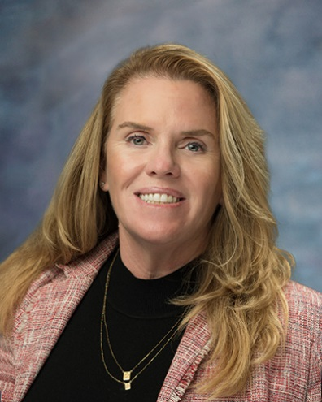
Educational Services
Instruction
San Diego Promise
Open Educational Resources (OER)
Zero Textbook Costs (ZTC)
Susan Topham, Ed.D.
Vice Chancellor
Educational Services

Slide 26
Enrollment Fee Cost for Students
Resident Credit Classes: | $46 per unit
Non Resident Tuition: | $331 per unit ($377 total per unit)
Baccalaureate Tuition Surcharge: | $84 per unit ($130 total per unit)
Non-Credit Classes: | Free
Community Education Classes: | Variable Fees $5-$20 per Instructional hour
Notes:
* Effective Fall 2018

Slide 27
Instruction
CurrIQnet Update
Timeline:
Fall 2022-Spring 2023 Develop credit and noncredit course and program pages
Summer 2023 Seamless conversion and import of course and program data from Curricunet V2 to META
Fall 2023 Development of online electronic catalog

Slide 28
Instruction
CurrIQnet Update
System Highlights:
CurrIQnet META's implementation leverages technology to enhance the overall educational experience and meet the changing needs of students.
CurrIQnet Meta successfully:
Integrates IDEAA (Inclusion, Diversity, Equity, Antiracism, and Accessibility) principles throughout course outlines of record, ensuring a comprehensive approach to education; and
Implements zero-cost textbooks to promote affordability, reduce financial burdens, and increase access.

Slide 29
Assembly Bills
AB 928:
By August 1, 2024, AB 928 requires California community colleges to place a student on an associate degree for transfer (ADT) pathway if the student declares a goal of transfer on their mandatory education plan, and such a pathway exists for their intended major. This requirement and guided pathways work should help ensure that students begin in the right math for their area of interest. Requires ICAS to establish a singular lower-division general education pathway
AB 1111:
Requires implementation of a common course numbering (CCN) system across the California Community Colleges (CCC) by July 1, 2024. The CCN system will assign the same course number to comparable courses to “streamline transfer to four-year postsecondary educational institutions and reduce excess credit accumulation.” The goal is establish a structure that maximizes credit mobility for all students.

Slide 30
Assembly Bills
AB 132:
Increase access to UCs and CSUs for students, especially underrepresented communities and those experiencing high school curriculum limitations, geographical constraints, or financial challenges. The program will guarantee future UC and CSU admission to high school graduates entering a California community college and who commit to transferring within three years. The Dual Admission program provides students clearer direction as they begin their post-secondary education.
AB 1705:
Requires community college districts to maximize the probability a student will enter and complete college-level coursework in English and math within one year. Districts are prohibited from using placement tests and may only use assessment instruments approved by the board of governors. Districts must rely on a student’s high school coursework, grades, and grade point average when placing students into English and mathematics courses.

Slide 31
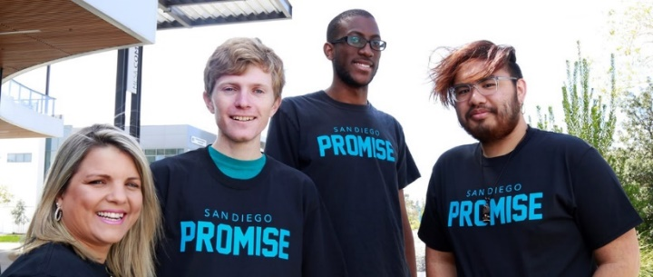
San Diego Promise Program
Enrollment Eligibility:
Recent high school graduate, GED, or HiSET or one of the following:
San Diego College of Continuing Education Student
Foster Youth
Veteran of U.S. Armed Forces
Formerly Incarcerated
Undocumented
Must be a California resident or AB 540 eligible
New State Promise Funding is coming available for returning students.
Students who completed college courses in high school are eligible for the San Diego Promise Program
Notes:
The San Diego Promise is a two-year program that pays for enrollment fees for all first-time, full-time students at City, Mesa, and Miramar Colleges. Students with the greatest financial need will also receive book grants. The San Diego Promise is intended to ensure that no deserving local students are denied the opportunity to go to college due to lack of resources.

Slide 32
San Diego Promise Fall 2023
2023-24 Promise Applicants
Fall Application and Contract Processing (Previous year data is at Fall Census)
 | Fall 2023 | Fall 2022 | Fall 2021 | Fall 2020 | Fall 2019
Application Submitted | 6,188 | 4,487 | 3,136 | 3,386 | 3,371
Applications that Meet Eligibility | 3,768 | 3,069 | 2,165 | 2,521 | n/a
Eligible to sign a contract, but not signed | 779 | 413 | 264 | 304 | n/a
Contracts signed | 2,990 | 2,552 | 1,901 | 2,217 | 2,176
Fall Class Enrollment (Previous year data is at Fall Census)
Enrolled In Units Profile | Fall 2023 | Fall 2022 | Fall 2021 | Fall 2020 | Fall 2019
Enrolled in 12 or More units | 2,313 | 2,188 | 1,567 | 1,836 | 1,900
Enrolled in less than 12 units | 451 | 257 | 200 | 209 | 157
Not enrolled in courses | 226 | 107 | 140 | 172 | 103
CCPG (California College Promise Grant) Eligible | 2,213 | 1819 | NA | NA | NA
NOT CCPG (California College Promise Grant) Eligible | 650 | 733 | NA | NA | NA

Slide 33
Promise Students Approved for Funding through the Foundation Fall 2023
2023-2024 Promise Applicants
Special Population Students Approved for Funding through the Foundation (Fall 2023 Cohort)
 | 2023-2024 | 2022-2023 | 2021-2022
College of Continuing Education | 40 | 12 | 21
Veteran of the US Armed Forces | 103 | 64 | 33
Formally Incarcerated | 115 | 43 | 7
Foster Youth | 99 | 61 | 11
Undocumented | 47 | 77 | 6

Slide 34
Open Educational Resources (OER) and Zero Textbook Costs (ZTC)
OER: Resources that reside in the public domain or have been released under an intellectual property license that permits their free use and re-purposing by others.
ZTC: Courses that use digital materials that are free of charge to students and may have a low-cost option for print versions.

Slide 35
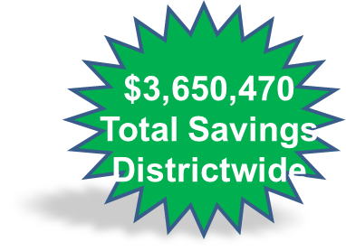
OER/ZTC – Cost Savings to Students
Source: SDCCD Bookstore
* Low Cost are textbooks that cost $40 or less
† Free non-OER has been included in the No Textbook Required category

Slide 36
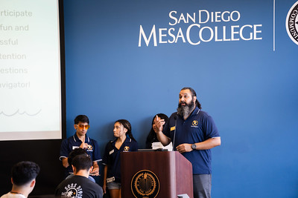

Slide 37
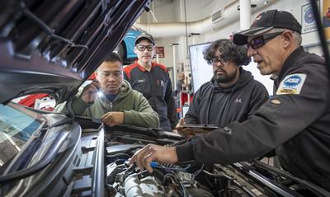

Slide 38
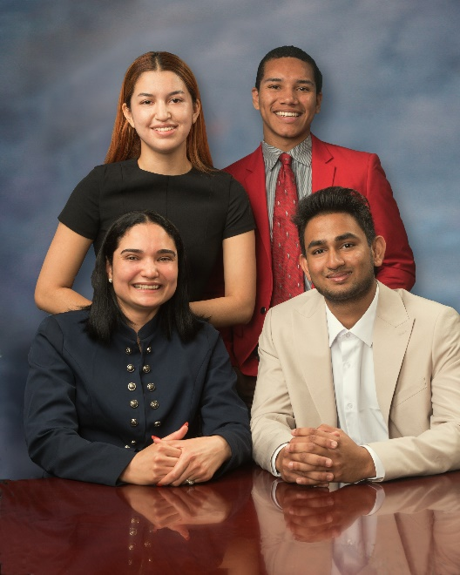
United Student Council
Beginning 2022-23, the United Student Council includes representation from all four colleges
San Diego City College
San Diego Mesa College
San Diego Miramar College
San Diego College of Continuing Education
Goals and Focus:
Support and access for housing-insecure students
Expand Associated Student Government engagement with students.
Student Trustees
Diego Bethea (City College)
Ixchel Valencia Diaz (Mesa College)
Namod Pallek (Miramar College)
Adriana Dos Santos (College of Continuing Education)

Slide 39
Student Centered Funding Formula (SCFF)
Increase student access and financial support:
Increase student access to financial aid – Blue Icon
Increase the number of CDCP students and course offerings
Enhance students' access to SDCCD classes and programs through ongoing evaluation and refinement of policies and procedures; eliminate obstacles.

Slide 40
Questions?
Instruction
San Diego Promise
Open Educational Resources (OER)
Zero Textbook Costs (ZTC)
Q and A

Slide 41
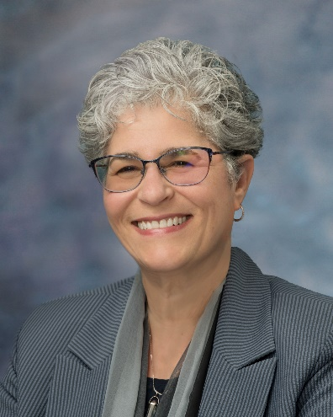
Institutional Innovation and Effectiveness
Division Overview
Strategic Planning Process Update
Michelle Fischthal, DBA
Vice Chancellor
Institutional Innovation and Effectiveness

Slide 42
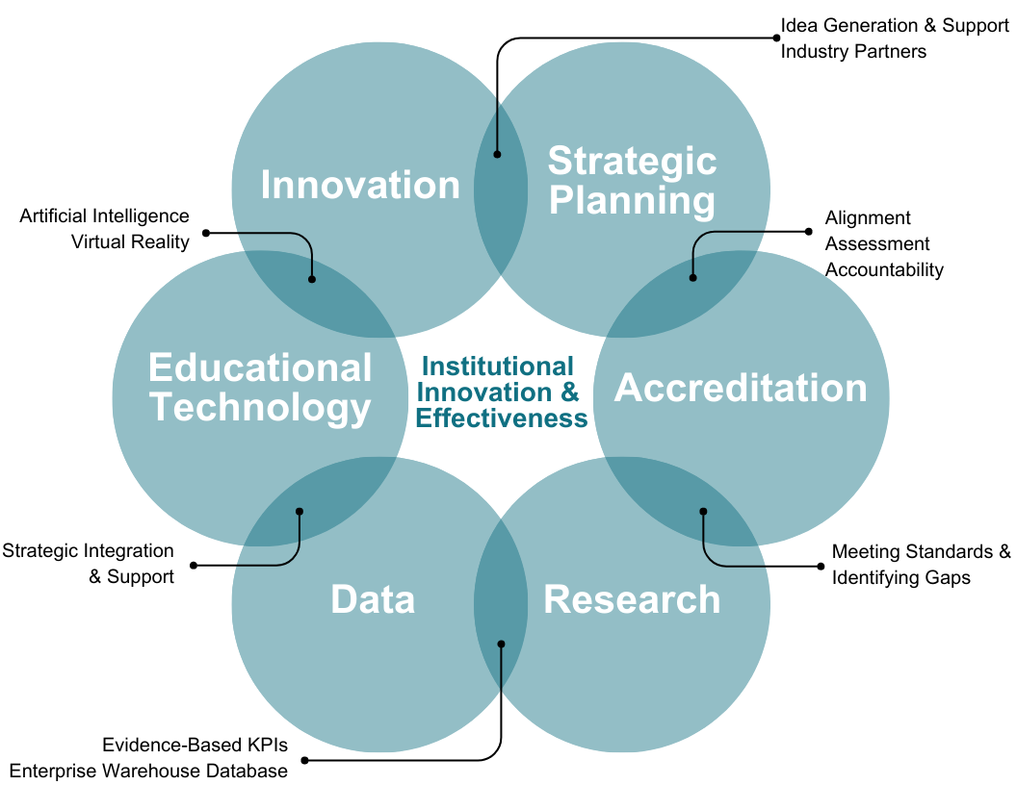
II&E Division Overview
Accreditation
Institutional Effectiveness and Research
Educational Technology
Institutional/Strategic Planning

Slide 43
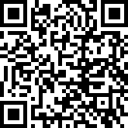
Opportunities through II&E
Survey- Emerging Technologies and Processes
Speaker Series, Workshops, Summit: Large Language models (LLM’s including AI-Artificial Intelligence), eXternal Reality (AR/VR/MR)
Collaboration and Ideation Convenings
Innovation Survey
43
43

Slide 44
II&E Support and Resources
https://www.sdccd.edu/about/departments-and-offices/institutional-innovation-effectiveness/index.aspx

Slide 45
Accreditation
Fall 2023
Self-Evaluation to ACCJC (August 1, 2023)
Hold Virtual Visits (September/October 2023)
Spring 2024
Site Visit: February 2024
Fall 2023
Vet Self-Study Report institution-wide
Meet with the Board of Trustee Subcommittee
Presentation to the Board of Trustees
Spring 2024
Visit: March 11-13

Slide 46
2023-30 District Strategic Plan
Spring 2022: The SDCCD Board of Trustees approved the 2023-2030 District Strategic Plan. This culminated a six-month process that included dozens of meetings, online presentations, and input from roughly 10,000 employees, students, and community members.
Summer 2022: The District Strategic Plan website was created (https://www.sdccd.edu/about/strategic-plan.aspx). The 2023-30 District Strategic Plan is available on the website.
Fall 2022 – Spring 2024: Goal Area Implementation Teams (GAIT) will create work plans and performance measures to assess progress on the implementation of the goals and objectives. A dashboard will be created to display results and progress.

Slide 47
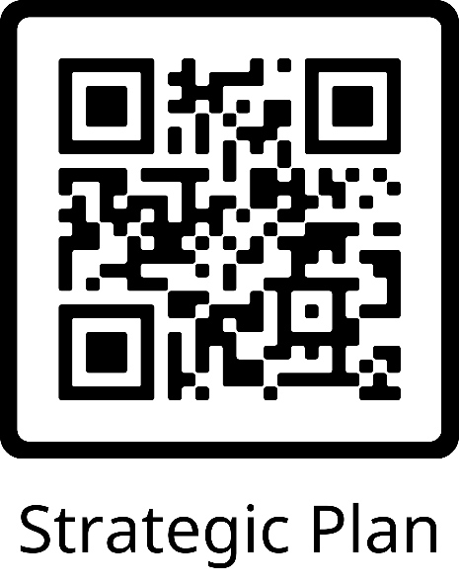
SDCCD Strategic Goals
Student Success and Wellbeing
Academic Excellence
Workforce Development
Financial Health
State of the Art Facilities
Institutional Resiliency

Slide 48
SDCCD Strategic Planning Process Cycle
2023 - 2030
PURPOSE: Determine Mission, Vision, & Values
ITERATE: Reflect on process & prepare to begin new cycle
RESEARCH: Conduct Internal & External Scans
Values-Driven, Student Centric & Continuously Improved
Collaborative ~ Human-centered ~ Equity-minded ~ Intentional ~ Scaled
Current
ASSESS: Evaluate progress & success
PRIORITIZE: Identify Goals & Strategies
Current
ACT: Implement Strategies
PLAN: Develop Shared Plan
Student Success
Notes:
Vision 2030 {Defined as part of the CCCCO Vision for Success}
SCFF {Which (if any) SCFF metrics are supported by this objective}
ACCJC Standards {Which (if any) Accreditation Standard are addressed}
Support SP Committee could Provide {supports (e.g. guidance and input, advocacy) that the SP committee could provide to departments, divisions, and offices around the SDCCD to further the SP goal and objective}
Exists in College Plans {Included as part of college plans}

Slide 49
Questions?
Division Overview
Strategic Planning Process Update
Q and A

Slide 50
Budget and Finance
Nancy Lane
Acting Vice Chancellor
Budget and Finance

Slide 51
California Community Colleges Budget Process
State Budget - Proposition 98
Governor - Legislature
State Board of Governors & System
73
Districts
Local Boards of Trustees & Districts
Federal &
Special Funds
San Diego Community College District
Allocations

Slide 52
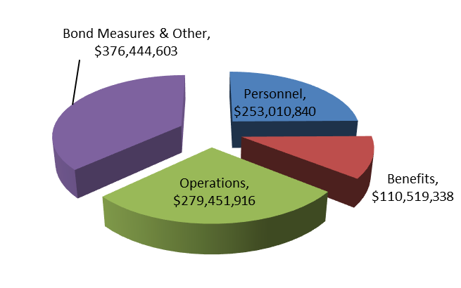
2023-24 Adopted Budget Approved by Board of Trustees on September 14, 2023
Summary of Fund Allocation
Summary of Operational Allocation
Total: $1,019,426,697
Total: $ 1,019,426,697

Slide 53
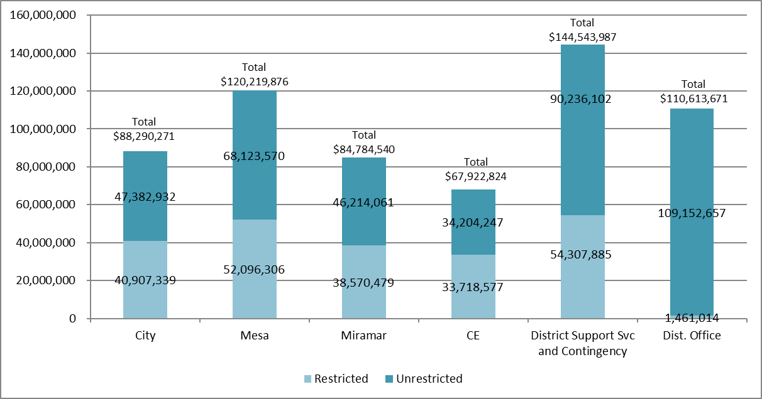
2023-24 Adopted Budget General Fund Unrestricted & Restricted Allocations Approved by Board of Trustees on September 14, 2023
Note: General Fund Budget for 2023-24 is $616,375,169. The GFU Budget is $395,313,569 and the GFR Budget is $221,061,600.

Slide 54
Reserves and GFU Beginning Balance (actuals) as of June 30, 2023
Insurance Reserve: Support District insurance liabilities.
GFU Beginning Balance: Includes the 5% Cash Reserve of $16,579,627 which per current Board policy requires a minimum of two months of expenditures ending fund balance reserve. Total Beginning Fund Balance is $45,784,017.
Post Retirement Health Benefit Trust: CCLC irrevocable trust for retiree health benefits.
Capital Projects Reserve: Facilities Projects other than Propositions S & N.

Slide 55
How the State Funds Community College Districts
General Fund Unrestricted revenue allocations under Student Centered Funding Formula (SCFF):
70% Student Enrollment (FTES based, Basic, # of credit Colleges and non-credit Centers)
20% Student Headcount and demonstrated financial need (Supplemental)
10% Student outcome achievement (Success)
Full-Time Equivalent Students
1 Student Taking 15 Units or equivalent, e.g. 5 Students Each Taking 1, 3-Unit Class (credit)
Actual Attendance Hours / 525 Hours (non-credit)
Hold-Harmless protection (FY18 apportionment revenue plus COLA each year) shifts to a ‘floor’ concept based on final FY25 funding below which districts cannot drop
No augmentation by COLA starting FY26 until apportionment being earned based on SCFF
Emergency Conditions Allowance (ECA) due to COVID-19 kept districts’ FTES enrollment at pre-pandemic levels
ended as of FY23, but benefit for several more years due to funding at a 3-year average

Slide 56
Balancing the Scales to Ensure Fiscal Stability & Resiliency
Achieve and maintain a minimum of two months of ending fund balance reserve, which is critical to ensure fiscal resiliency and health.
Focus on achievement of Strategic Plan 2023 goals and objectives.
Identify and receive net (after all expenses) revenue funding beyond state revenue apportionment.
Fund long-term liabilities e.g., OPEB (other post employment benefit obligations).
Align annual operating expenses and revenue to avoid deficit budgeting and spending.
Remain compliant with federal, state and grant requirements and laws including “Unmodified” clean annual audits.
Retain District’s bond rating and reaffirmation of credit and non-credit colleges accreditation.

Slide 57
Areas That Could Cause the Scales to Become Out of Balance
CalSTRS – CalPERS employer cost*
FY 2013-14 $14 million
FY 2023-24 $44.4 million
Declining enrollment impacts on SCFF’s calculated FTES, Supplemental and Success apportionment revenue.
State cash shortfalls due to tax revenue declines as a result of downturns or significant events e.g., inflation and/or a recession would impact apportionment revenue payments.
SCFF “Hold Harmless” protection ends in FY 2024-25; SDCCD needs to increase enrollment to bridge the gap between funded and earned levels of apportionment revenue.
Two months of ending fund balance Reserves critical to ensure fiscal resiliency.

Slide 58
Questions?
The Budget
Q and A

Slide 59
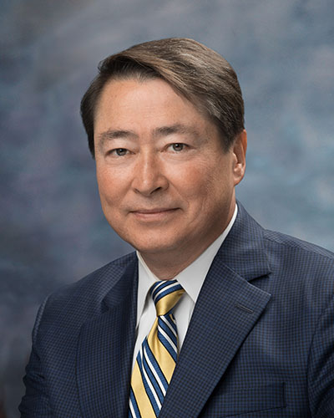
Operations, Enterprise Services,
and Facilities
__________________________________________________________________________________________________________________
2024 Bond
Affordable Student Housing
Food Services
Parking/Use of Facilities
Joel Peterson, Ph.D.
Vice Chancellor
Operations, Enterprise Services, and Facilities

Slide 60
2024 Bond Measure
November 2024 election
$3.5 billion (polling to help guide amount)
Project identification, prioritization, and costing in-progress
Citizen’s Campaign committee formation in-progress
Polling and outreach, post-committee formation
Bond detail, ballot, and bond measure language development in early 2024
Outreach, communication, and community engagement Spring 2024

Slide 61
Affordable Student Housing
Feasibility, programming, and conceptual design completed
Construction grant application accepted by the state
800+ bed affordable student housing complex envisioned
Wrap-around services (e.g., basic needs, academic support services, student support services, etc.)
Public/Private Partnership (P3) Development Partner selected
City College student housing project serves as a pilot program for SDCCD
Lessons learned to inform future housing projects
Affordable student-family housing
Affordable employee housing
Integrated student life program in support of academic success

Slide 62
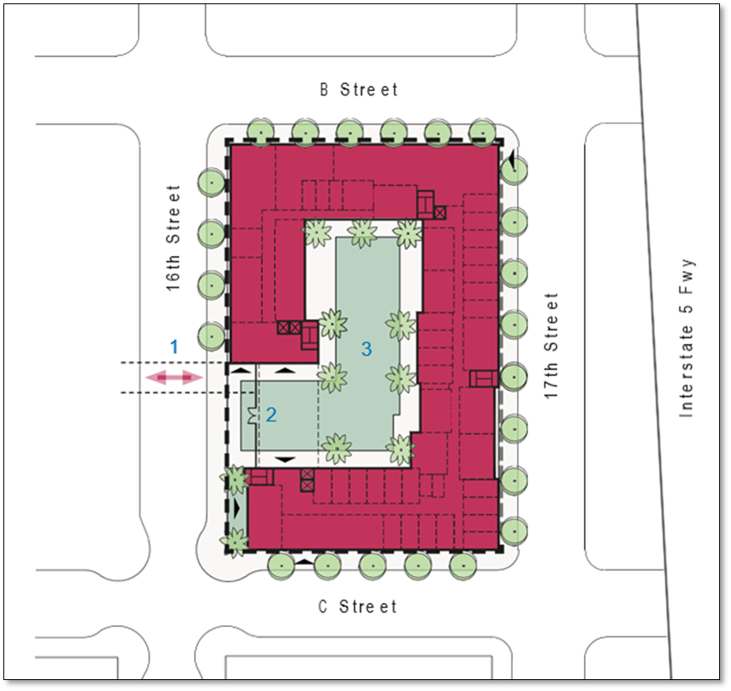
Affordable Student Housing
Conceptual Direction

Slide 63
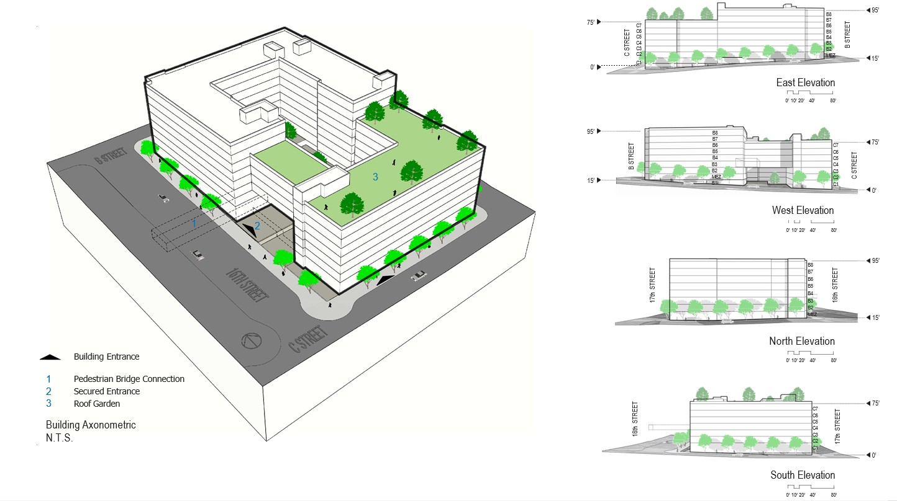
Affordable Student Housing
Pedestrian Bridge Connection
Roof Garden
Secured Entrance

Slide 64
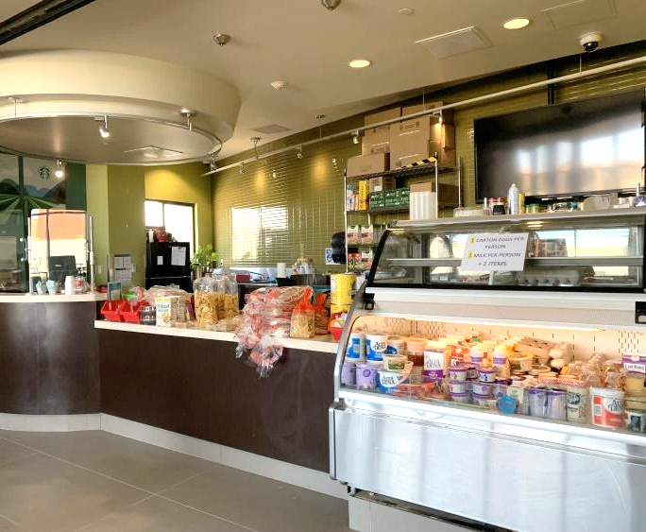
Food Services
New Food Services Model
Public/Private partnership with Company Kitchen
Company Kitchen provides:
all necessary personnel
all costs of goods sold
all POS equipment, functions, and inventory management
extended and flexible service hours to meet student and community demand
Limited duration pilot program
Evaluate service model after pilot

Slide 65
Parking/Use of Facilities
Paperless automated parking permits
Significant budget savings
Improves convenience for students, faculty, and staff
Reduces citations (e.g., forgot to hang tag)
Leverages technology to improve efficiencies
Less time on parking enforcement; more time providing services and assistance
Reduces citation error
Automation better supports third-party facility usage and Civic Center rentals
Non-academic alcohol use to be allowed for third-party events on SDCCD property
New BP, AP, and procedural documents in development
Enhances third-party event options
May generate non-traditional revenue that support student programs
May enhance fundraising initiatives and events that support SDCCD’s mission

Slide 66
Questions?
2024 Bond
Affordable Student Housing
Food Services
Parking/Use of Facilities

Slide 67
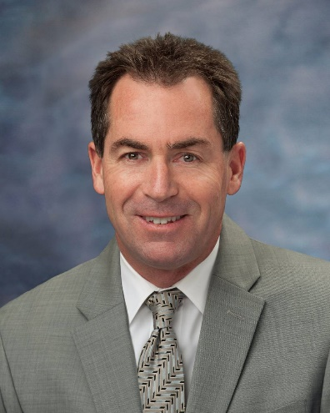
Districtwide Communications and Public Relations
Jack Beresford
Director, Communications and Public Relations

Slide 68
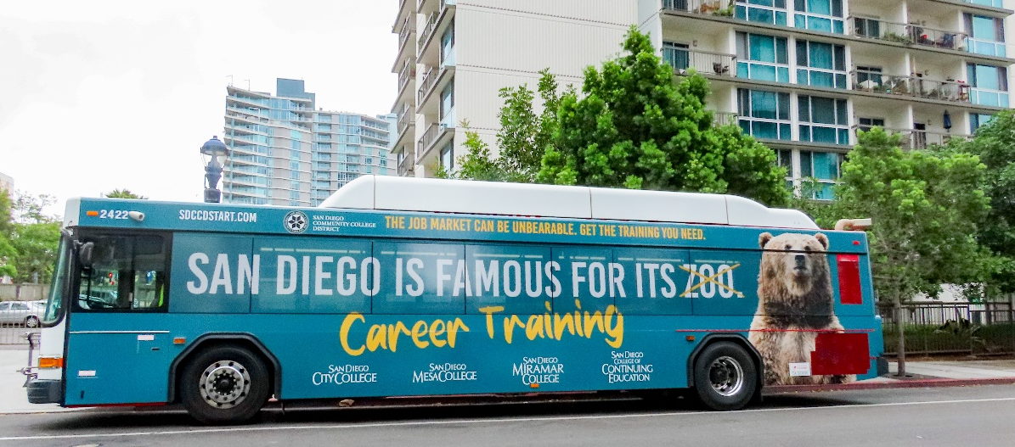
Districtwide Marketing
“Reimagining San Diego” campaign targets adult learners
Bus wraps, billboards, social media, OTT, Google search
Call center and Spanish language component
Campaign runs August 2023-May 2024
9,693 clicks in first two weeks of campaign

Slide 69
District and College Branding
District evaluating its identity and branding
Current visual identity system dates to 2005
Importance of reinforcing our mission, vision, awareness, and value of our District and colleges
Stakeholder engagement includes surveys, workshops, interviews, and presentations
1973-2001
2001-2005
2005-2017
2017-present

Slide 70
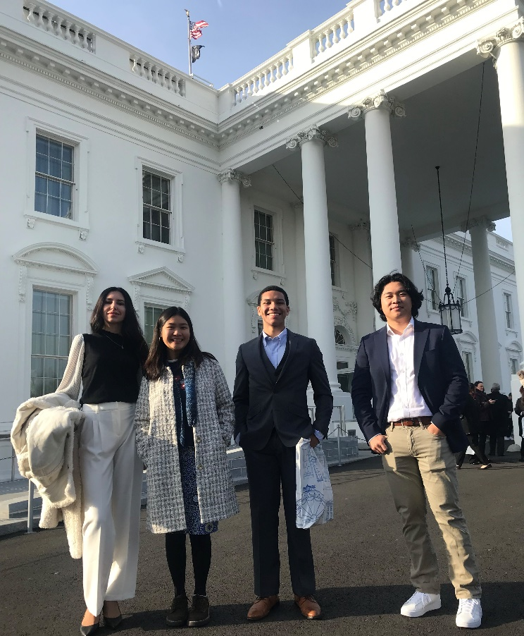
Legislative Advocacy
State Advocacy Highlights
Baccalaureate expansion
Affordable Student Housing Program
Budget advocacy
Federal Advocacy Highlights
Increase in maximum Pell Grants
FAFSA simplification
Additional funding from American Rescue Plan Act, CHIPS and Science Act, Bipartisan Infrastructure Law, and Inflation Reduction Act

Slide 71
Questions?
District Communications and Public Relations
Q and A

Slide 72
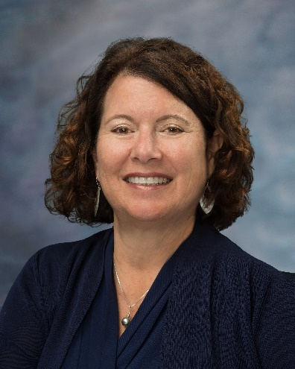
Development and Entrepreneurship
Laurie Coskey, Ed.D.
Vice Chancellor,
Development and Entrepreneurship

Slide 73
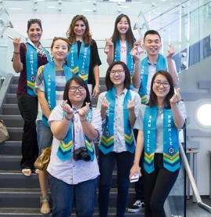
SDCCD Vision
Ensuring Success for All Students* and Expanding Our Efforts to Achieve Diversity, Equity, Inclusion and Access in Everything We Do.
* by “all Students” SDCCD is encompassing people of all backgrounds including but not limited to students from all ethnic and racial groups…, those of two or more races: students with disabilities and special needs, and all LGBTQIA* students…
73

Slide 74
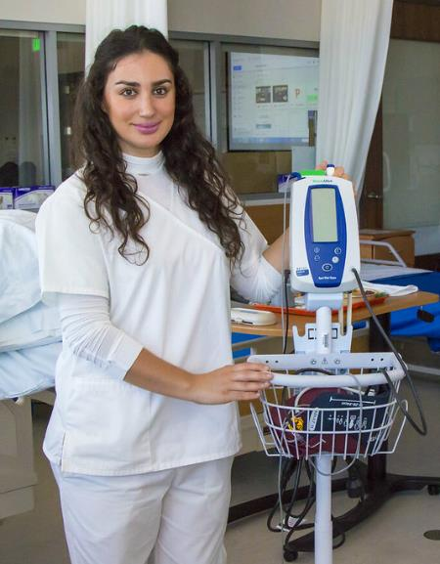
GOALS
Student Success and Well Being
Academic Excellence
Workforce Development
Financial Health
State of the Art Facilities
Institutional Resiliency
74

Slide 75
Support Strategic Goals through Districtwide Development Strategies
Increase collaboration among the 5 district foundations
Increase corporate and foundation partnerships leading to significant investments supporting students and colleges
Convene new private/public collaborations to fund critical student initiatives and interventions
Increase local, state, and federal funding partnerships/collaborations
Fund districtwide supports to remove barriers to student access and success

Slide 76
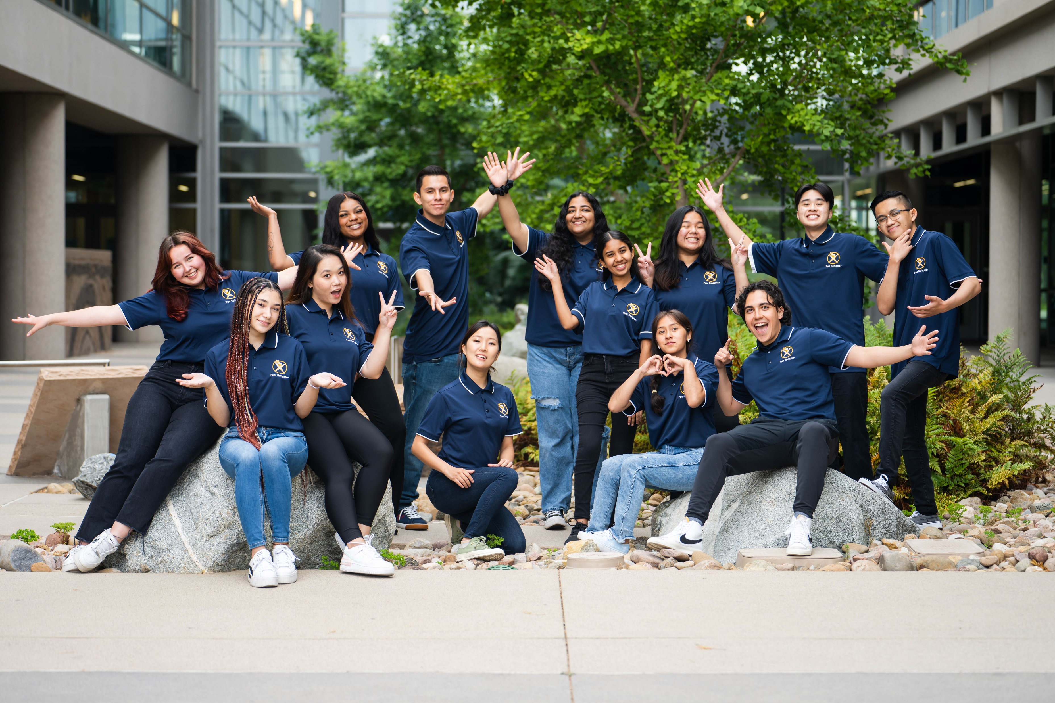
Support Strategic Goals (continued)
Increase individual donor fundraising and friendraising supporting students, programs and colleges
Host bi-annual fun fundraising event
Convene a Chancellor’s Circle/Ambassador’s Program for major donors
Establish a retiree program for social engagement and fundraising support.
Boost, inspire and expand employee giving
Create a Legacy Program.
76

Slide 77
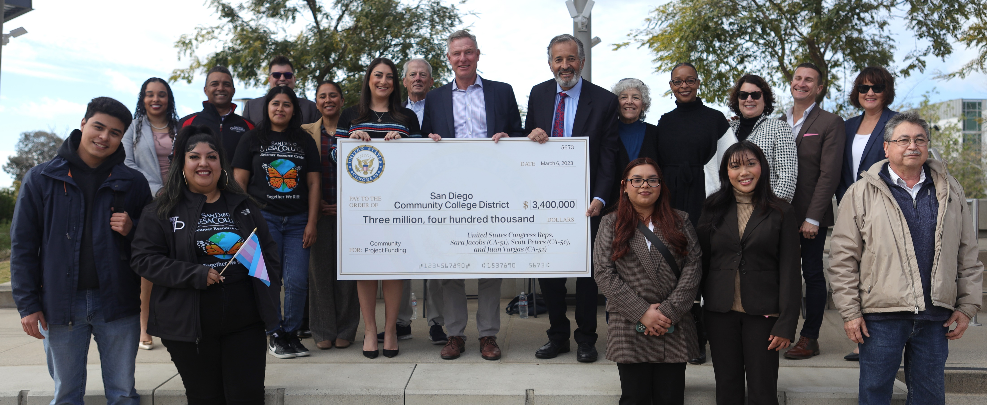
Example 1: In FY 23 we received $3.4 million in Community Benefits grants from our federal legislators including Senator Feinstein and Congresspersons Jacobs, Peters and Vargas. As of now, for FY 24 there are $2 million dollars of community benefits grants pending and headed to the House floor where they will hopefully pass.

Slide 78
Example 2. Students at all 4 colleges in certain pathways struggle to their pay end of program testing, licensing and certification fees. These are a barrier to entry into students’ chosen profession. We have begun an initiative that aims to pay all student testing, licensing and certification fees. We began with an initial donation from a single donor.
Example 3. A large bank that has funded individual donations to our college foundations has changed their funding model and will fund the District only, including all 4 colleges, with a single, larger donation.

Slide 79
Example 4. The 5 district foundations worked together to create a template of a collaborative basic need grant that reflects the unique needs of each of the colleges that can be used for multiple grant requests.
Example 5. Working with community agencies, government leaders and public and private funders to better support our unsheltered students with particular emphasis on the possibilities of funding safe parking programs and low-income housing.

Slide 80
Questions?
Development and Entrepreneurship
Q and A

Slide 81
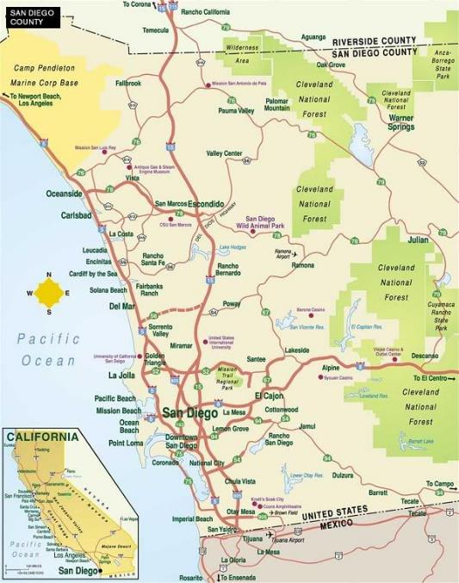
Planning Map for 2023-2024
Implement Districtwide Strategic Plan
Complete Chancellor Search
Revise hiring policies and procedures
Adapt to state budget challenges
Update Enrollment Management plans
Increase SCFF revenue
Expand Promise Program
Implement Facilities Plans
Develop Comprehensive Housing Plan
Develop Alternative Models of Campus Policing
Increase Development and Entrepreneurial Outcomes

Slide 82
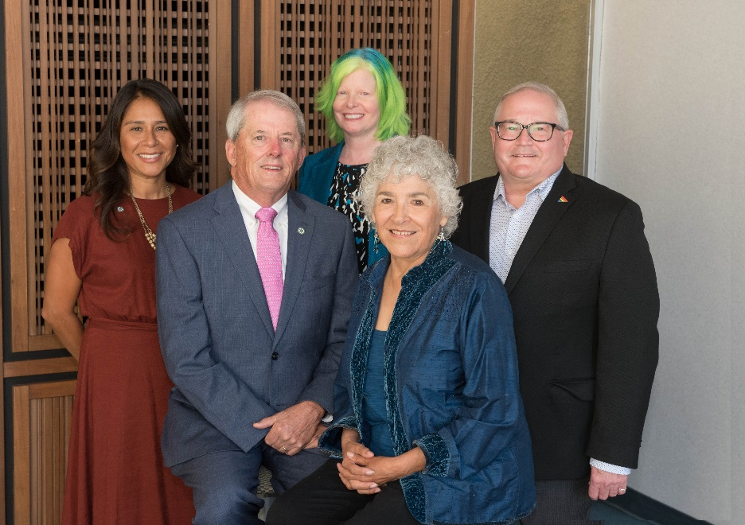
San Diego CCD Leadership Team
Board of Trustees Geysil Arroyo, Craig Milgrim, Dr. Maria Nieto Senour, Mary Graham, Bernie Rhinerson
Student Trustees
Diego Bethea (City College)
Ixchel Valencia Diaz (Mesa College)
Namod Pallek (Miramar College)
Adriana Dos Santos (College of Continuing Education)

Slide 83
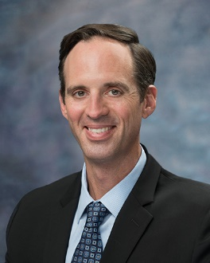
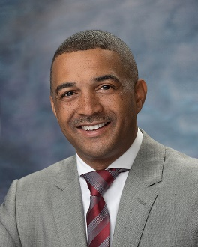
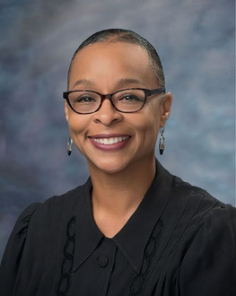
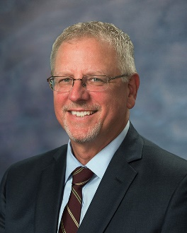
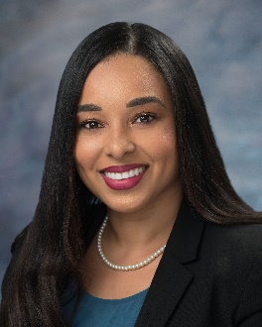
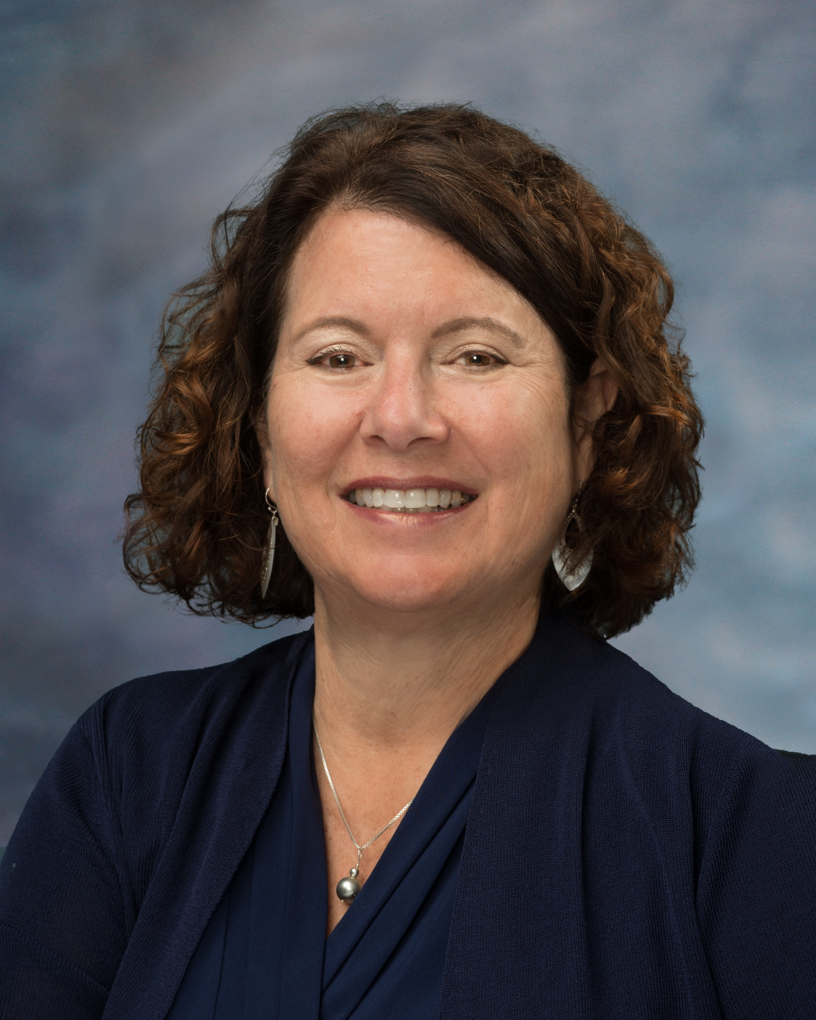
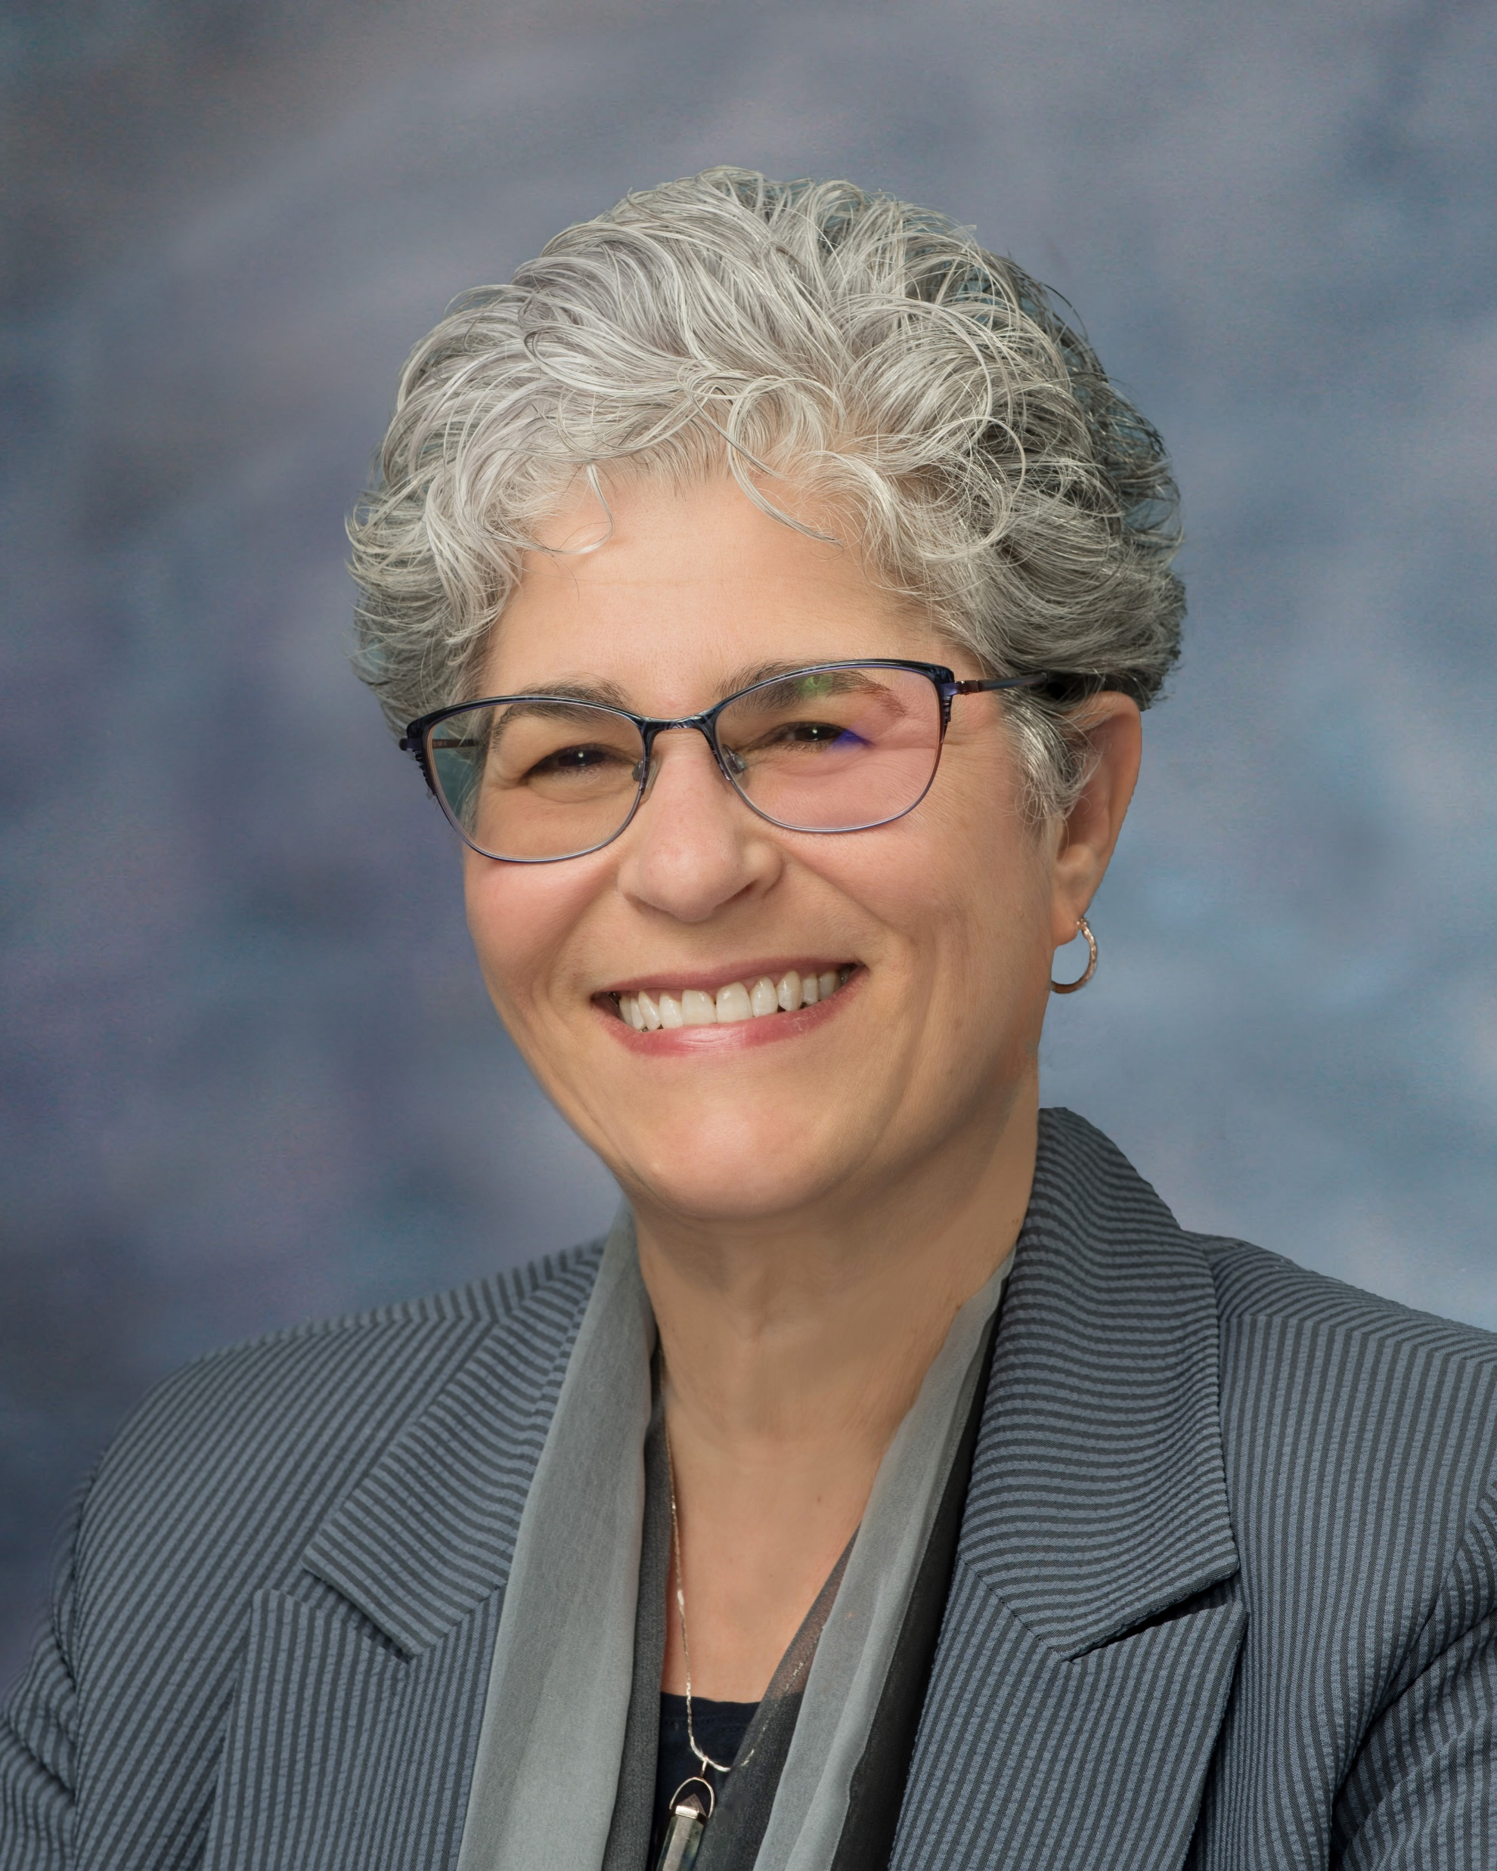
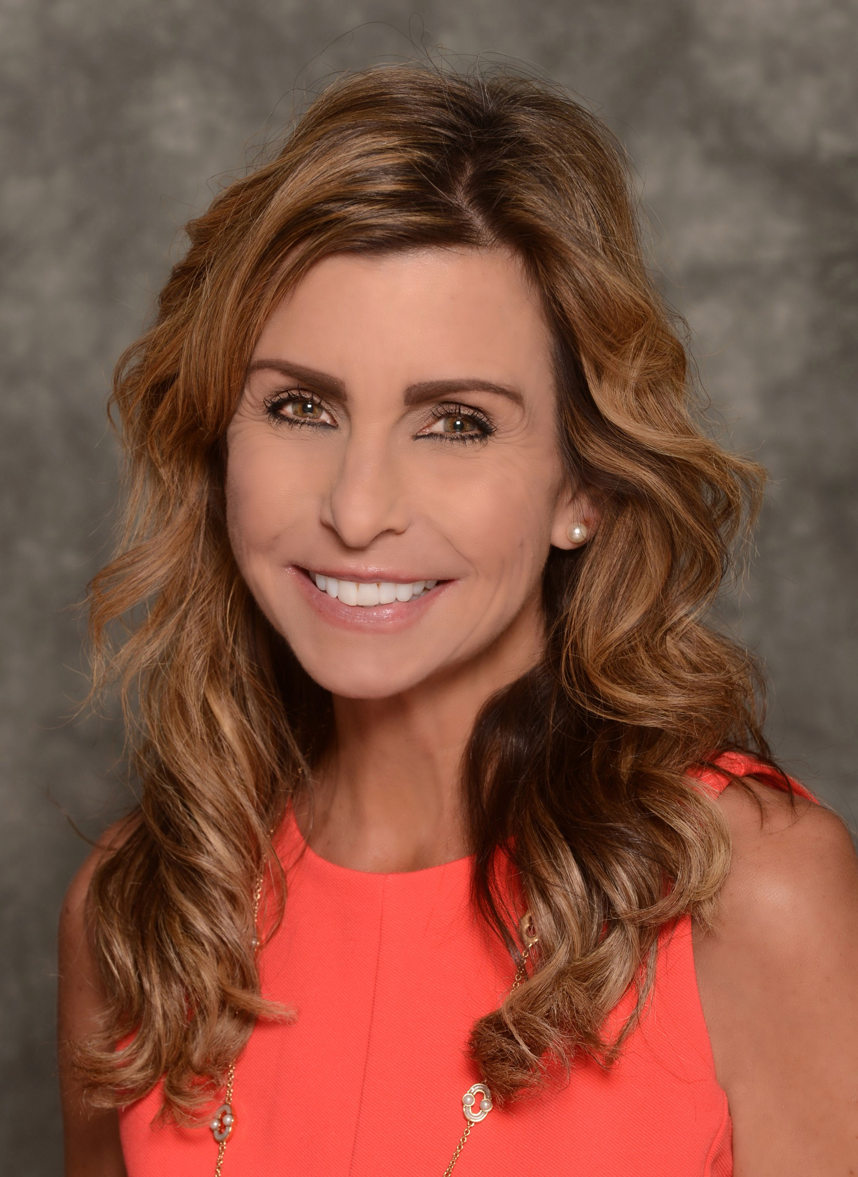
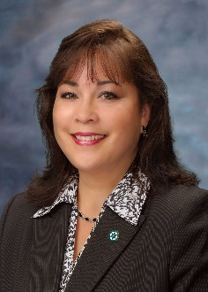
San Diego CCD Leadership Team
Gregory Smith Acting Chancellor
Dr. Ricky Shabazz
President
City College
Dr. Ashanti Hands
President
Mesa College
Dr. P. Wesley Lundburg
President
Miramar College
Dr. Tina M. King
President
College of Continuing Education
Dr. Laurie Coskey
Vice Chancellor
Development and Entrepreneurship
Dr. Susan Topham
Vice Chancellor
Educational Services
Nancy Lane
Acting Vice Chancellor
Finance and Business Services
Dr. Michelle Fischthal Vice Chancellor
Institutional Innovation and Effectiveness
Dr. Joel Peterson
Vice Chancellor
Operations, Enterprise Services, and Facilities
Aimee Gallagher
Acting Vice Chancellor
People, Culture, and Technology Services
Jack Beresford
Director
Communications and Public Relations
Margaret Lamb
Executive Assistant to the Chancellor

Slide 84
Questions?
Forum
Q and A

