Slide 1
Board Policy & Administrative Procedures
District Governance Council
July 12, 2023

Slide 2
The WHAT
Board Policy
Administrative Procedure
3rd Level Documents

Slide 3
The WHAT: Board Policy
Voice of the Board
Addresses “the what”
Sets general goals and acceptable practices for the operation of the District
Implements Federal, State, Local Laws and Regulations
When a law says “the governing board must/shall”
Must be adopted by the Board of Trustees for approval and implementation
Establishes standards and creates focus

Slide 4
The WHAT: Administrative Procedures
Implements Board Policy
Addresses “the how”
Includes prescriptive details
When a law says “the district/college must/shall”
Responsibility of the Chancellor; does not require Board action, so generally does not go to the Board
Determines the plan of action to fulfill a Board Policy

Slide 5
The WHAT: 3rd Level Documents
Detailed operation guideline/handbook for all departments within the District
Helps to further explain departmental processes and practices
Addresses “the how” only step-by-step with specific details
Maintained by individual departments
Must be in-line with the board policy and administrative procedure

Slide 6
Board Policies
Establish the what – define goals and practices
Represent the voice of the Board
The responsibility of the Board
Require Board approval
Delegate authority
Best expressed in broad statements
Should be clear and succinct
Should not require frequent updates or changes, absent changes in law, regulations, or the goals and mission of the District
Administrative Policies
Establish the how – address implementation of goals and practices
Do not require Board action
The responsibility of the CEO
Should include sufficient detail to be implemented appropriately
Should be clear
Should be updated as-needed to remain current under applicable law, regulations, best practices, and the District’s organizational structure

Slide 7
The WHY
  Federal, State, and Local Legislation and Regulations
    Including Attorney General Opinions, CCC Chancellor’s Office Legal Opinions and Mandates, and Relevant Case Law
  Accreditation Standards
  Reflect minimum language required for legal compliance
  For the benefit of our students and employees

Slide 8
The HOW
Administrative Procedure 2410 - Board Policies and Administrative Procedures
  Explains review process for all new and revised policies and procedures, including three categories of review:
  Category 1 = New and/or major revisions that are not required by law; Most extensive review
  Category 2 = New and/or revisions in response to legal and/or regulatory requirements
  Category 3 = Technical and/or non-substantial revisions such as reference update, title changes, or documents that are being reviewed for currency but not undergoing significant revision

Slide 9
The HOW: Review and Revisions
Board Policy and Administrative Procedure changes may be initiated in various ways:
  Community College League of California’s Policy & Procedure Subscription Service (legally required, legally advised, and best practices updates)
  Division-generated revisions/additions
  Participatory Governance Committee-generated revisions/additions (including Academic Senate, Classified Senate, and United Student Council)
  Board-generated revisions/additions (policy only)

Slide 10
The WHO
Subject Matter Area Leaders
Appropriate District Participatory Governance Councils
Chancellor’s Cabinet
District Governance Council
Board of Trustees or Chancellors signature

Slide 11
The WHO: Subject Matter Area Leaders
Review current and draft policies and procedures from operational lens
Ensures language is current, accurate, and in compliance with Federal, State, and local laws/regulations
Takes draft through participatory governance process

Slide 12
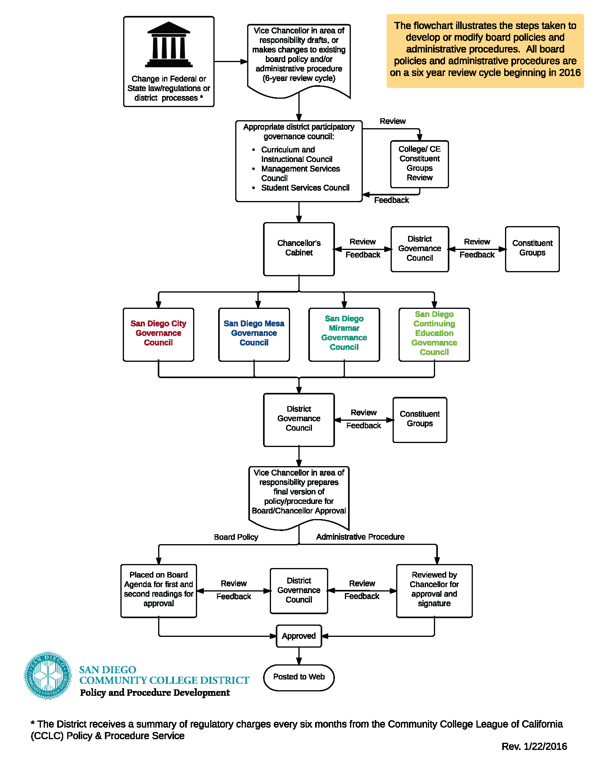
The WHO: District Participatory Governance

Slide 13
When Considering Adding a Policy/Procedure
Not every issue or incident requires the creation of a policy.
Is this an individual incident that may be addressed in another manner?
Does the BP/AP have districtwide application or is it better addressed as department guideline or protocol?
Is the language in the BP/AP brought enough to avoid the necessity for frequent revisions?

Slide 14
The WHERE
SDCCD Board Policy and Administrative Procedures Website
CCLC Subscription Service

Slide 15
CCLC Subscription Service
Chapter # | Title | BPs | APs
Chapter 1 | The District | 2 | 0
Chapter 2 | Board of Trustees | 38 | 19
Chapter 3 | General Institution | 34 | 40
Chapter 4 | Academic Affairs | 22 | 39
Chapter 5 | Student Services | 27 | 38
Chapter 6 | Business and Fiscal Affairs | 23 | 39
Chapter 7 | Human Resources | 26 | 55
Total Templates = 402 |  | 172 | 230
Accreditation-Related Templates = 77 |  | 37 | 40

Slide 16
How Did We Get Here?
Old Conventions
  Mixture of policy and procedure within the same document
  Little differentiation between third level documents and administrative procedure
  Numbering of documents: policies were whole numbers ( ex. 1001), while procedures were number 1001.1, 1001.2, etc

Slide 17
How Did We Get Here?
2017 – The District’s colleges underwent accreditation; the credit colleges received 3 major recommendations for improvement, including one related to policies and procedures
  In order to increase effectiveness, the Team recommends that the District complete the review and update of its policies and procedures and establish a formal schedule for their regular review and publication.

Slide 18
How Did We Get Here?
2017 – The Vice Chancellors start meeting with the Board Office twice a year to map out what BP/AP documents are likely to go before DGC in the next six months
This was in part a response to a DGC request, as between 2016-2017, approximately 170 documents made their way through the review process in anticipation of the accreditation visit
Unfortunately, that momentum was not sustained

Slide 19
So Now What?
The vice chancellors have committed to prioritizing accreditation-related board policies and administrative procedures over the next 6 to 9 months
At the August 23 DGC meeting, we will be bringing a list of those policies and procedures that we hope to bring before the DGC in the fall 2023 semester
After completing review of the accreditation-related policies and procedures, the vice chancellors will focus on other legally required documents, those documents that are excessively out of date, and legally advised documents

