Slide 1



Fall 2023
Convocation
Thursday, August 17th, 2023

Slide 2

Today's Program
Land Acknowledgement
District Greetings
Constituent Welcomes
What is Community & How do we Build it?
President's Message
Our "Why"
Share out & Next Steps
Break
Closing Remarks
Recognition of New Employees

Slide 3
Land Acknowledgement
We recognize that San Diego Miramar College sits on the ancestral homeland of the Kumeyaay people, who have lived in this area for well over 10,000 years, and we honor their past, present, and future connection to this land and its inherent connection to their identity.
We acknowledge our occupation of unceded Kumeyaay land and the violent systemic injustices this has continuously perpetuated for Native peoples of this region. We pay respect to the Indigenous people of San Diego County - past, present, and future - and honor their continuing presence in their homeland and their spiritual beliefs that land does not belong to people; people belong to land.
We also acknowledge that this is merely the beginning, and there is far more work to be done in an attempt to heal all of the injustices and inequities that still exist today and throughout their entire historical diaspora. Hopefully we can find a way to move forward together.
Notes:
Heather Paulson will read.

Slide 4

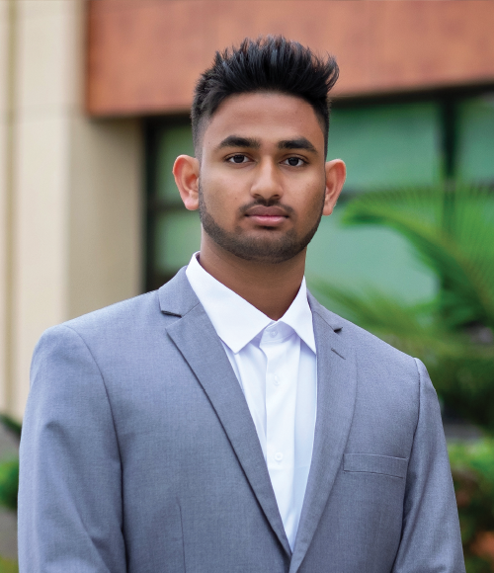
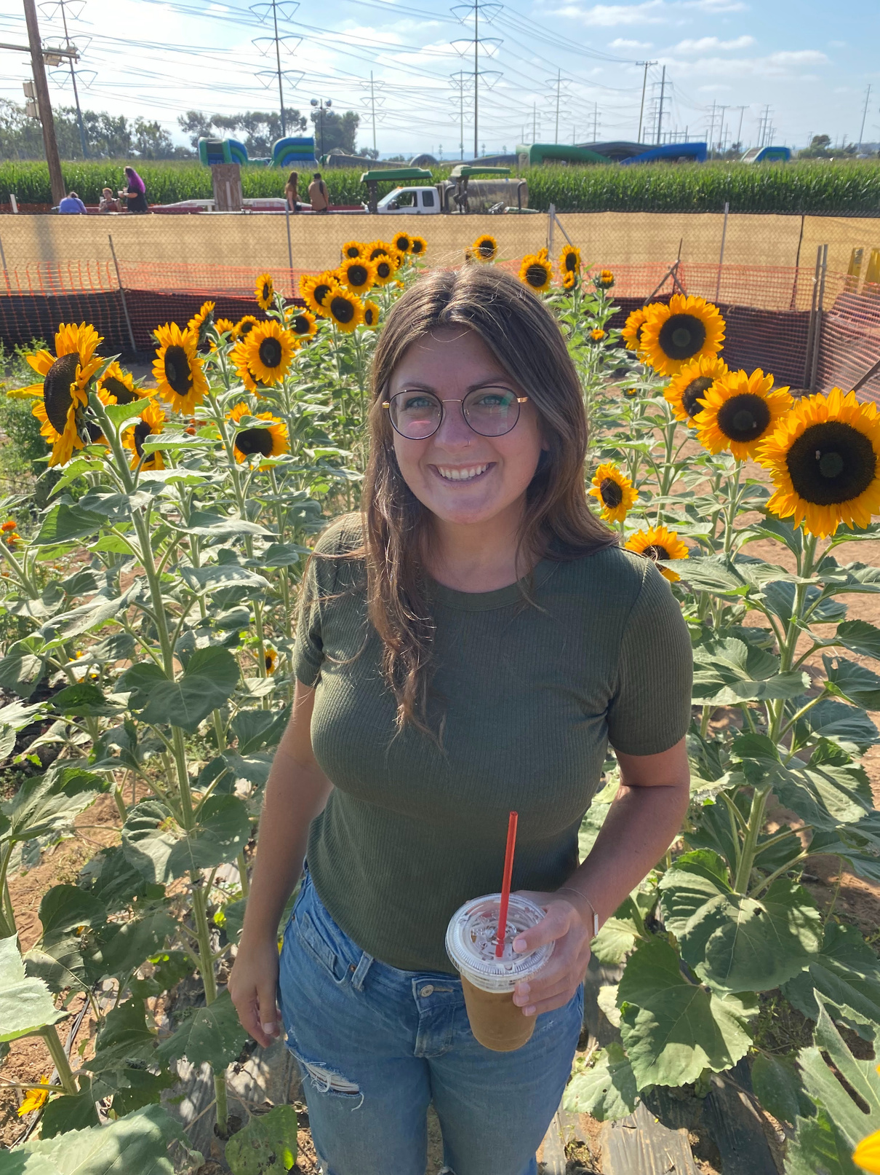
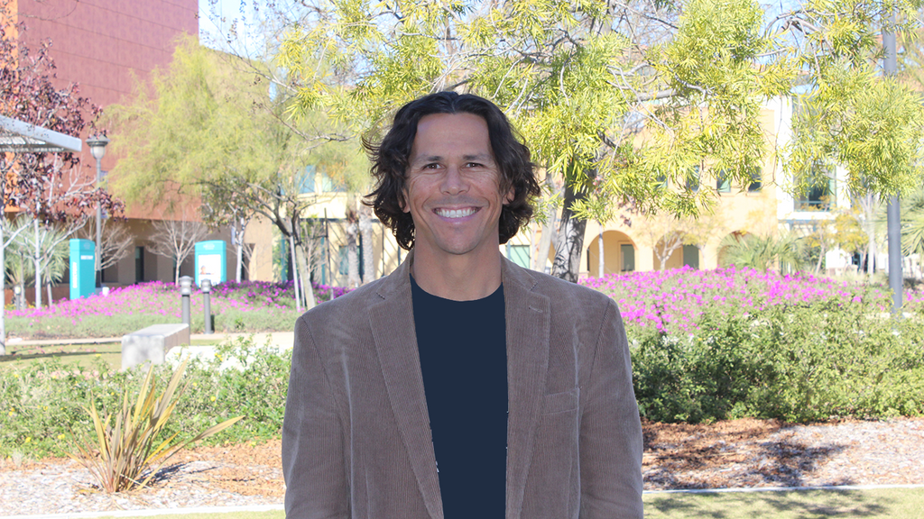
Constituent Welcomes
Namod Pallek, ASG President
Malia Kunst, Classified Senate President
Pablo Martin, Academic Senate President

Slide 5
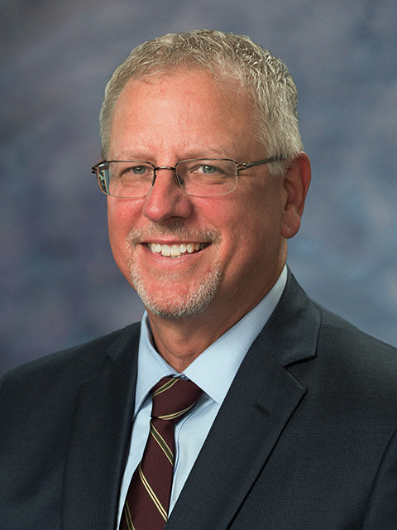
President's Welcome Message
Wes Lundburg, President

Slide 6
Our "Why"
Part 1
Step 1: Write down three things you were hopeful for when starting your career
Step 2: Write down three things that brought you joy when you started your career
step 3: Write down three things you were grateful for when you started your career
Part 2:
Same questions but current/present day

Slide 7



Break

Slide 8

Recognition of New Employees

Slide 9
26 new classified
15 New faculty
7 new managers

Slide 10
Classified Professionals
Colette Sprenger
Alicia Lopez
Caitlyn Morgan
Sharilyn Wilson*
Luis Cuarao
Kathrine Pack
Evan Smith
Carlos Pelyao
Emmanuel Saltis
Daniela Perez Padilla
Saribel morales-rivera
cheyanna morence*
Joshua Konkle
Sam Beumaher*
Martha Jimenez
John Abbott
Rob Spatafore*
Gabrielle Hermogino
John Abbot
Haruko Takeshita
Lori DeJongh-Slight
Marco Palombo
Giovanna Bustamante
Edward King
Christian Torres
Rebecca Seiverd
*Promotion

Slide 11
Faculty
Catrina Gillus
Judy Wu
Janina Moretti
Joel Palhegyi
Amy ALsup
Leslie Marovich
Ivan Gutierrez Valdovinos
Jennifer Aase
Olivia Flores
Martin gonzalez
veronica Hartmann
Laura marin
Landa Cain
Emi Kuwafuchi
Alex Hofler

Slide 12
Managers
Allison Douglas-Chicoye
Vincent Ngo*
Kurt Hill*
Denise Kapitzke*
Dan Gutowski*
Lisa Cole-Jones
Dana Stack*
*Promotion

Slide 13

GROUP PHOTO TIME!

Slide 14
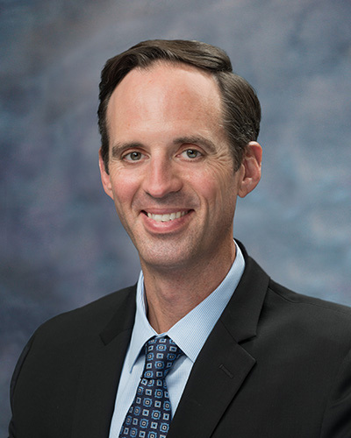
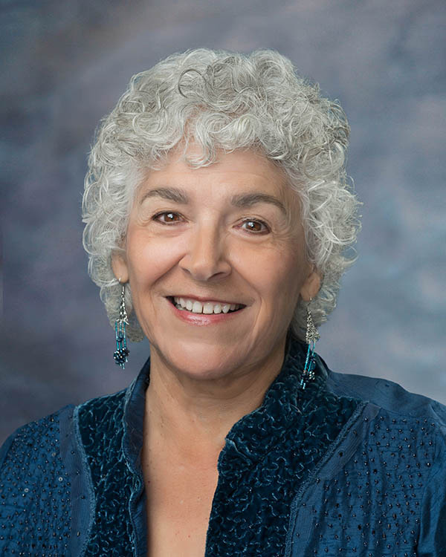
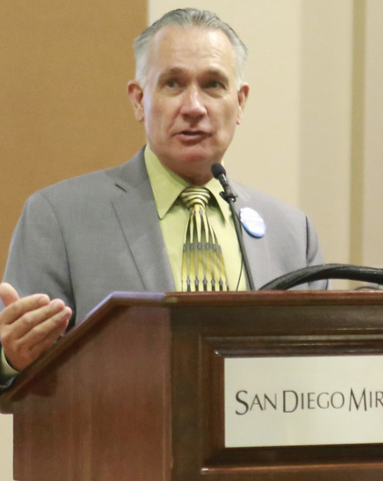
District Greetings
Greg Smith,
Acting Chancellor
Maria Senour, Board President
Jim Mahler,
AFT President

Slide 15
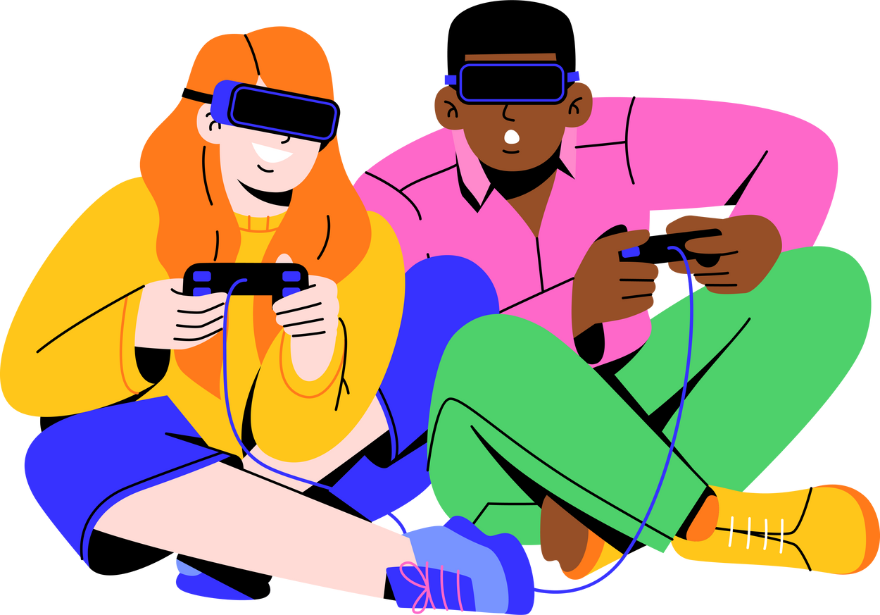
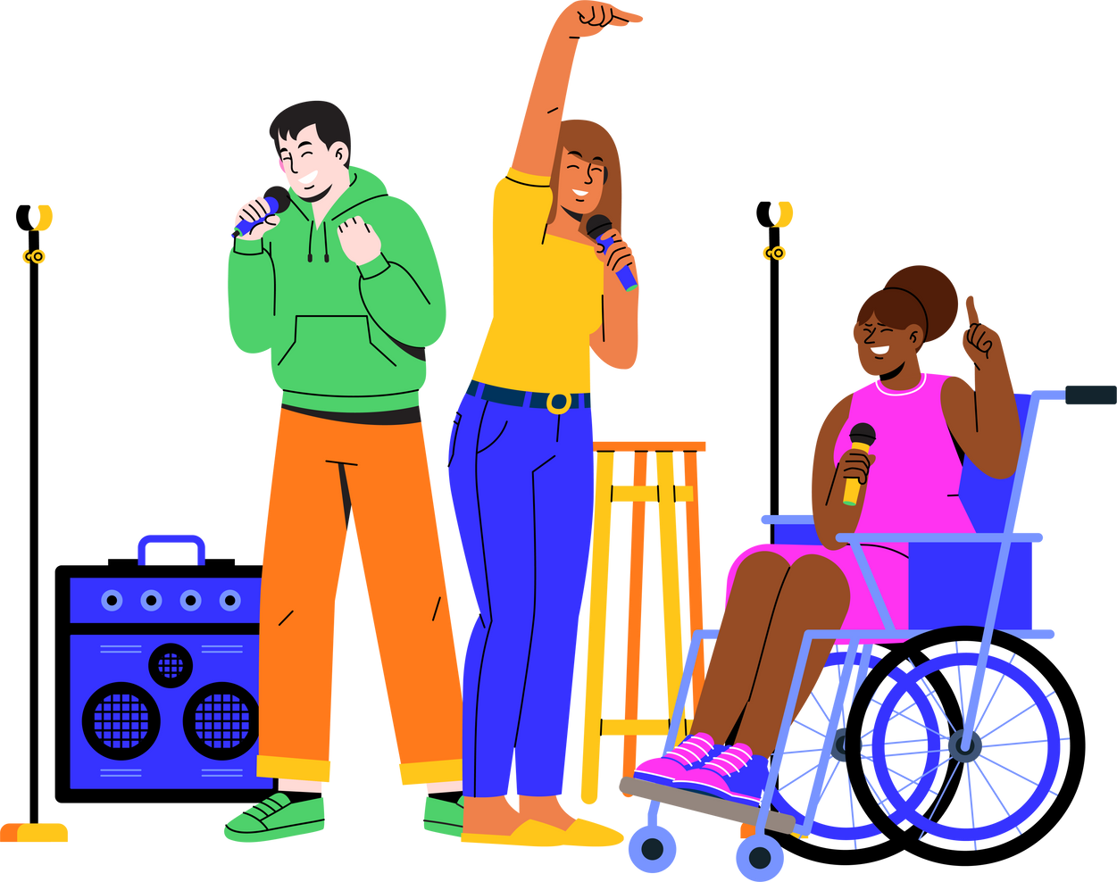
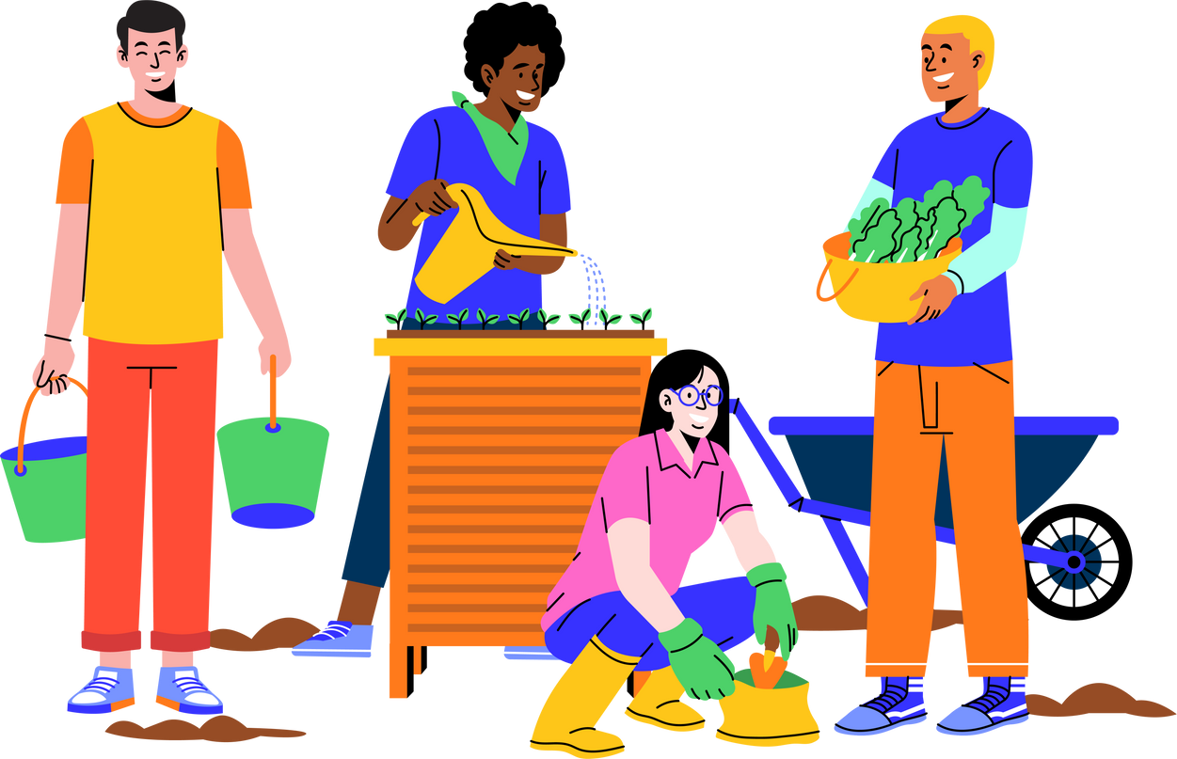
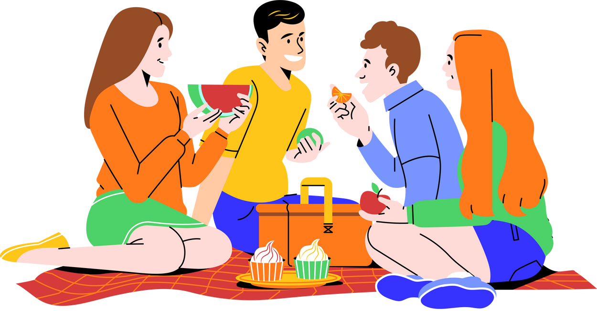
What is Community and how do we build it at Miramar?

Slide 16
Part 1: What is Community
  breakout into small groups
  Side one of notecard – personal definition of community (10 minutes)
  side two of notecard – group definition of community (10 minutes)
  share out/discussion within group (10 minutes)
Part 2: How do We Build Community
  Stay in small groups
  Side one of notecard – ideas on how to build community within your department (10 minutes);
  side two of notecard – ideas on how to build community as a broader campus (10 minutes).
  Share out (10 minutes); Groups share definitions on community and ideas on how we can build/continue to build it.

Slide 17
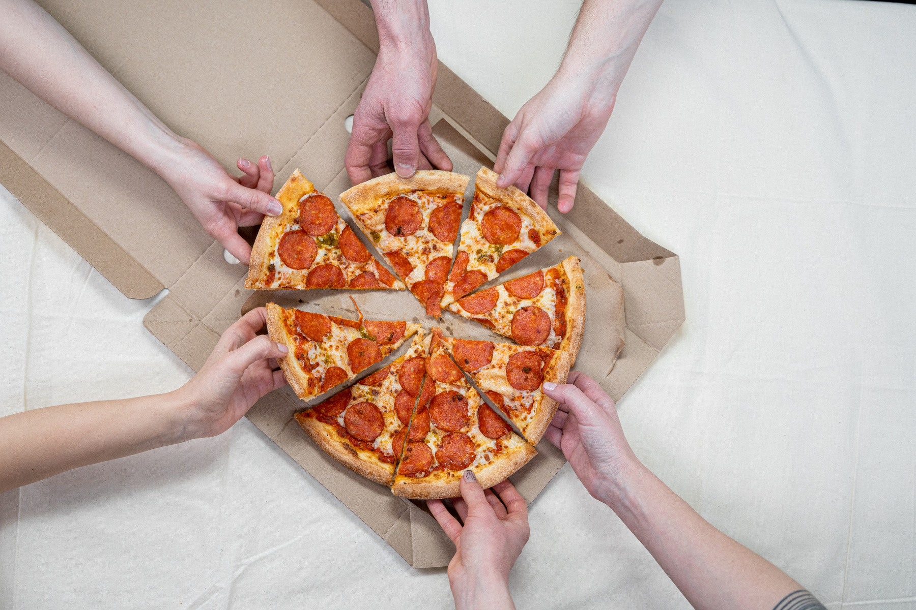
Share out & Next Steps

Slide 18

Thank you!
Closing Remarks

