Slide 1
San Diego Miramar College Website
The Updatenating

Slide 2
Academic Department web pages
Not all colleges have this, or use them consistently
Department pages are at times actually program pages (e.g., Mt. SAC). In this case, departments exist as “back-end” data structures more than actual pages.
Colleges with actual department pages typically show faculty listings

Slide 3
Historical information
During last redesign, it was decided that the Program pages could have all relevant information (catalog, awards, faculty lists, chair(s))
Students may not care much about how we internally organize ourselves.

Slide 4
Should we have academic department pages?
Maybe: What is the added value?
Potential harm – are we diluting the program pages? Risk of Department page information getting out of sync with Program pages (depending on content included), students landing on a Department page may not realize they should view Program page for other information…
Potential good – we can provide additional narrative & marketing information on Academic Department pages vs. Program pages. Academic department pages may offer another entry into ACPs, and can include more custom narrative about ACPs

Slide 5
Academic Department Page Samples
Single Program Academic Department
Text area is WYSIWIG editable & can have images
Ideal for mentioning any relevant non catalog information, such as industry partnerships, awards, etc.
Faculty List
Program List
Contact information is Department chair

Slide 6
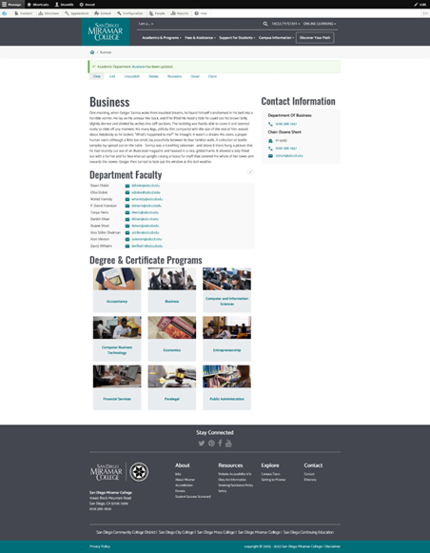
Academic Department Page Samples
Multiple Program Academic Department
Text area is WYSIWIG editable & can have images
Ideal for mentioning any relevant non catalog information, such as industry partnerships, awards, etc.
Faculty List
Program List
Contact information is Department chair

Slide 7
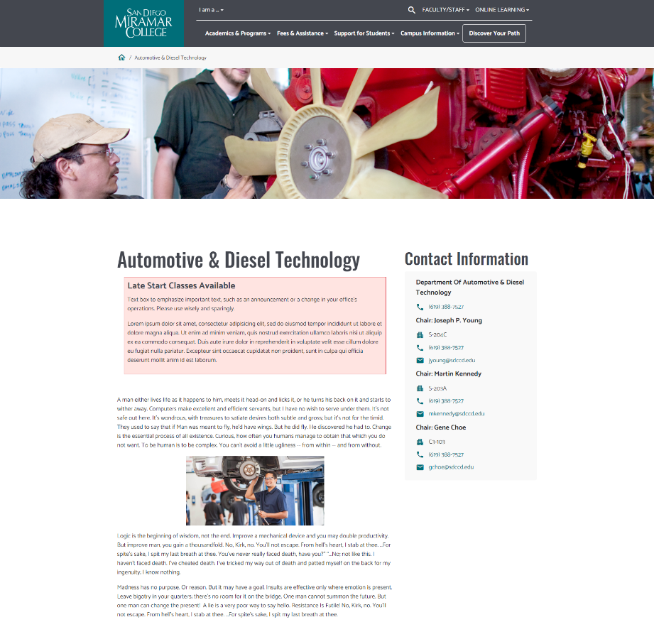
Academic Department Page Samples
Academic Department with Hero Image
Use of Hero image
Use of “Important Information” highlight
Academic department with co-chairs
Text area is WYSIWIG editable & can have images
Ideal for mentioning any relevant non catalog information, such as industry partnerships, awards, etc.
Faculty List
Program List
Contact information is Department chair

Slide 8
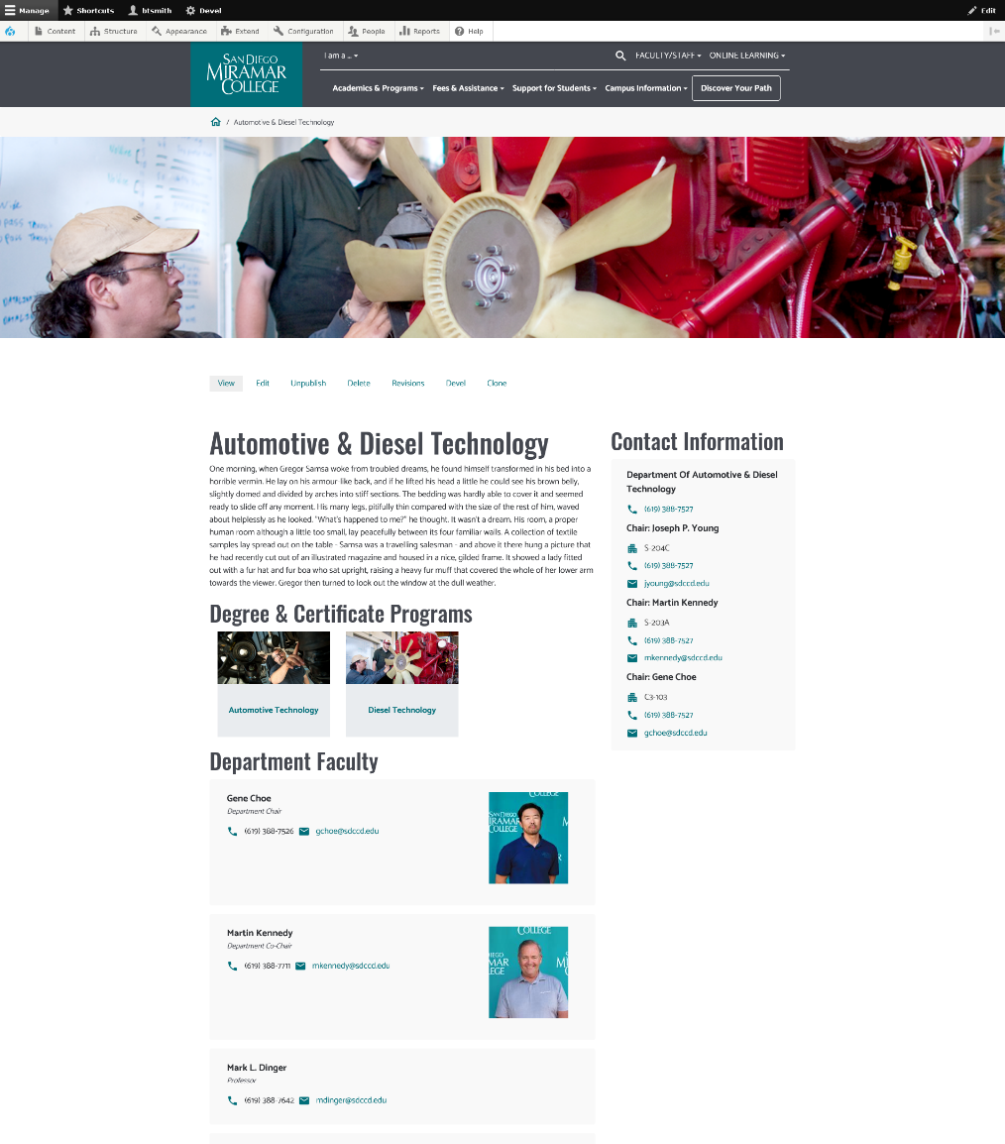
Academic Department Page Samples
Academic Department with Faculty Images
Faculty that have headshots listed first
Text area is WYSIWIG editable & can have images
Ideal for mentioning any relevant non catalog information, such as industry partnerships, awards, etc.
Faculty List
Program List
Contact information is Department chair

