Slide 1
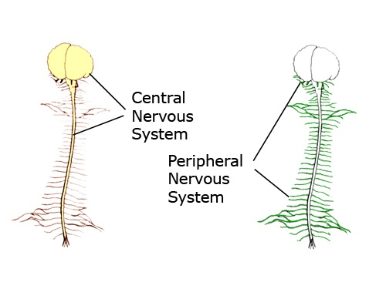
The Nervous System
Spotlight on the Peripheral Nervous System

Slide 2
Central Nervous System
Peripheral Nervous System
Somatic N.S.
Autonomic N.S.
Voluntary*
Involuntary*
(has 2 divisions)
Effector Tissue is:
Skeletal Muscle
only
Parasympathetic
Sympathetic
Effector Tissues are:
1. Cardiac Muscle
2. Smooth Muscle
3. Glands

Slide 3
The Somatic Nervous System (SNS)
This one is simple and easy – so let it be!
CNS
One Somatic Motor Neuron
to a single effector tissue:
Effector Tissue
Skeletal Muscle
This thing!
All that ever happens is that a Somatic Motor Neuron ‘fires’ a signal
to skeletal muscle fibers and then the muscle contracts!
If they do not send a signal, the muscle stays relaxed!
e.g., the radial nerve sends a signal and presto, the triceps brachii contract!
Easy, huh?

Slide 4
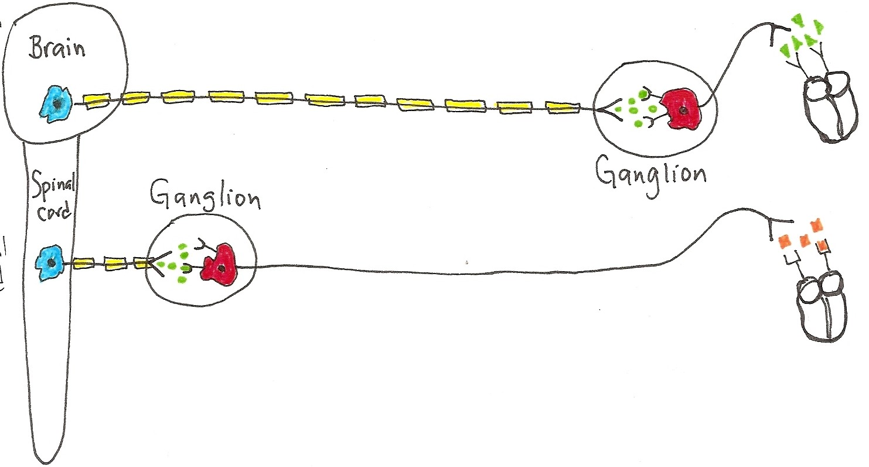
The Autonomic Nervous System
Effector Tissue
(the ANS is more complex than the SNS!)
The ANS is mostly involuntary and involves
2 Motor Neurons going to 3 types of Effector Tissue

Slide 5
Notes:
The Autonomic Nervous System (ANS) is complex.
It has 2 divisions: Parasympathetic and Sympathetic. There are 3 basic effector tissues in the ANS:  cardiac muscle,  smooth muscle and  glandular tissue. So both divisions have the same effector tissues, but often the 2 divisions have antagonistic (opposing) effects.
The ANS involves two motor (efferent) neurons; one neuron from the CNS to a ganglion (called the preganglionic neuron) and the second neuron from the ganglion to the effector tissue (called the postganglionic neuron).
A ganglion is a cluster of nerve cell bodies in the PNS. And a nerve fiber is a single axon. Right? : )
In the detailed drawings, please notice how the ganglion in the Para division are close to the effector tissue, but in the Sym division they are close to the CNS. Also, the nerve fibers (axons) for the preganglionic neurons in the Para are very long and the nerve fibers for the postganglionic are very short. It is the opposite arrangement for the Sym division! What do you notice about axon myelination?

Slide 6
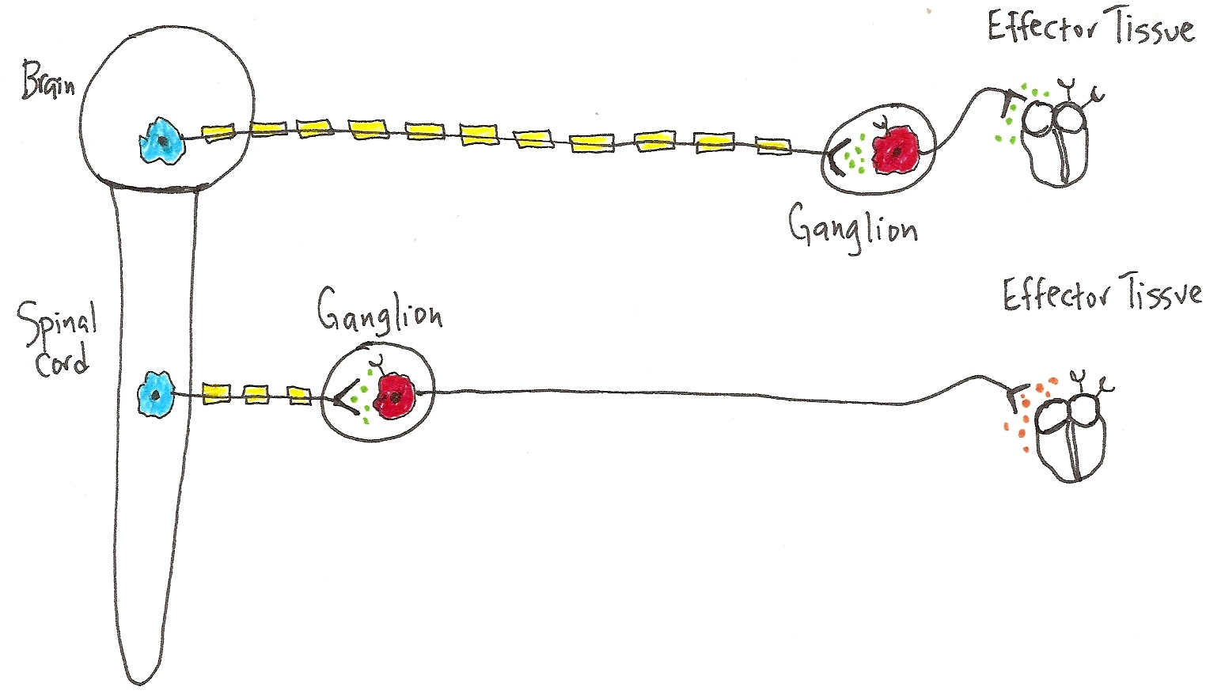
CNS
PNS
Tissue
Preganglionic Neurons
PARA
SYM
Postganglionic Neurons
In CNS: Preganglionic Neurons
Para = Craniosacral Origin
Sym = Thoracolumbar Origin
At Ganglion:
Postganglionic
Nerve cell bodies
Effector Tissue:
Cardiac, Smooth Muscle
and Glands

Slide 7
Notes:
In general, Para is for ‘housekeeping’ activities (“Rest & Digest”), storing needed things, relaxing, getting rid of things and doing some chores!
e.g., after lunch, as you decide to sit and read - Para is at work! Heart rate is low, saliva and G.I. tract activity is high, bronchiole (airways) diameter is small, no need for much air, everything is fine, there’s no hurry, you’ve got all day. Pupil diameter is small too, enabling that fine focus to get all the details!
In general, Sym is for emergency situations (“Fight or Flight”)! You may have to fight or run – either way it takes a lot of energy.
e.g., imagine as you sit down to read, a big scary creature enters the room. Presto - immediately the Sym is at work. Heart rate skyrockets (to pump more blood to body to get you out of danger), your G.I. activity comes to a halt, and bronchioles diameter gets larger, as you need more air flow to either fight or run. More Sweat? Yep. Dry mouth? Yes. Pupil diameter becomes larger too, enabling distant focus so you can see an escape route! You are ready!!!

Slide 8
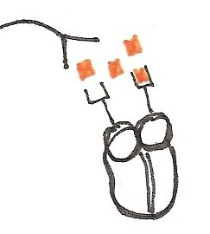
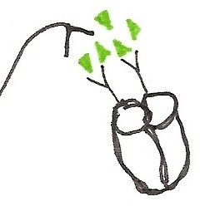
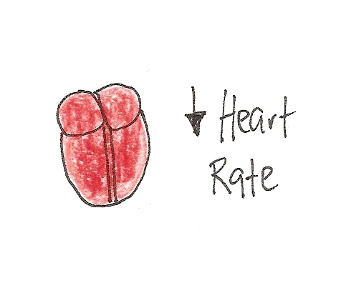
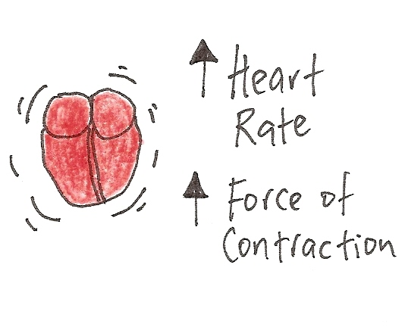
PARA
Let’s compare how the 2 –‘s of the ANS Effect
the Heart.
SYM
. .
ACh released from Postganglionic
Parasympathetic neurons
NE released from Postganglionic
Sympathetic neurons
Effect?
Effect?
PARA = “Rest and Digest”
SYM = “Fight or Flight”

Slide 9
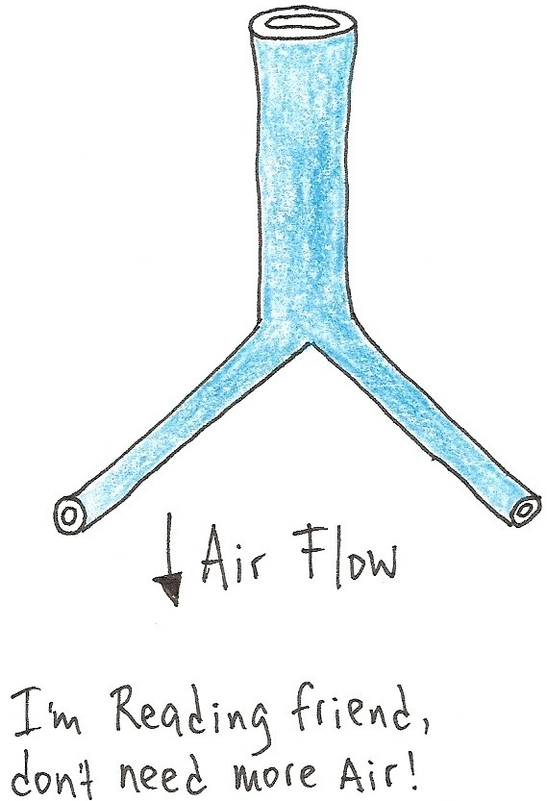
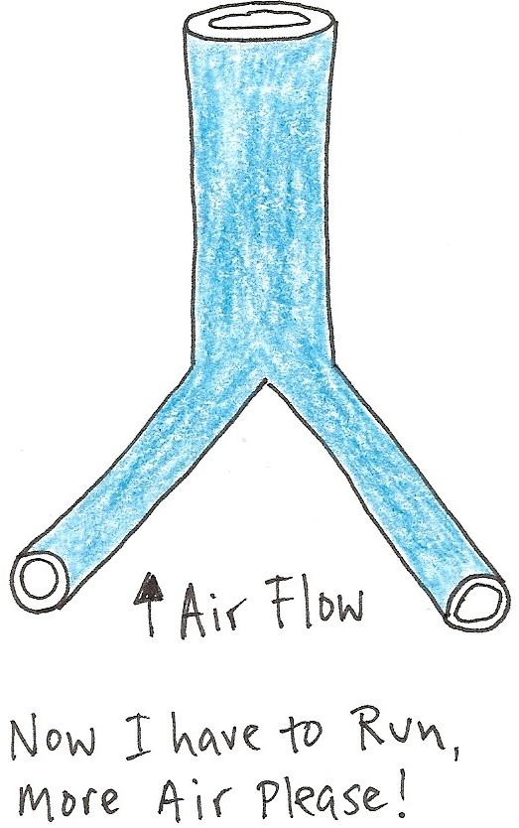
PARA
SYM
The
Lungs?
(Bronchioles)
Diameter of
Bronchioles
Diameter of
Bronchioles
What is the direct “effector tissue” for the bronchioles?
Remember, you really only have 3 choices!

Slide 10
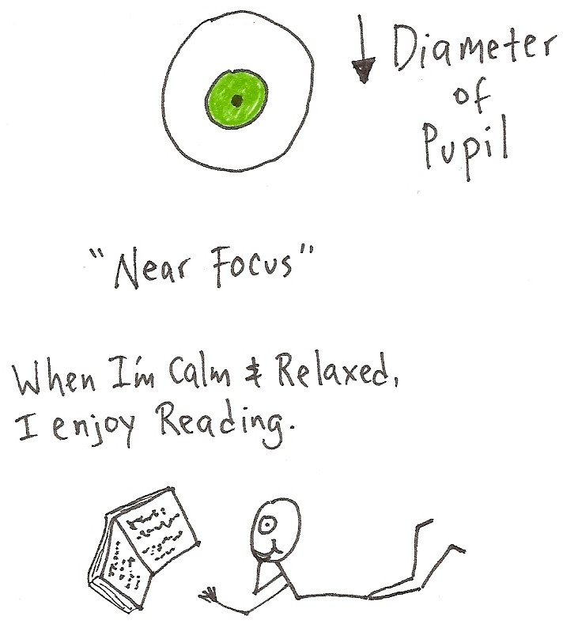
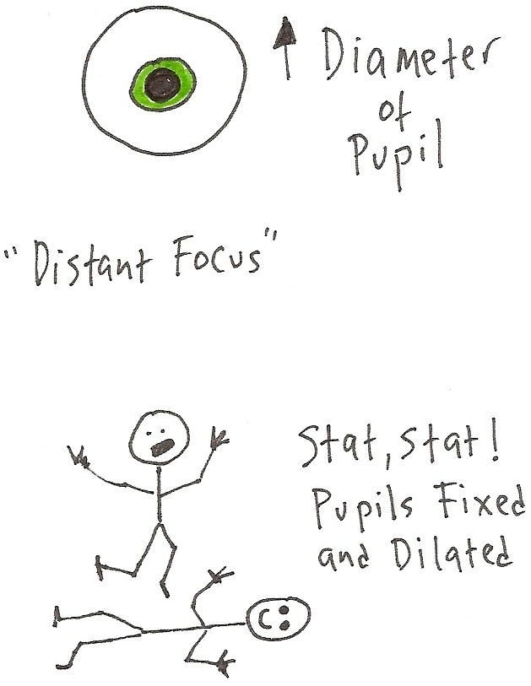
PARA
SYM
Vision?
Hmmm, did you know coconut oil is a natural saturated fat with medium chain fatty acids and is excellent for human health?
Good thing I read …
Note: Similar effects to Sympathetic stimulation are found from being in Love – seriously.
The pupil is a hole in the center of the iris (colored part) of the eye. It has two sets of intrinsic ‘muscles’ that can change pupil diameter, which changes the amount of light that hits the retina and photoreceptors.

Slide 11
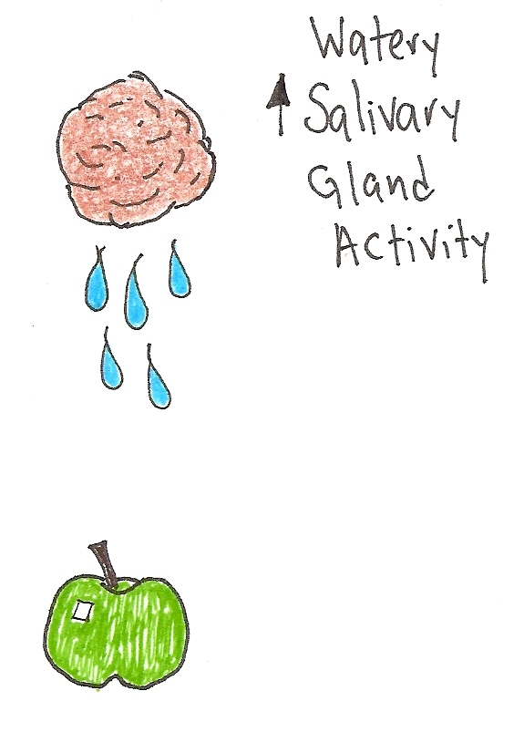
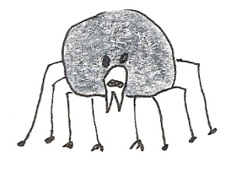
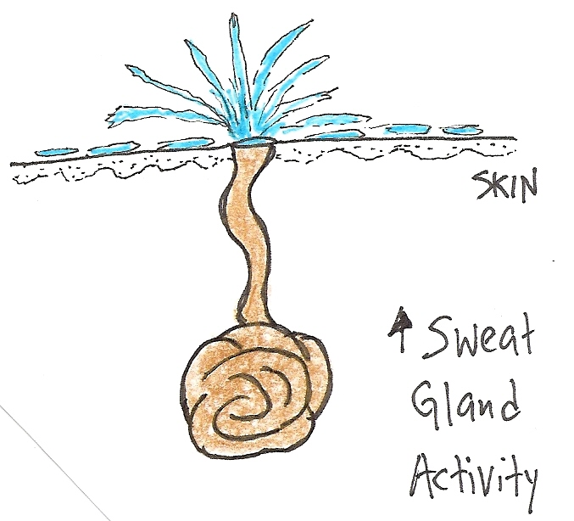
PARA
SYM
Saliva & Sweat?
“What a tangled web
we weave, when our
aim is to deceive!”
Yum, I can just
Imagine how nice
this will taste!
Make sure it’s Organic, salvesterols are good for you.
Note: Not telling the truth
will also make you sweat!

Slide 12
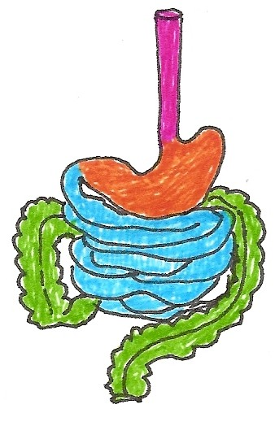
PARA
SYM
G.I. Tract
Or
Alimentary Canal
Rest and DIGEST
Emergency - no time to digest!
In G. I. Tract Motility
In G. I. Tract Motility
In G. I. Tract Secretions
In G. I. Tract Secretions

Slide 13
Notes:
Vascular Smooth Muscle (VSM) is around blood vessel walls and is predominantly controlled by the Sym division of the ANS.
Sympathetic postganglionic neurons release norepinephrine (NE):
a) if α (alpha) receptors present = vasoconstriction = ↓Flow, ↑ Blood Pressure
b) if β (beta) receptors present = vasodilation = ↑Flow, ↓ Blood Pressure
The rule of thumb is: The more Sym stimulation there is, the more constricted blood vessels become (except for blood vessels supplying skeletal muscle!). So this means your blood pressure will go up when you get excited!!!
Please Note: Skeletal muscle is controlled by the Somatic (soma = body) nervous system (SNS), not the Autonomic nervous system (ANS). However, the SNS and the ANS work together. The blood vessels supplying skeletal muscles have β receptors on them, and when NE binds to these receptors it causes vasodilation – this then increase blood flow to muscles so you can run faster and swing your arms harder!

Slide 14
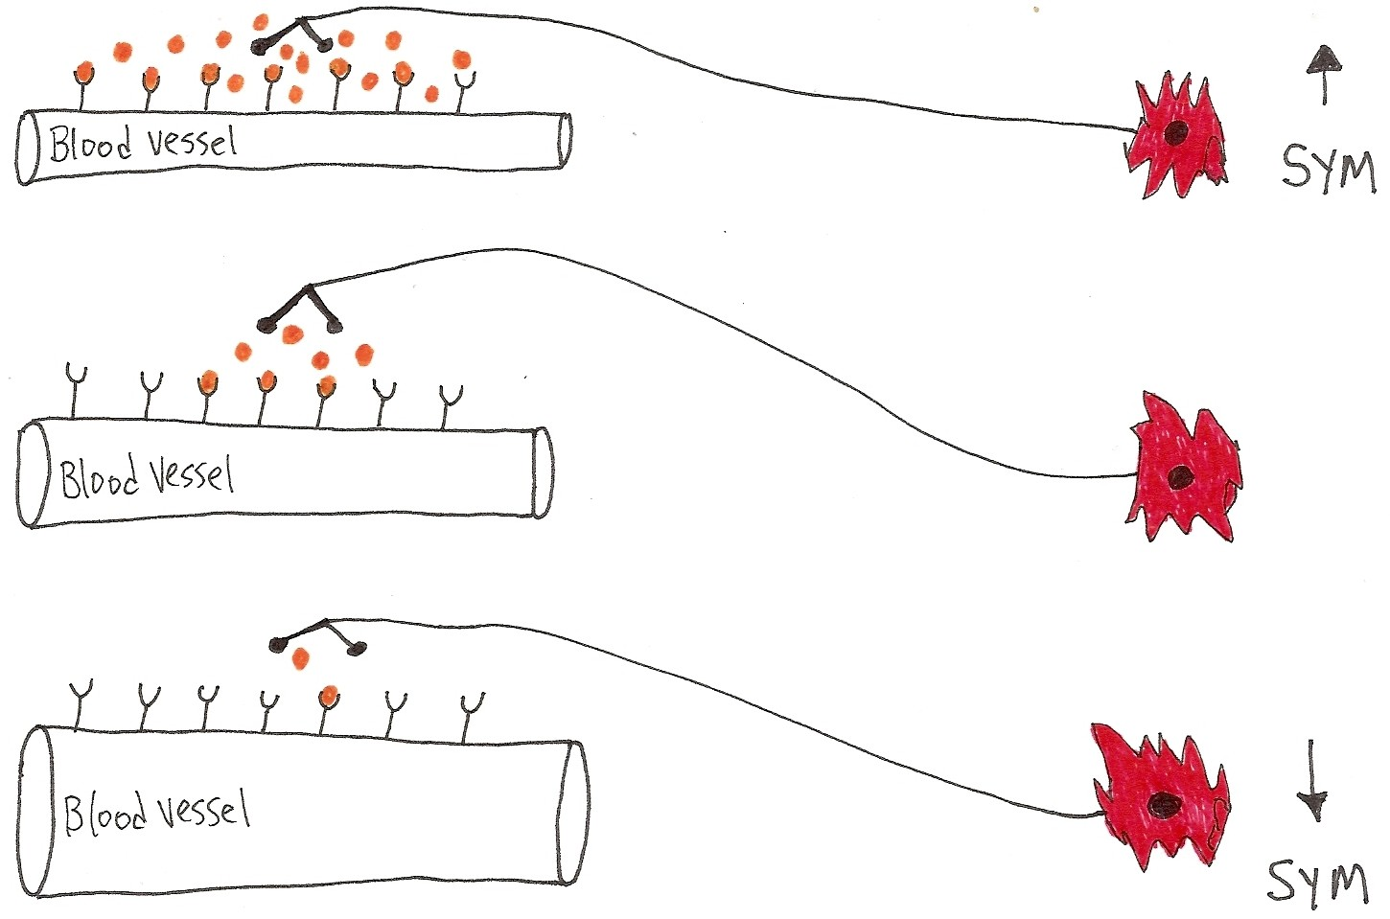
Blood Vessel Diameter: SYM
↓r -> ↑R -> ↑BP -> ↓flow
These are
the α receptors
and NE is binding
to them, big time!
Sympathetic Innervation
These are the
same α receptors but
there is less NE and thus
it is not binding to
all of them!
↑r -> ↓R -> ↓BP ->↑flow
α’s = constriction; β’s = dilation. The vessel above must have which receptors? Alpha?

Slide 15
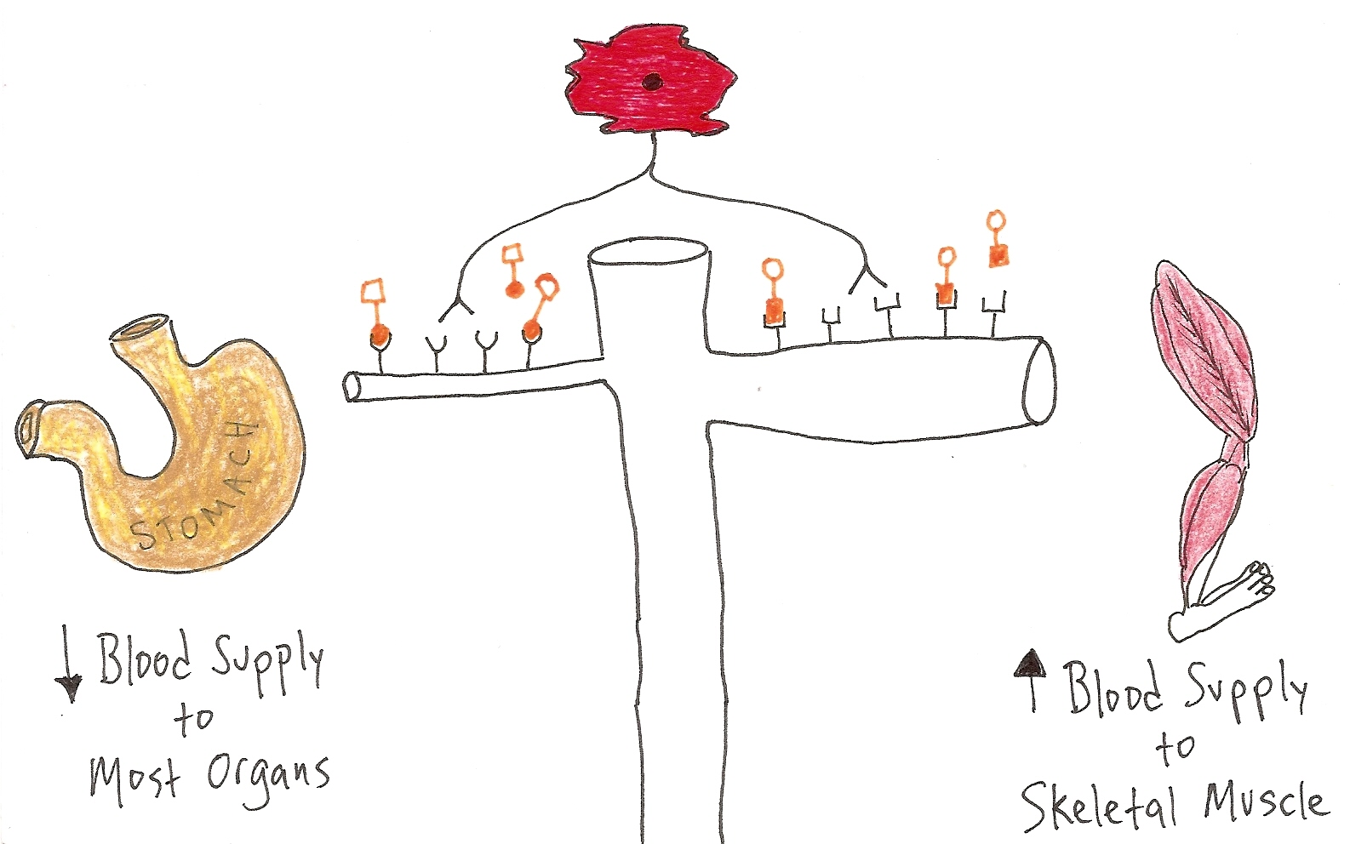
Diverting Blood Flow: SYM
In times of Emergency!
α R’s = Vasoconstriction
β R’s = Vasodilation
α = alpha receptors
β = beta receptors
b
l
o
o
d
v
e
s
What’s the Effector Tissue for blood vessels?
Note: The ANS does not innervate Skeletal Muscle!

Slide 16
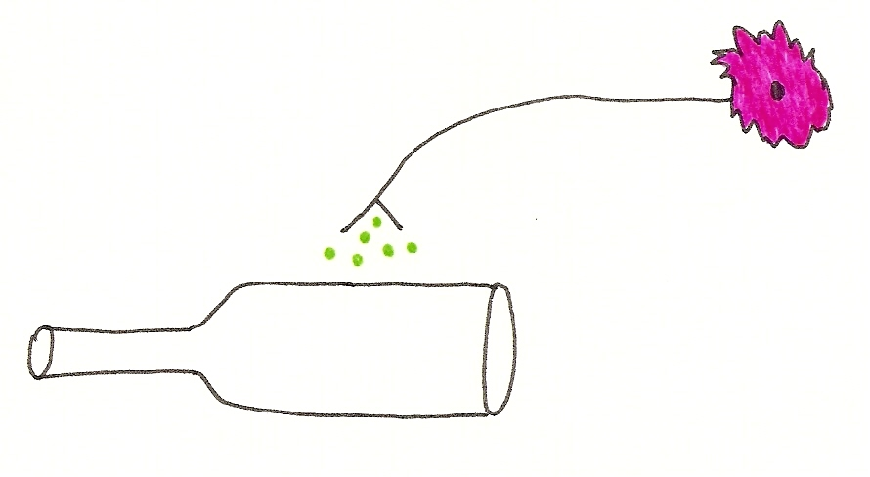
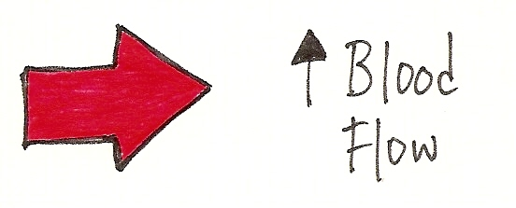
PARASYMPATHETIC
*PARA has no effect on blood Flow except to erectile tissue!
to
Erectile tissue of
clitoris for females
vasodilation
blood vessels to erectile tissue
Yep –> Engorged and Tingly
vasodilation
to
Erectile tissue of
penis for males

Slide 17
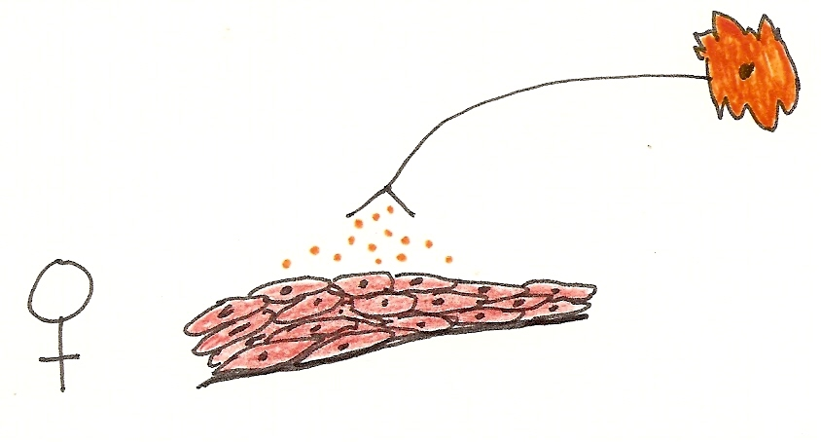
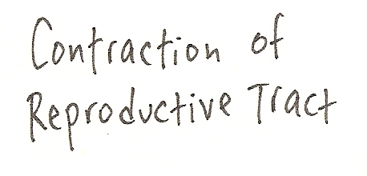
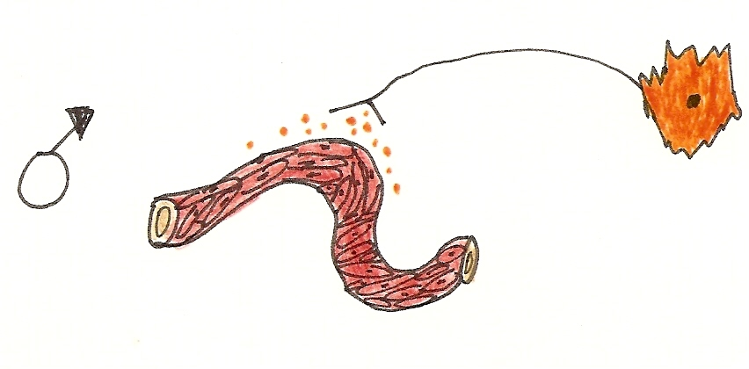
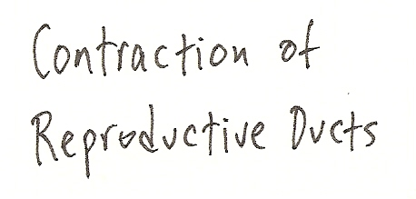
SYMPATHETIC
Lining of Repro tract
Yep –> Ejection of Fluids
Lining of Repro duct
Q: What’s the Effector Tissue that lines these ducts?

Slide 18
Notes:
The Anatomical arrangement of two divisions is indicative of their function.
Para is more Convergent, such that it often focuses on one thing at a time, like only one effector tissue, not 4 at once. Usually the ganglion is very close to or on the effector tissue, so it is a focused response, it is not wide-spread.
Sym is more Divergent, such that it can signal multiple tissues at once. With the ganglion so close to the spinal cord, this allows the response to be wide-spread, branching out into many directions at once (simultaneously).
Note how the 2 divisions seem to cooperate more with reproductive issues?
In matters of Reproduction…
Para relaxes VSM* and increases blood flow to erectile tissue = the “point” factor.
Sym causes the smooth muscle of reproductive ducts to contract = the “shoot” factor.
*VSM = vascular smooth muscle (the muscle around blood vessels)

Slide 19
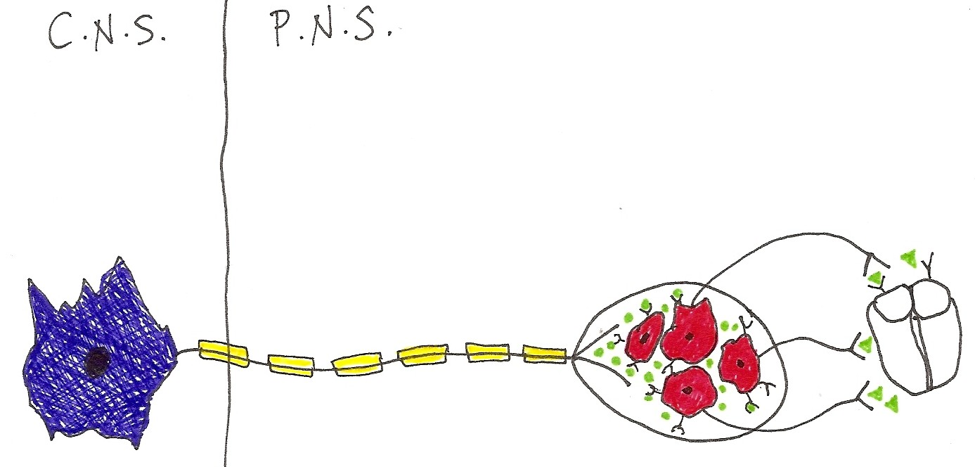
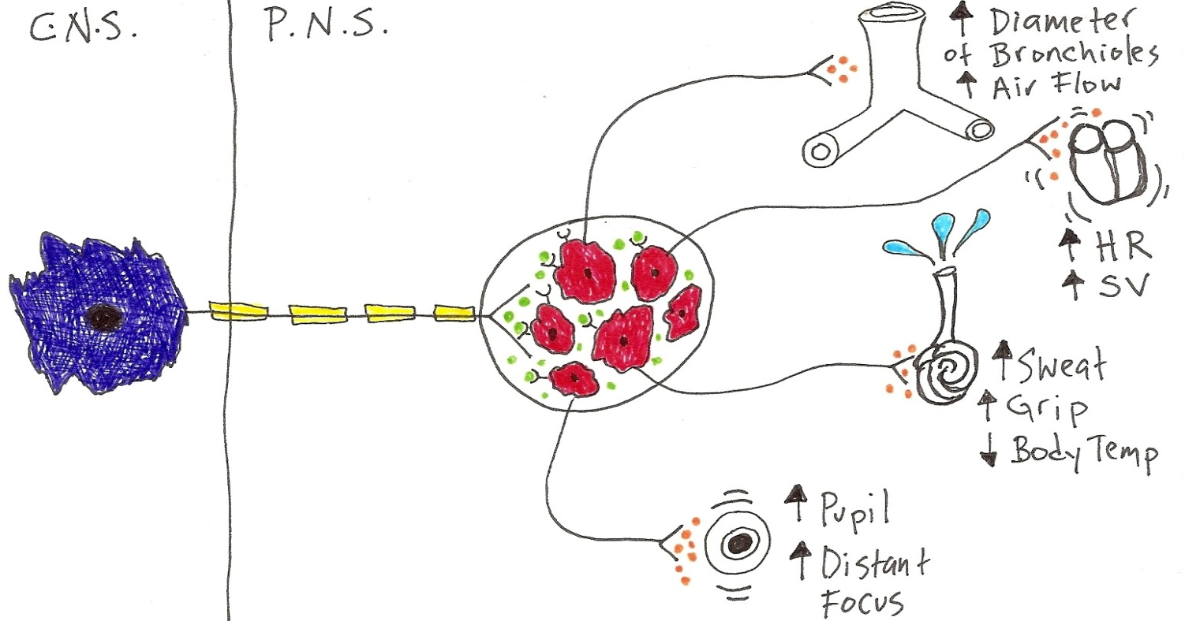
Anatomical Arrangement of ANS
Para
is
CONVERGENT
Ganglion
Effector
Tissue
Sym
is
DIVERGENT
Ganglion
Effector
Tissue

Slide 20
Table of Actions of the 2 Divisions of the Autonomic Nervous System
Fill in the table on your question sheet regarding how the ANS influences Effector Tissue
Effector Tissue | PARA | SYM
Heart
Bronchioles
Pupil
Salivary Glands
Sweat Glands
Digestive Activity
Blood Vessels
Erectile Tissue
Reproductive Ducts/Tracts
“point”
“shoot”

