Slide 1


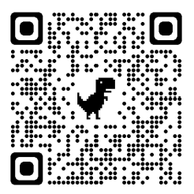
Soft Skills for STEM Students!
Presented by: the PLTL Program
Join us in room M-205
Thursdays, from 1:30pm to 2:30pm
TOPIC SCHEDULE
APRIL 6:
APRIL 13:
APRIL 20:
APRIL 27:
MAY 4:
MAY 11:
MAY 18:
Cover Letters & Resumes for
Internships and REUs
Study Skills & Time Management
Research Skills
Using Excel & Logger Pro/Vernier
Work/Life Balance & Stress
How to Talk to Professors
Managing Test Anxiety
JOIN OUR CANVAS SHELL FOR MORE INFO :)
Maximize your potential with
peer-led workshops!
Collaborate with like-minded peers to learn valuable STEM skills and take your academic achievements to new heights!

