Slide 1
San Diego Miramar College
Academic Senate Meeting
April 18
2022-23 Academic Year
Attending for Flex credit? Email jalley@sdccd.edu or jbartolo@sdccd.edu
(QR Code for A.S. Webpage)

Slide 2
2. Agenda Overview
Call to Order
Approval of Agenda
Consent Calendar:
  Meeting Minutes (4/4)
Land Acknowledgement
Public Comments
Action Items:
  Strategic Enrollment Mgmt Plan
Discussion Items
  CFHPC Form & Rubric
  Guided Pathways Plan
  Recommended Changes to ASC&B
  Input on CGH Change Requests
Reports
  Executive Committee Reports
  SDCCD Response to IT Resolution
Announcements
Adjournment
See the complete A.S. Agenda here

Slide 3
4. Land Acknowledgment
“Making a land acknowledgment meaningful”; A call for more powerful land acknowledgements
Notes:
Beginning with the Spanish invasion of 1769, continuing through the Mexican Period of 1826 to 1848, and on through the American Period, the Kumeyaay were forced off their ancestral lands. Nearly all of the Kumeyaay lands were taken into private ownership or made U.S. government holdings. Treaties negotiated with 18 California tribes in 1850 to set aside 8.5 million acres in specific tribal lands were never ratified by the United States Senate as a result of opposition by the state of California.

Slide 4
5. Public Comments (10 min)
Limited to topics not on the agenda
3 min. per speaker
To be continued at the end of the meeting if necessary

Slide 5
6. Action Items
6.1. (Second Read) Strategic Enrollment Management Plan – Kevin Petti (5 mins. plus 5 mins. Q&C)
  Strategic Enrollment Management Plan

Slide 6
7. Discussion Items
7.1. (First Read) CFHPC: Contract Faculty Hiring Form & Rubric – Kevin Petti (5 mins. plus 5 mins. Q&C)
Contract Faculty Hiring Form
Contract Faculty Hiring Rubric
7.2. (First Read) Seeking A.S. Approval for the Guided Pathways Plan – Lisa Brewster (5 mins. plus 5 mins. Q&C)

Slide 7
Guided Pathways Workplan 2022-2026
Last meeting you heard from Nessa on the connection of the Equity Plan to the Guided Pathways workplan 2022-26
This week I will share the first draft of the Guided Pathways Workplan

Slide 8
1 Student Success in the Enrollment Process
What does your college need to do to develop and implement a continuous improvement process related to the goal?
Have access to data from CCC Apply
Invest in CRM to communicate with students
Develop wrap around services to assist students in enrollment processes
DI representation in staffing
Allocate resources to directly support efforts
Continued Program Mapper updates and enhancements
Institutionalize Program Mapper efforts
Create a process for approving program maps on a yearly basis & editing on a bi-annual basis

Slide 9
1 Student Success in the Enrollment Process
What learnings and improvements does your college believe it will benefit the most from engaging in the continuous improvement cycle over the next 4 years?
Access to data will allow us to make informed decisions that will help us develop strategies and intervention which strategically impact our various sub populations
Targeting communication to the various sub populations will allow us to integrate the strategies identified to particular populations
Targeted professional development on culturally responsive practices embed in Light the Fire programs
Stronger connection between instruction and student services creating a collaboration that will yield towards a more holistic approach wherein students are guided by multiple areas of the college
Continue to expand Jets JumpStart
Introduce ACP orientation to help acclimate students
New student section is being built into the ACP Canvas Shell to clearly identify steps to enrollment
District will auto enroll students in the ACP Canvas Shell upon completing application
Continue adding differentiated orientations based on student demographics (I.e. undocumented students, re-entry/re-engagement students, athletes, etc.)
Develop onboarding for new faculty

Slide 10
2 Students Persisting from 1st to 2nd semester
What does your college need to do to develop and implement a continuous improvement process related to the goal?
Establish data points needed and mechanism to share access to the data
Implement success team model using inquiry and action model
Assess effectiveness of ACP canvas shell by tracking student usage
Assess effectiveness of regularly communication with students
Host student engagement opportunities for DI students to connect to their ACP
Quantitative/qualitative data to determine areas of strength/weakness to support DI students
Utilize the Program Review process to examine areas of strength and opportunities to improve support for DI students. Our revamped Program Review & Outcomes Assessment Guide includes guides for DEI reflection such as the equity definition, equity plan metrics, and disproportionate impact data, and the friction point/barriers to equity. Program Review also includes the Budget Resource Development Planning Process.
Targeted professional development on strategies/practices to support DI students
Centralized data (one system) for support services to understand student engagement on-campus
Early alert system/process to capture students who are at-risk of failing/dropping out

Slide 11
2 Students Persisting from 1st to 2nd semester
What learnings and improvements does your college believe it will benefit the most from engaging in the continuous improvement cycle over the next 4 years?
Access to data will help inform the Inquiry and Action teams of the barriers that exist by ACP
The development of a communication plan for what to and when to communicate with students will help inform the college of the key message’s students need in order to assist them with staying on the path
There are multiple approaches that have been taken with the student engagement opportunities: calling campaign, mentoring program, paired learning, career exploration events, transfer events, in class presentations, LAEP student involvement
Quality Program Review will help identify data per program which will spark discussions on persistence and success by DI population, age, and gender.
Professional Development events by ACP, by program, and through the Light the Fire PD series addressed at building community and student persistence
Revisions to ACP canvas shells to include links to college success strategies, updated faculty information, and modules to help students when they need it
Development of Undeclared ACP and undeclared orientation.
Success Team formed to connect with students who are Undeclared
Campaign for student success with calling of students and showing that Miramar employees are here to help with their success
Launch of MyCoach, an app with resources and milestones that can help students stay on the path
Launch of Program Mapper for all Full Time and Part Time students to CSU, UC and career path

Slide 12
3 Students successfully completing Math/English in first year
What does your college need to do to develop and implement a continuous improvement process related to the goal?
Marketing importance of taking Math and English
Increase persistence and success rates
Prioritization of resources to directly support efforts to close gaps for DI students
Targeted professional development on strategies/practices to support DI student success in Math and English
Align the program mapper with these efforts, specifically to have Math and English completed in the first year
Create learning communities in each ACP with Math, English, and a light the fire course in a student’s first semester targeting DI student populations

Slide 13
3 Students successfully completing Math/English in first year
What learnings and improvements does your college believe it will benefit the most from engaging in the continuous improvement cycle over the next 4 years?
Piloted paired coursing with MATH 104 and PERG 120
Mentoring program for STEM (faculty/student)
3 Mentoring events per semester for STEM
Title V for STEM
Program Mapper identifying course sequences which strategically place Math and English in first year
In conversation to determine if a we can develop and offer a CTE version of Math and English
Continue regular norming sessions with English
ACP tutors
Program Mapper Event for freshmen.

Slide 14
4 Students successfully transfer to a four-year institution
What does your college need to do to develop and implement a continuous improvement process related to the goal?
Make access to data on transfer by subpopulations available
Staff transfer center
Increase number of students who have comprehensive SEP’s
Market Program Mapper
Targeted Transfer workshops to various subpopulations
Revision of Miramar website
Institutionalize Program Mapper efforts.
Annually review of Program Mapper with counseling and departments
Institutionalize Program Mapper efforts.
Annually review of Program Mapper with counseling and departments.

Slide 15
4 Students successfully transfer to a four-year institution
What learnings and improvements does your college believe it will benefit the most from engaging in the continuous improvement cycle over the next 4 years?
Hiring of a transfer center director
Development of group abbreviated educational planning
Hiring of 4 new general counselors
ACP event focusing on educational planning
ACP event focusing on transfer: educational in first semester, to build on in future semesters
Program Mapper Event for freshmen and transfers.

Slide 16
5 Advance the goal of Completion without creating new barriers
What does your college need to do to develop and implement a continuous improvement process related to the goal?
Increase number of SEP’s completed
Regular communication with students nearing completion
Host student engagement opportunities for DI students to connect to their ACP
Quantitative/qualitative data to determine areas of strength/weakness to support DI students
Utilize the Program Review process to examine areas of strength and opportunities to improve support for DI students. Our revamped Program Review & Outcomes Assessment Guide includes guides for DEI reflection such as the equity definition, equity plan metrics, and disproportionate impact data, and the friction point/barriers to equity. Program Review also includes the Budget Resource Development Planning Process.
Targeted professional development on strategies/practices to support DI students
Identify resources to directly support intentional efforts
Revision of Miramar homepage to reflect Guided Pathways framework

Slide 17
5 Advance the goal of Completion without creating new barriers
What learnings and improvements does your college believe it will benefit the most from engaging in the continuous improvement cycle over the next 4 years?
Embed a counselor in each ACP
Establish communication plan on what to and when to communicate with students
Train success team on inquiry and action plan
Engage faculty and classified professionals in the ACP model
Collaborative efforts by student success and instruction
Career Ambassadors
Student involvement in success team though LAEP
Program Mapper with enhancements
ACP specific monthly events
First semester orientation connecting student services and instruction
College hour
ACP tutors

Slide 18
6 Integrating SEA Program with Guided Pathways
What are some present challenges in that affect reaching full integration?
Resources
Staffing
Currently in the planning process for the launch of ACP success teams
What are the actions your college is taken/plans to overcome some of these challenges?
Training for ACP success teams
Professional development targeted towards DI populations
Leaning into the continuous improvement efforts, what are your immediate, intermediate and long-term goals for full integration?
  Immediate goals- train ACP success team
  Intermediate goals- engage faculty, staff and administrators in data driven conversations highlighting inequities based on DI populations
  Long-term goals-
How will your college evaluate these outcomes?
Persistence rates by ethnicity, age and gender
Success rates by ethnicity, age, and gender

Slide 19
7 Integrating ADT with Guided Pathways
Please provide an example of how the college is integrating.
What did your college learn from this process?
What is your college's plan for continuous improvement?

Slide 20
8 Integrating ZTC with Guided Pathways
What are some present challenges in that affect reaching full integration?
Resources
Faculty willingness to participate
Lack of accurate data about actual usage or lack thereof
Marketing
No taskforce with representation from various constituency groups
Lack of data on OER/ZTC for college and students
What are the actions your college is taken/plans to overcome some of these challenges?
Regular emails by OER librarian on OER resources by discipline
Small OER committee
OER events
OER Professional Development cohort called FLOC (currently 30 faculty members have participated)
Apply for OER/ZTC grants to work on developing ZTC pathways across the district.
Calculate student saving if OER/ZTC adopted
Calculate number of courses using OER/ZTC
Gather more data about campus support, OER / ZTC usage and impact

Slide 21
8 Integrating ZTC with Guided Pathways
Leaning into the continuous improvement efforts, what are your immediate, intermediate and long-term goals for full integration?
  Immediate goals- collection of OER and ZTC resources available for all General Education courses
  Intermediate goals- regular communication with departments (programs) on ZTC and other stakeholders.
  Continuation of OER/ZTC professional development opportunities.
  Connect faculty across district for collaborate on creation/adoption of OER and ancillary materials
  Long-term goals- work with stakeholders to develop processes for embedding ZTC in courses
How will your college evaluate these outcomes?
Number of faculty embedding ZTC textbooks in their courses

Slide 22
9 Integrating CAEP with Guided Pathways
What are some present challenges in that affect reaching full integration?
Resources
Staffing
Curriculum process
What are the actions your college is taken/plans to overcome some of these challenges?
Participated in REACH, where a workgroup completed an analysis of what is currently occurring and how we could improve pathways for Adult Learners
Developed new degree for adult learners returning to college
Developed stackable credentials tailored to soft skills needed in the workforce
Developed a marketing plan for adult learners
Strategized interventions and programs to aid adult learners complete their degree/certificate

Slide 23
9 Integrating CAEP with Guided Pathways
Leaning into the continuous improvement efforts, what are your immediate, intermediate and long-term goals for full integration?
  Immediate goals- develop curriculum for stackable credentials and adult learners' degree
  Intermediate goals- market new degree and certificates
  Long-term goals- create more stackable credentials leading to other degree pathways
How will your college evaluate these outcomes?
Number of students enrolling in courses for stackable credential
Number of students enrolling in courses for adult degree
Persistence rates by ethnicity, age and gender
Success rates by ethnicity, age, and gender

Slide 24
10 Integrating SWP with Guided Pathways
What are some present challenges in that affect reaching full integration?
Resources
Staffing
What are the actions your college is taken/plans to overcome some of these challenges?
Stronger connection between Guided Pathways Coordinator and Associate Dean of Strong Workforce

Slide 25
10 Integrating SWP with Guided Pathways
Leaning into the continuous improvement efforts, what are your immediate, intermediate and long-term goals for full integration?
  Immediate goals- Alignment of the CTE Operational Plan to GP and Equity Plan
  Intermediate goals- Expand partnerships with our K-12 partners to improve student onboarding experiences to CTE
  Long-term goals- Better alignment with K-12 Career Pathways with our CTE program offerings as well as alignment with the transition of Non Credit.
How will your college evaluate these outcomes?
Persistence rates by ethnicity, age and gender
Success rates by ethnicity, age, and gender

Slide 26
7. Discussion Items
7.3. (First Read) Recommended Changes to the A.S. Constitution & Bylaws – Carmen Carrasquillo (5 mins. plus 5 mins. Q&C)
[The Amendments and Bylaws] committee will study and recommend all amendments to this Constitution and its Bylaws. This committee shall consist of the Executive Committee, excluding the President and the Chair of Chairs, and shall be chaired by the Vice President or President-Elect. This committee may opt to utilize the President or a legal or administrative advisor as needed but retains sole authority for any recommendations to amend this Constitution and its Bylaws.

Slide 27
Report cont.:Amendments and Bylaws Committee
Summary of Proposed Changes:
Add the Curriculum Chair to the AS Executive Committee.
Remove the appointed At-Large and keep the elected Contract At-Large.
Make all AS Exec terms consistent (2 years).
Clarify VP/President Elect position.
Change Senator terms from one year to two years.
Review and update AS Exec member responsibilities.
Update re-assigned time language.

Slide 28
Report cont.:Amendments and Bylaws Committee
Current Re-assigned Time Distribution | Proposed Re-assigned Time Distribution
President: 1.0 | President: 1.0
Vice President: .40 | Vice President: .40
Secretary: .20 | Secretary: .20
Treasurer: .10 | Treasurer: .10
Contract At-large: .025 | Contract At-large: .10
Adjunct At-large: AFT hourly reimbursement | Adjunct At-large: AFT hourly reimbursement
At-large Appointee: .025 | Curriculum Chair: .10
Chair of Chairs: .25 (plus release time from the College) | Chair of Chairs: .10 (plus release time from the College)

Slide 29
Report cont.: Amendments and Bylaws Committee
Please send comments or questions to the Chair of the Amendments and Bylaws Committee.
Thank you!

Slide 30
7. Discussion Items
7.4. Seeking Input on the Spring 2023 CGH Change Requests –
Pablo Martin (5 mins plus 5 mins. Q&C)
  1. Academic Success Committee: Merge ASC and SEEM (Success in English, ELAC, and Math) Committees. Retain faculty representation in English, ELAC, and Math. Streamline and eliminate redundancy. The CGH Change Workgroup recommends moving forward, noting the need to identify specific positions under ex-officio members

Slide 31
7. Discussion Items
7.4. Seeking Input on the CGH Change Requests (cont.)
2. Contract Faculty Hiring Prioritization Committee, 1 of 2: Change meeting requirement to, “Meet at least once each semester, with subsequent meetings as needed per the discretion of the Committee Chair.” The CFHPC supports this change.
CFHPC, 2 of 2: Remove Academic Senate President as a committee member. The CFHPC supports this change.
CGH Review Taskforce: Adding or clarifying language on 1) term limits, 2) sabbaticals, 3) adjunct service, 4) roles of committee members, 5) which committees must adhere to the Brown Act, and 6) overall clarity and currency of the CGH. The CFHPC supports this change, but asks that “Curriculum Committee” be added to #5.

Slide 32
7. Discussion Items
7.4. Seeking Input on the CGH Change Requests (cont.)
Curriculum Committee: Modify language on term limits to include, “Additionally, members may serve additional terms beyond the standard term limits in situations where doing so would contribute to the continuity and effectiveness of the committee’s work, foster value professional growth opportunities, and promote the best interests of the college.” The CFHPC supports this change.

Slide 33
7. Discussion Items
7.4. Seeking Input on the CGH Change Requests (cont.)
Guided Pathways Steering Committee: Propose eliminating the GPSC and fold work into a newly created student success committee. The CFHPC supports this change.
Student Services Council: Propose eliminating the SSC and fold work into a newly created student success committee. The CFHPC supports this change.

Slide 34
7. Discussion Items
7.4. Seeking Input on the CGH Change Requests (cont.)
Technology Committee: Update membership to reflect the Administrative Services reorganization of Technology Services and to align membership with current roles/responsibilities. The taskforce asked the committee to meet to discuss various recommendations. The taskforce will review the updated change request for review.

Slide 35
8.1: Executive Committee Reports
8.1.1: President’s Report (10 minutes)
As always, please interrupt me if you have questions. I’m also available for further discussion via email, FTF or Zoom meetings, and you can also invite me to your department meetings. More details from my report can be found in the Current Miramar, SDCCD, and ASCCC Resource List.
Campus/Senate:

Slide 36
8.1.2-8. Executive Committee Reports
  Vice President - Carmen Carrasquillo
  Secretary – Josh Alley
  Treasurer – Monica Demcho
  Adjunct Representative – Najah Abdelkader
  Member-at-Large – Francois Bereaud
  Member-at-Large – Brit Hyland
  Chair of Chairs – Kevin Petti

Slide 37
8.3. Special Reports
  8.3.1. Update on District Response to Resolution 2022.9.4 (I.T. Updates Needed for SDCCD Classrooms and Faculty Offices) – Peter Maharaj (5 mins. plus 5 mins. Q&C)

Slide 38
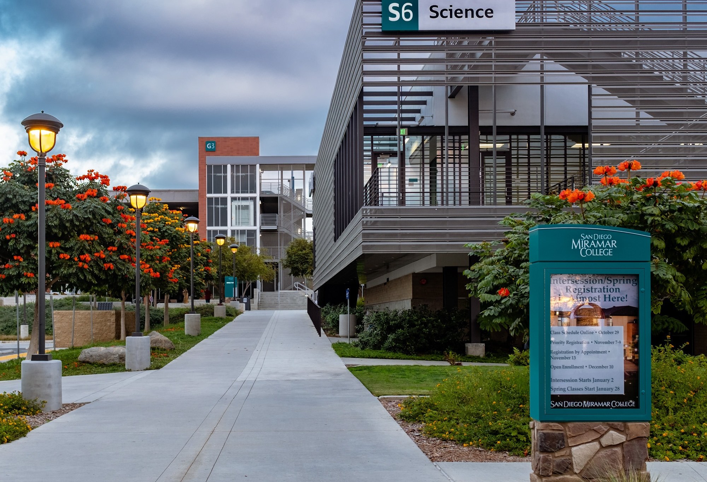
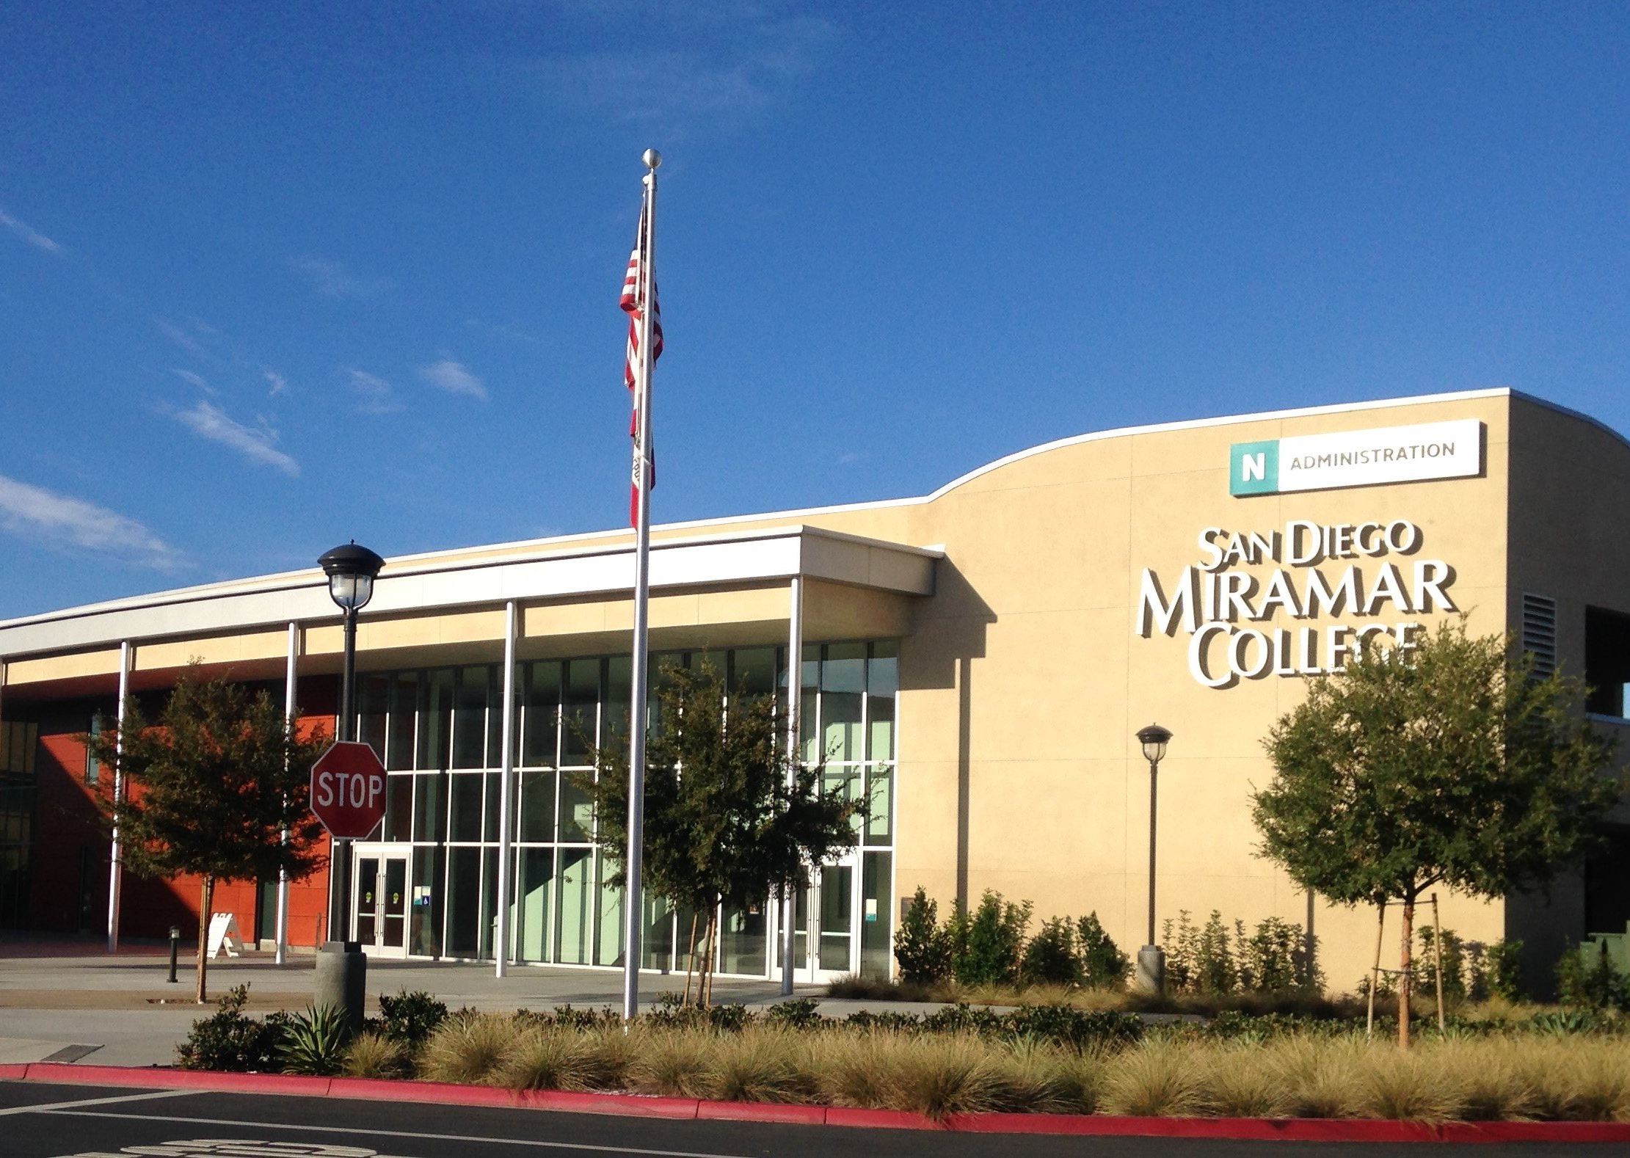
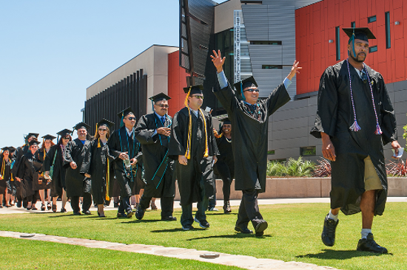
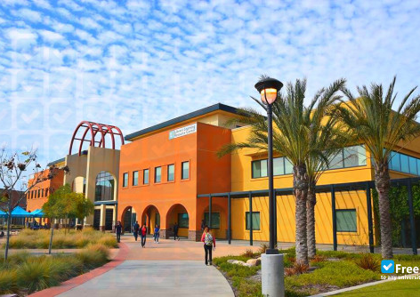
Miramar College
Academic Senate
Information Technology Services
April 18th, 2023

Slide 39

Think Digitally
Digital Imperative in Education
Digital Transformation: cloud, unify data & platforms, prioritize security, embrace collaborative business processes and re-energize our team.

Slide 40

ITS Vision
SDCCD Information Technology Services (ITS) vision is to become technology leaders within California and the United States, catering to the teaching and learning needs of our students, faculty, and staff.
We aspire to implement and maintain robust, secure, and scalable enterprise services to support the vision and goals of the SDCCD Chancellor and college Presidents to achieve the educational outcomes governed by the California State Chancellor’s Office.
We will work to provide digital resources, access, and training to our colleagues and community to build a collaborative, positive environment and close the digital divide. We will lead with kindness – We will practice good fiscal management – We will be transparent and communicative – We will follow through and follow up on our responsibilities – We will seek and continue to improve our customer service and support each other in building a better community to those we interact with.

Slide 41
SDCCD Digital Imperative
Strategy to improve teaching, learning through innovation
Prioritize Security
PEN Testing, devices, network security and user awareness.
Migrate to the cloud
ERP to CMS
Cost Centers
We limit wastage. We deliver projects within time and budget.
Unify data and apply AI models
Enhancements & augmentation.
Re-energize our team
Connecting all
Embrace collaborative
Sustainability & future planning.

Slide 42
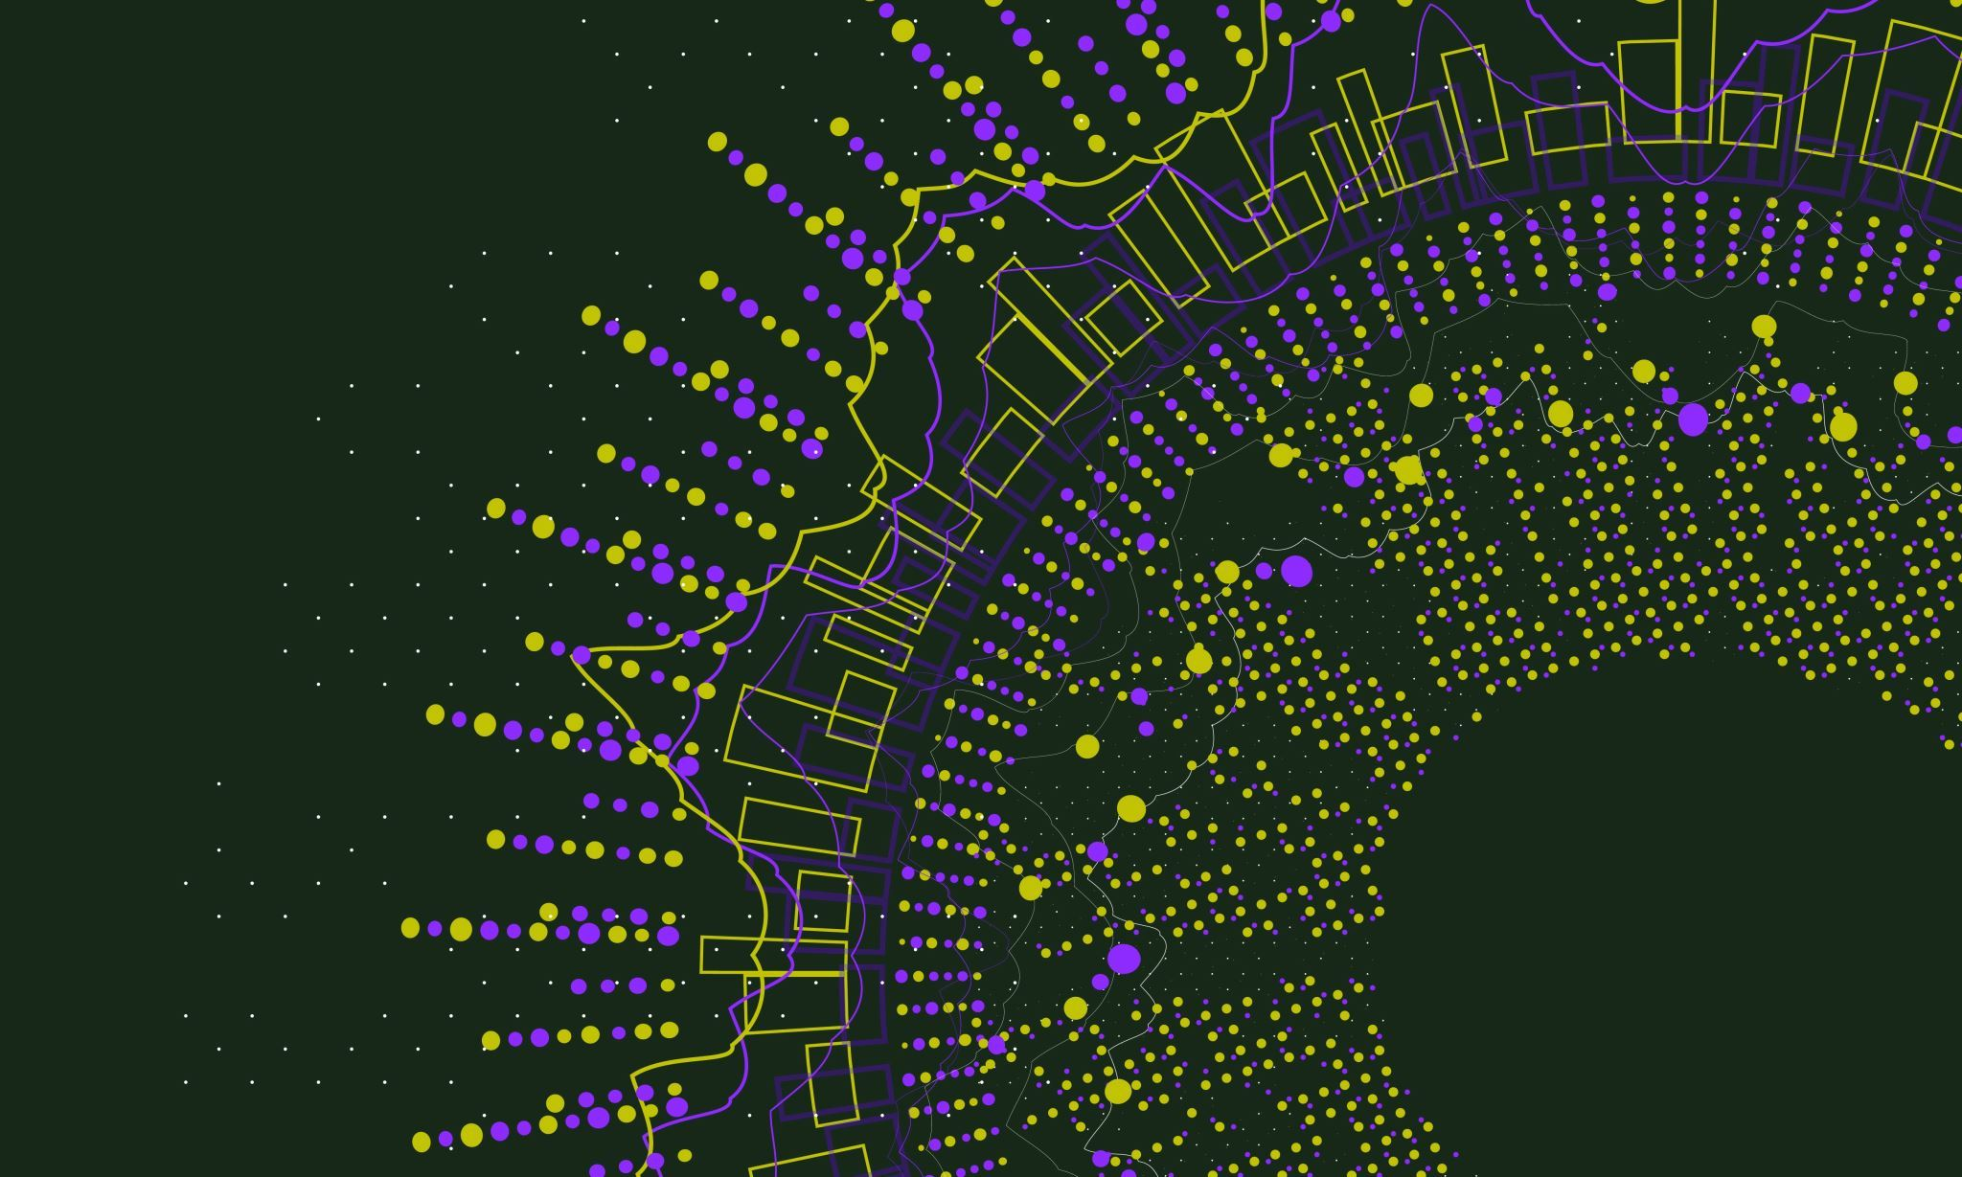
New Ways. Better Outcomes

Slide 43

What starts here changes San Diego.

Slide 44
Projects
Desktop Deployment
Wireless Deployment
ERP Cloud Migration
SharePoint Enhancement
Security
Jan
‘23
Jan-Jul
‘23
Jan-Jul
‘23
Feb
‘23
Mar
‘23
Across SDCCD, new enhanced desktops, for employee success.
Expanding SDCCD wireless footprint
Moving PeopleSoft/Oracle to the cloud.
Intranet services and enhancements across all colleges.
Data Governance to access controls.

Slide 45
Projects
Employee Onboarding
SOC Implementation
CMS/website Cloud migration
Celebrate as a Team
Continue to Innovate
Apr
‘23
Apr
‘23
May-Jun
‘23
Jul
‘23
Aug
‘23
Bridging and automating the HR processes.
Security Operations Control services in partnership with Microsoft.
Cloud migration for SDCCD CMS.
Launch services such as ERP, Cloud services, EDW.
Roll out of services and continue to enhance user experiences.

Slide 46
SDCCD Digital Imperative
Strategy to improve teaching, learning through innovation
Prioritize Security
PEN Testing, devices, network security and user awareness.
Migrate to the cloud
ERP to CMS
Cost Centers
We limit wastage. We deliver projects within time and budget.
Unify data and apply AI models
Enhancements & augmentation.
Re-energize our team
Connecting all
Embrace collaborative
Sustainability & future planning.

Slide 47
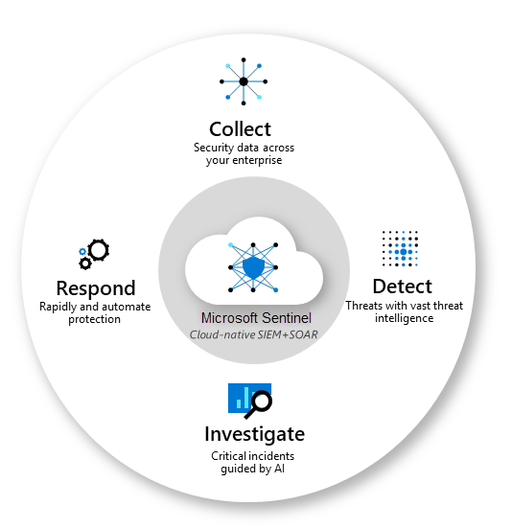

Slide 48
OBJECTIVES KEY RESULTS
SDCCD Information Technology Services
Fiscally Responsible
We limit wastage. We deliver projects within time and budget.
Capital Expenditure to
Operational Expenditure
Reduce the cash and rid high depreciation costs. Move towards predictable services.
Improve our Customer Service
Improve Quality of Service across all departments.
Becoming a Strategic Partner for SDCCD
colleges & departments
Collectively work and partner with colleges and to attain success: Recruitment. Retention. Persistence. Graduation.

Slide 49

What starts here changes the World.

Slide 50

SDCCD Information Technology Services
D.A.A.R.T.
Dependability
Authenticity
Analytical
Respect
Expectations
Transparency
Creating of winning mentality, winning behavior, and successful completion of tasks, projects, engagement with vendors,
colleagues and the stakeholders we serve.

Slide 51
What starts here changes California.

Slide 52
What is Blue Ocean Strategy?
Creating new market spaces and customer demands
Reconstructing actions and beliefs
Making competition irrelevant

Slide 53
9. Announcements
1 min. time limit each

Slide 54
The next meeting of the SDMC
Academic Senate:
Tuesday, 4/18/23 from 3:30-5:00pm in L-309 and on Zoom
(complete A.S. Senator Remote Attendance Form here)
Please submit agenda items to both Pablo Martin and Juli Bartolomei. If you are a senator and cannot make the meeting, please submit a proxy form or email to our Secretary, jalley@sdccd.edu, and your proxy by 3pm the day of the meeting.
10. Adjournment

