Slide 1
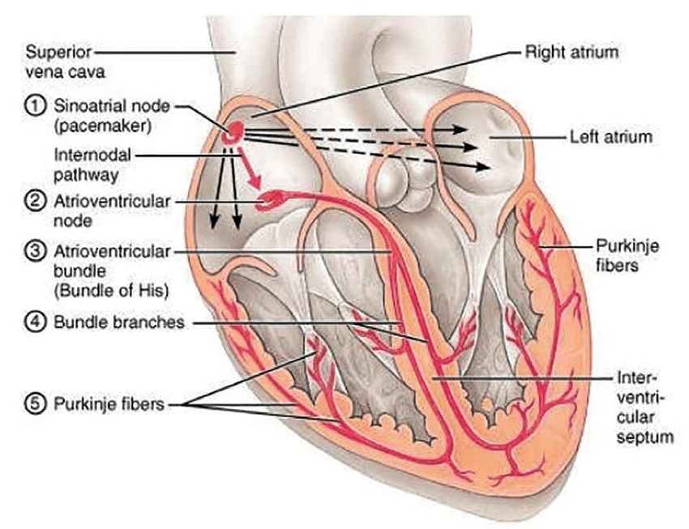
Electrical Conduction System of the Heart
(b)
Note: The internodal pathway (a)
Note: The interatrial band (b) (Bachmann’s bundle)
(a)
There are 5 main components (with location) of this conduction system:
1) Sinoatrial (SA) node
2) Atrioventricular (AV) node
3) AV Bundle (of His)
4) Left and Right bundle branches
5) Purkinje fibers
Sinus rhythm = the normal contractile pattern of the heart.
Electrical Conduction Region | Spontaneous Rate of Action Potentials/min
SA Node (sets the pace)
AV Node
AV Bundle
R and L Bundle Branches
Purkinje Fibers

Slide 2
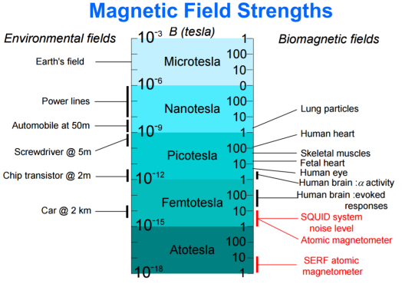
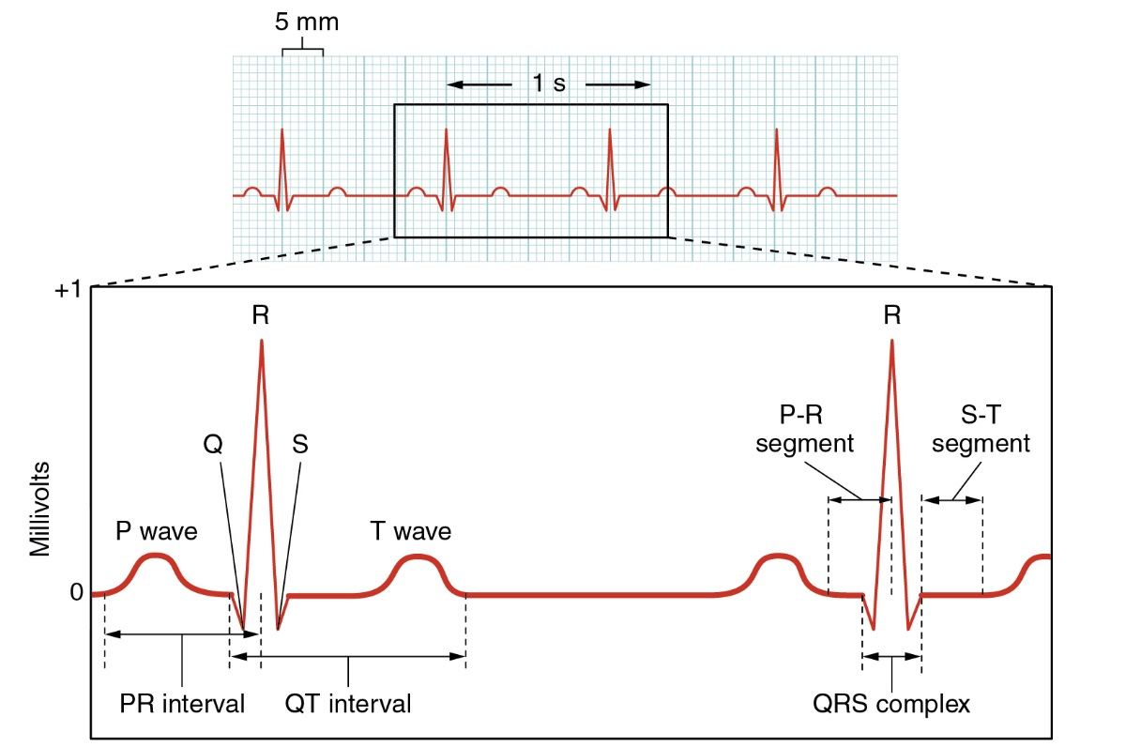
Trace of an ElectroCardioGram (ECG)

Slide 3
Components of the ECG
General Features of ECG
Wave – Deflection from baseline (+ or - direction).
Segment - A line between waveforms.
Interval - A waveform and a segment.
Complex - Consists of several waveforms.
Take a look at these links…
https://www.youtube.com/watch?v=RYZ4daFwMa8
http://ekginterpretation.weebly.com/cardiac-cycle.html
Specific Waves and Complexes
P Wave -
QRS Complex -
T Wave -
Specific Intervals and Segments
S-T Segment, T-P Segment
PR Segment, P-R Interval
QT Interval

Slide 4
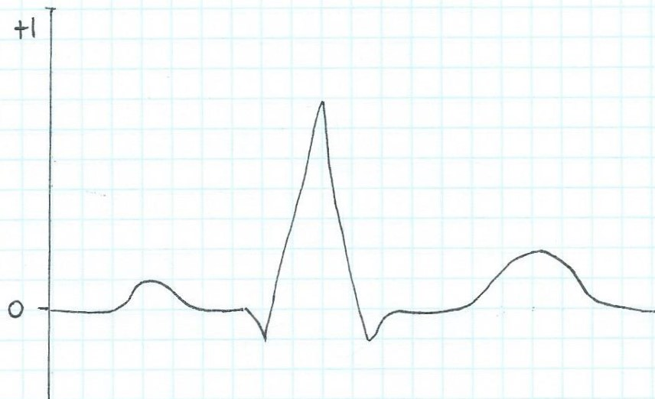
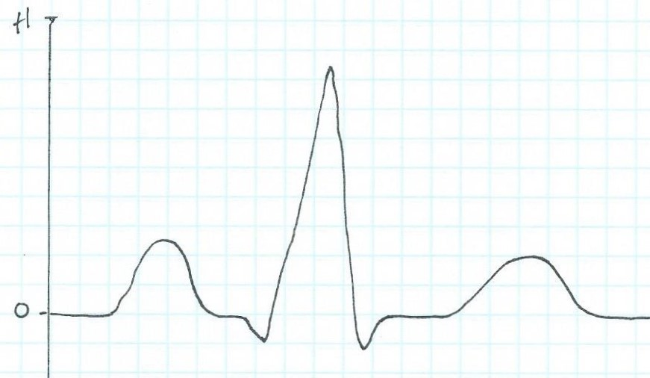
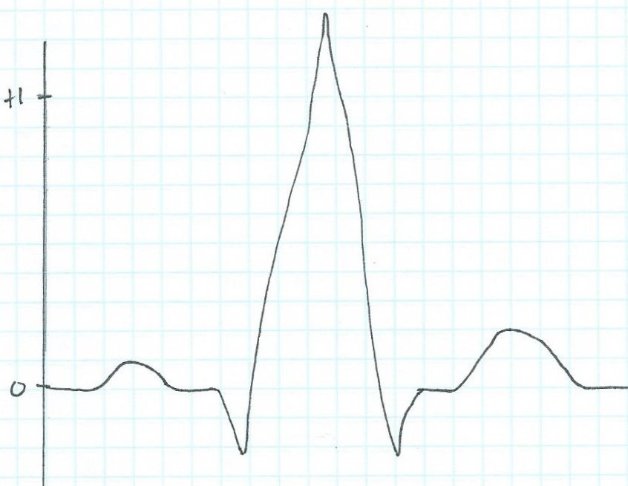
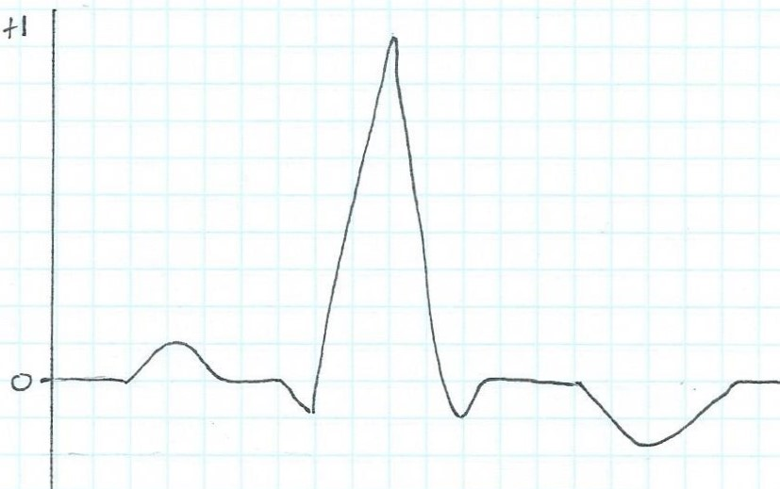
Examine the ECG traces below. Use the Normal ECG trace as a guide. Identify the waves and complexes and state what they indicate. Then find the abnormal component on each of these ECG traces a), b) and c) and suggest what they might indicate:
Normal ECG trace
a)
b)
c)

Slide 5
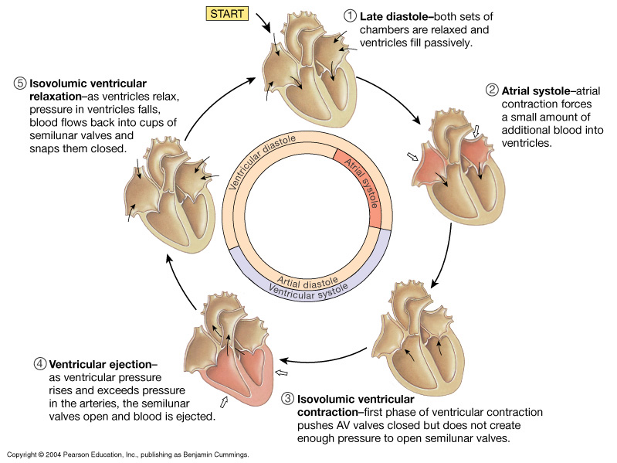
Diastole
Systole
The Cardiac Cycle
http://www.youtube.com/watch?v=rguztY8aqpk

Slide 6
The Cardiac Cycle:
Mechanical Events of the Heart
Late Diastole: “Heart at rest” all chambers relaxed filling with blood (passive filling ~ 80% full).
2. Atrial Systole: atria contract, adds the last 20% of blood to ventricles (top off ventricles)
Occurs after P-wave on EKG
End Diastolic Volume (EDV) = Maximum ventricular volume*

Slide 7
3. Ventricular Systole (part 1):
Ventricular contraction begins - ↑Pressure (P).
Closure of AV valves = 1st heart sound ("lub")
Sealed Compartment – all valves are closed.
Isovolumetric ventricular contraction:
=> pressure builds as volume stays the same.

Slide 8
4. Ventricular Systole (part 2):
Ejection phase: ↑P pushes open semilunar valves, blood forced out into artery leaving ventricle.
Pulmonary Semilunar => 25 mmHg (minimum pressure)
Aortic Semilunar => 80 mmHg (minimum pressure)
End Systolic Volume (ESV) = volume remaining in
heart after ejection (~½)*.
Stroke Volume = EDV - ESV (ml/beat)

Slide 9
5. Ventricular Diastole:
Relaxation of ventricles, artery back flow slams semilunar valves shut = 2nd heart sound ("dup").
Sealed Compartment again – all valves are closed.
Isovolumetric ventricular relaxation:
=> ↓ pressure as volume stays the same.
The AV valves then open, refilling starts –
back to start of cycle.

Slide 10
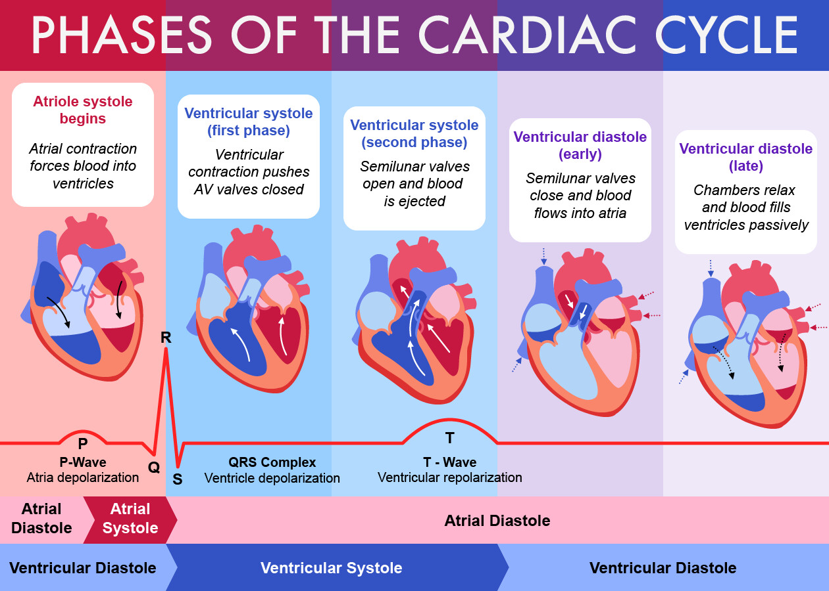
The Cardiac Cycle Summary
❷
❸
❹
❺
❶
Note: For our 5 phases we started here!
This image is nice as it shows chamber blood volumes and major ECG activity. The way we have numbered the phases is different but that does not matter since the titles of the phases are always the same. It’s a ‘cycle’ (circle) so we can start anywhere!

Slide 11
Cardiac Output
Cardiac Output (C.O.) = volume of blood ejected by heart ventricles per unit time.
Typically expressed as minute volume, or liters of blood per minute (L/min)
Maintaining/regulating C.O. to meet metabolic needs (basic function of system). Usually proportional to the tissues’ need for oxygen (O₂) and nutrients, and removal of carbon dioxide (CO₂) and waste.
Normally, C.O. changes with changes in body position.
e.g., moving from recumbent (lying down) to an upright HR and SV increase (depending on how quickly these changes occur).
At rest healthy adult basal C.O. about 5 L/min.
C.O. can increase 50-100% by anxiety/excitement, as much as 500% by exercise.
Measurements of C.O. can evaluate respiratory exchange, i.e., the delivery of O₂ to the tissues.

Slide 12
Calculating Cardiac Output (C.O.) = Heart Rate x Stroke Volume
*Heart Rate = beats/min
*Stroke Volume = EDV-ESV (volume/beat)
Example Calculations:
Some values are presented for at rest and during exercise. Now calculate the C.O., including units and showing all work!
1) At Rest:
HR = 72
EDV = 135
ESV = 65
2) During Exercise:
HR = 121
EDV = 178
ESV = 42

Slide 13
Cardiac Output = Heart Rate and Force (Contractility) is Modified by ANS
Parasympathetic activity decreases heart rate and force of contraction.
Sympathetic activity increases heart rate and force of contraction.
Multiple Factors Influence Stroke Vole (SV), it’s homeostatically regulated.
SV directly related to the force generated by cardiac muscle during contraction.
Greater force of contraction means greater SV, and lesser force means lower SV.

Slide 14
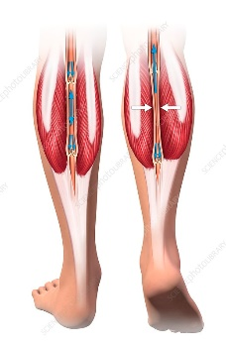
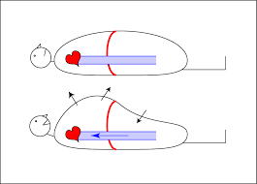
Things that influence SV:
a) Length-Tension (Stretch-Force) Relationships (Starling's Law of the Heart)
As cardiac muscle sarcomere length increases, tension generated contracting muscle increases = SV.
More force, greater amount of blood ejected.
b) Venous Return or Cardiovascular Preload
Blood returning to the heart is termed 'venous return'.
Greater venous return = stretch cardiac muscle, and they contract more forcefully.
Venous return determines EDV and this determines stroke volume (SV)!
Several factors affecting venous return:
The ‘Skeletal Muscle Pump’.
The ‘Respiratory Pump’.
Sympathetic Activity.
Preload = another way of expressing EDV. The greater the EDV = Greater preload = Greater SV.
Note: Decreased EDV = Decreased preload = Decreased SV.
Afterload = the force ventricles must generate to pump blood against resistance in vascular system. Any increased resistance requires a greater afterload to force open the semilunar valves and pump the blood into the arteries. Increased afterload decreases SV; decreased afterload increases SV.

Slide 15
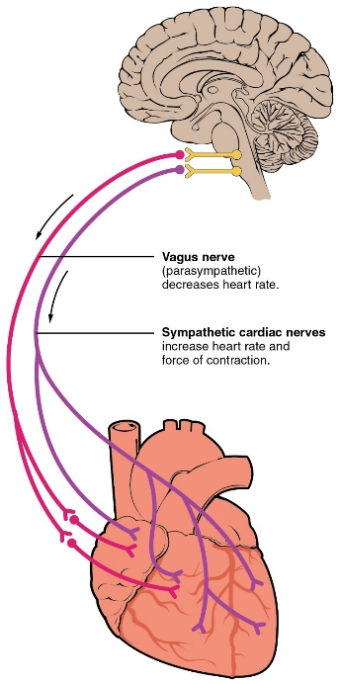
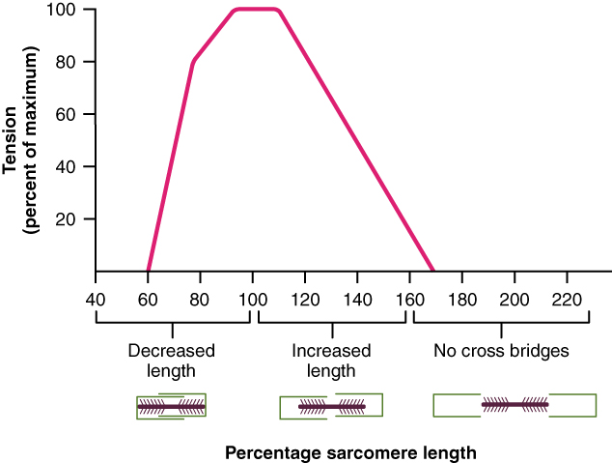
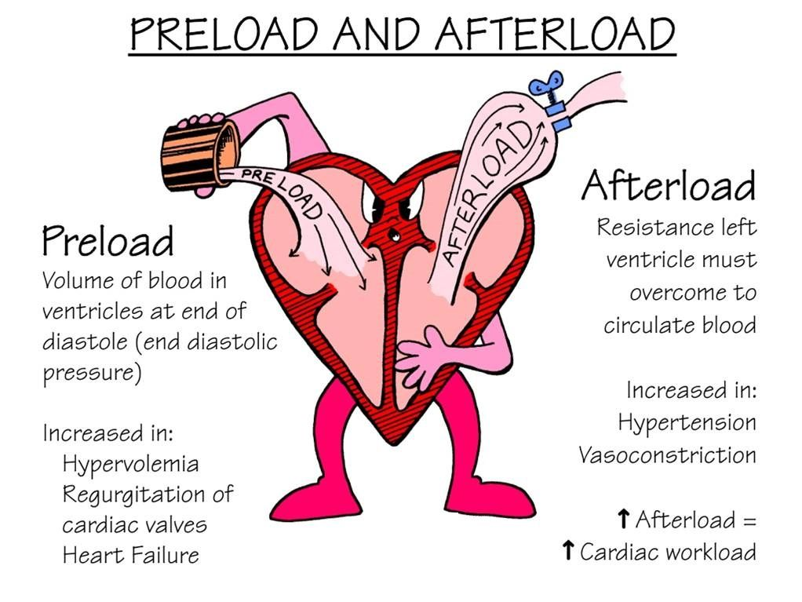
Summary of Impacts on Cardiac Output
❶
❶
Parasympathetic activity decreases heart rate and force of contraction.
Sympathetic activity increases heart rate and force of contraction.
❷
Optimal Length of Sarcomere = Most Force
Note: At rest, cardiac sarcomeres are short, thus stretching heart chambers (with increased volume) makes heart contract with more force, this will increase SV.
❸
Preload and Afterload effect Stroke Volume!
❷
❸

