Slide 1
Transforming Institutional Use of Data

Slide 2
Presenters
Craig Rutan
Santiago Canyon College
ASCCC Data and Research Committee
Eric Wada
Folsom Lake College
ASCCC North Representative
Notes:
Both

Slide 3
Description
Have you ever heard the phrases “I am not a data person” or “That isn’t what I am seeing in my class?" The data presented to us only seems to tell part of the story and it may not represent the individual challenges you have seen your faculty and students tackle every day. Academic senates must be actively engaged in determining what data is being tracked, determining what it really means, and deciding what still needs to be explored to work towards equitable student success.
Notes:
Eric

Slide 4
Preliminaries
Nearly every meeting that happens on a campus, whether in person or on Zoom, will include the discussion of reports and some type of data.
The collection of data isn’t something new, but the increased use of data has made framing it even more important.
Faculty must work with administration to guide research questions and determine what is most important. We are the ones that meet with students and we must ensure that students do not just become another number on a page.
Notes:
Eric

Slide 5
Types of Data
Our colleges collect data about everything that we do, but there are certain things that you might encounter more than others. These include:
  Throughput - How many students successfully complete transfer level mathematics or English in one year.
  Retention - The percentage of students that remain in a course until the end (measured relative to census).
  Persistence - Percentage of students that enroll in the next term.
  FTES Generation - How many full time equivalent students will the college be paid for.
  Efficiency (or productivity) - Often shown with average class size or FTES/FTEF (full time equivalent faculty).
  Outcomes - ADT, degree/certificate completion, transfers, CTE units
Notes:
Eric

Slide 6
Why Do Some Measures Seem More Important?
Nearly every measure that we hear about is driven by compliance and funding.
  Compliance with something being monitored by the Chancellor’s Office (AB705, SEA Program, etc.)
  Increasing the amount of funding for the college through enrollment and performance metrics in the SCFF
There are legislative and external influences on college priorities and decisions.
Notes:
Craig

Slide 7
What Story Do These Measures Tell?
Efficiency, throughput, completion of ADTs, etc. are all important details about how well our colleges are doing in some areas.
It seems like many details that we used to care about have been forgotten. Measures like:
  Course success rates
  Grade distributions in courses
  Completion of course sequences
  Students being able to transfer to the school of their dreams
  Students completing their desired degrees after transfer
Notes:
Craig

Slide 8
Are We a Business or a College?
The focus of faculty is on their students, the focus of administration is about the fiscal health of the college. How do we align these two different perspectives?
If a college is not financially stable then it will not be able to hire full time faculty, offer support services to students, and offer all of the course sections that students need.
At our center we are here to support and educate students and we must shift the data conversations to ensure that is not forgotten in the pursuit of increased funding and improved performance in system level metrics.
While we need to be fiscally responsible, we cannot sacrifice the needs of individual students and let them become part of aggregated numbers on a page.
Notes:
Craig

Slide 9
Limitations of Quantitative Data
When the focus is on the numbers, and the numbers are not contextualized, the focus tends to stray away from instructional programs and equitable student success.
  Discussions centering on how to increase enrollment without increasing capacity to support learning.
  Earning more money while spending less on instructional and student support programs.
  One-size fits all is not an equitable strategy.
Quantitative data are easier to obtain, less expensive to collect and analyze, and can provide quick answers. They can start the conversations.
If too narrowly-focused, or if the data collection methods are not robust, our analysis will be biased.
Notes:
Eric

Slide 10
Shifting the Discussions on Data
It is imperative that local senates drive the conversations about what data the college should be tracking and what measures the faculty need to improve instruction and student success.
This does not mean that every faculty member must love looking at numbers, but they must understand what the numbers mean and be able to provide context on how they are interpreted.
We are talking about people, not just numbers and if faculty do not advocate for the needs of students then who will?
Context is important, and that’s the way we center authentic voices and lived experiences.
Notes:
Craig

Slide 11
You Must Have Access
Faculty should have access to the same information that administration has. How can we be active participants in discussions based on information we have never seen?
If the information that your college is tracking doesn’t answer the questions you have, meet with your research office and discuss the questions you are trying to answer. Your institutional researchers are there to help.
  Examples: Further data disaggregation, surveys of student needs pre-enrollment, graduate exit interviews/surveys.
We must determine how to share our students successes - re-define what does student success look like.
We must look for information that will tell us (where needed) how to improve instructional and student services.
Notes:
Craig

Slide 12
Data Disaggregation
Quantitative
Data disaggregation is essential to determine if there are disproportionate impacts for different populations.
Does your disaggregation go beyond the required groups for the SEA program?
Does your campus have specific populations that are not common in the system? Are they part of your data disaggregation?
Qualitative
When collecting qualitative data, how are the surveys or focus groups structured? Are you inviting representative students to respond? Do the students feel safe responding?
As faculty share student stories, are faculty supported and heard? Are the faculty made to feel safe responding?
Notes:
Eric

Slide 13
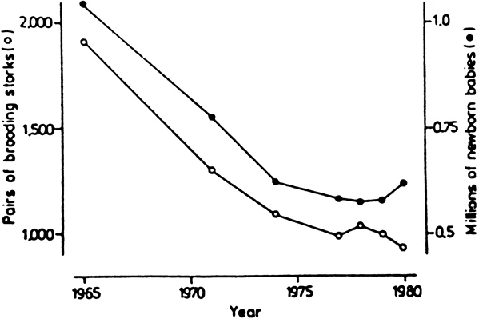
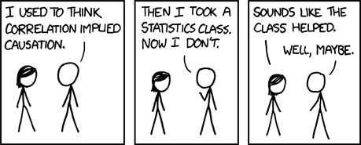
Data Interpretation
Carefully consider conclusions:
  e.g. Over 25% of burglaries occur between Memorial Day and Labor Day
Limitations of observational studies:
  Systematic differences between populations are not captured
    Controlled, randomized studies are necessary
  Correlation does not imply causation
Sources:
Sies, H. (1988) “A New Parameter for Sex Education.” Nature. 332: 495
https://xkcd.com/552/
Notes:
Eric

Slide 14
Program Review
We are all convinced that our programs are great and that we are doing an amazing job for our students and program review is our opportunity to show it.
Who determines what data is part of your program review?
Does your program review only include quantitative data or does it include qualitative data like student satisfaction surveys?
Whatever information faculty need to tell the full story of their programs and their students should be available and incorporated.
Processes for program review are part of 10+1 and your senate needs to ensure your model includes everything necessary to develop a complete picture of how well you serve students.
Notes:
Craig

Slide 15
Exploring Instructional Modalities
As colleges have begun to move past the pandemic, there is an increased push to offer more synchronous and asynchronous online courses because “this is what the students want”
Is your college tracking the success in face-to-face, face-to-face and asynchronous hybrid, synchronous online, and asynchronous online?
Is your college pushing for hyflex instruction? Is there any data to support the effectiveness of this modality in your discipline?
Ask questions about the data presented - are they from out of state, at what sort of institution were the data collected, what discipline, how many students?
Make good decisions that focus on equitable student success rather than focusing exclusively on equitable access.
Notes:
Craig

Slide 16
Summary
We are working at data centered colleges and faculty and senates cannot sit by and let administration decide what is really important.
Engage your institutional research to determine what data is being collected and if there are opportunities to collect additional information.
Your college will have lots of quantitative data, but qualitative data is important to provide a complete picture.
Faculty must analyze data about student demand and success in different modalities and scheduling should be about data not funding.
Notes:
Eric

Slide 17
Thank You
Please share ideas and questions.
info@asccc.org

