Slide 1
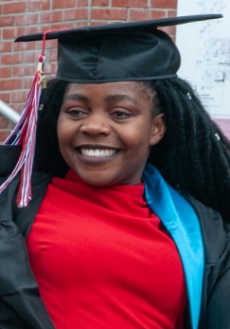
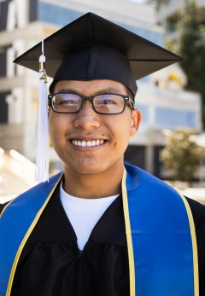
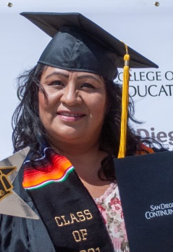
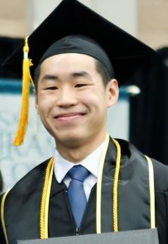
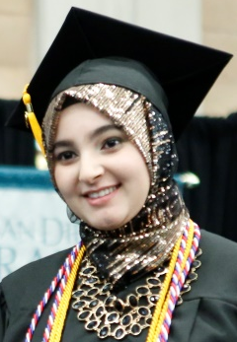
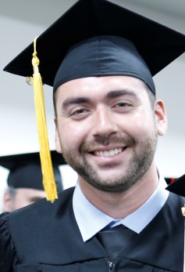
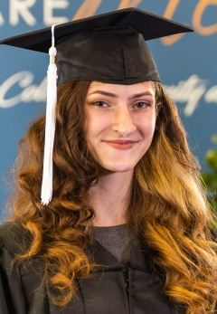
Chancellor’s Forum
2022-2023
Carlos O. Cortez, Ph.D. | Chancellor

Slide 2
Agenda
District Overview and Enrollment
Addressing Student Costs/The San Diego Promise
Budget and Finance
District Office Reorganization and Technology Services Initiatives
Operations, Enterprise Services, and Facilities
Districtwide Communication and Public Relations
Planning Map for 2022-2023

Slide 3
District Overview

Slide 4

California Community College Mission
Open Access to Higher Education
Transfer Education
Career Technical Education
Adult/Continuing Education
Basic Skills/Remedial Education
Baccalaureate Program
Student Support and Success Services
Economic Development
Workforce
Bachelor Degrees
Associate Degrees
Certificates
73 Districts
116 Colleges
Notes:
4

Slide 5
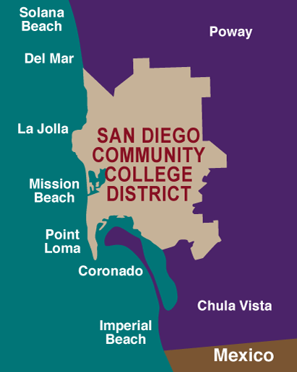
The San Diego
Community College District
  One of California’s largest community college districts
  Serves the City of San Diego and surrounding region
  5 Member Elected Board of Trustees
  Student Trustee (Rotating)

Slide 6
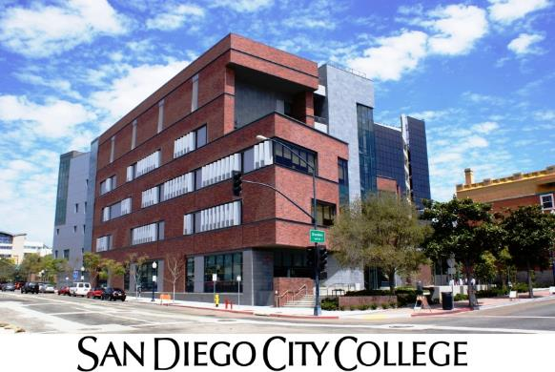
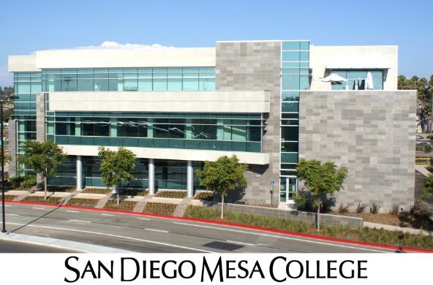
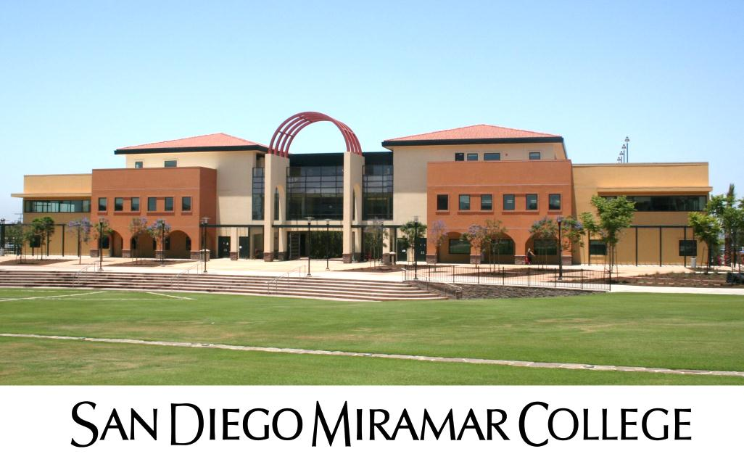
50,921 Students Enrolled in
Credit Colleges

Slide 7
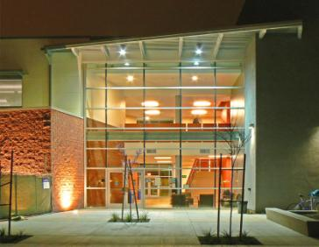
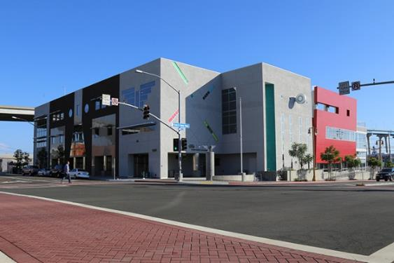
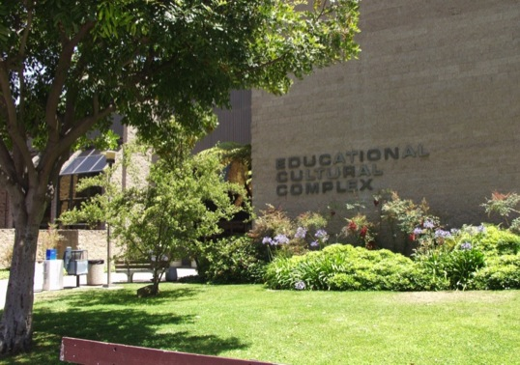
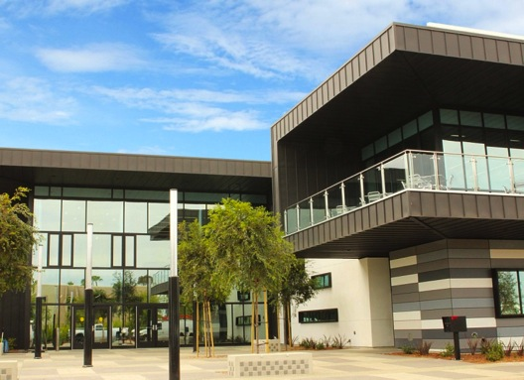
17,378 Students Enrolled in the
College of Continuing Education
Educational Cultural Complex
César Chávez Campus
Mid-City Campus
North City Campus
West City Campus
At Mesa College
At Miramar College

Slide 8
SDCCD Mission
The mission of the San Diego Community College District (SDCCD) is to provide accessible, high-quality learning experiences, and undergraduate education at an affordable price to meet the educational needs of the San Diego community and the state.

Slide 9
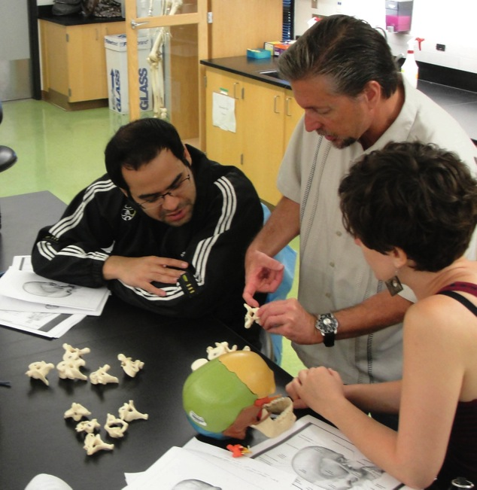



SDCCD Functions
Instruction
  Two-year and Four-year Degrees
  Career Technical Education
  Adult High School Diploma and Equivalency
  English Language Acquisition
  and Citizenship Training
  Noncredit Lifelong Learning
  Contract and Fee-based Education
  Community Education
Student Support and Success Services
  Admissions and Records
  Assessment
  Career Placement
  College Transfer
  Counseling
  Equity
  Financial Aid
  Library
  Tutoring
Student Life
  Athletics
  Clubs
  Government
  Performing Arts
  Study Abroad

Slide 10
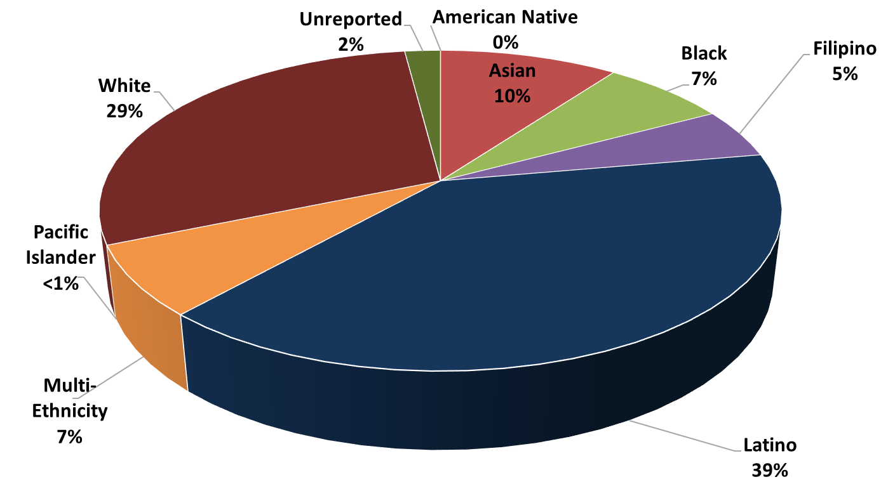
Ethnicity of Credit College Students
Fall 2021

Slide 11
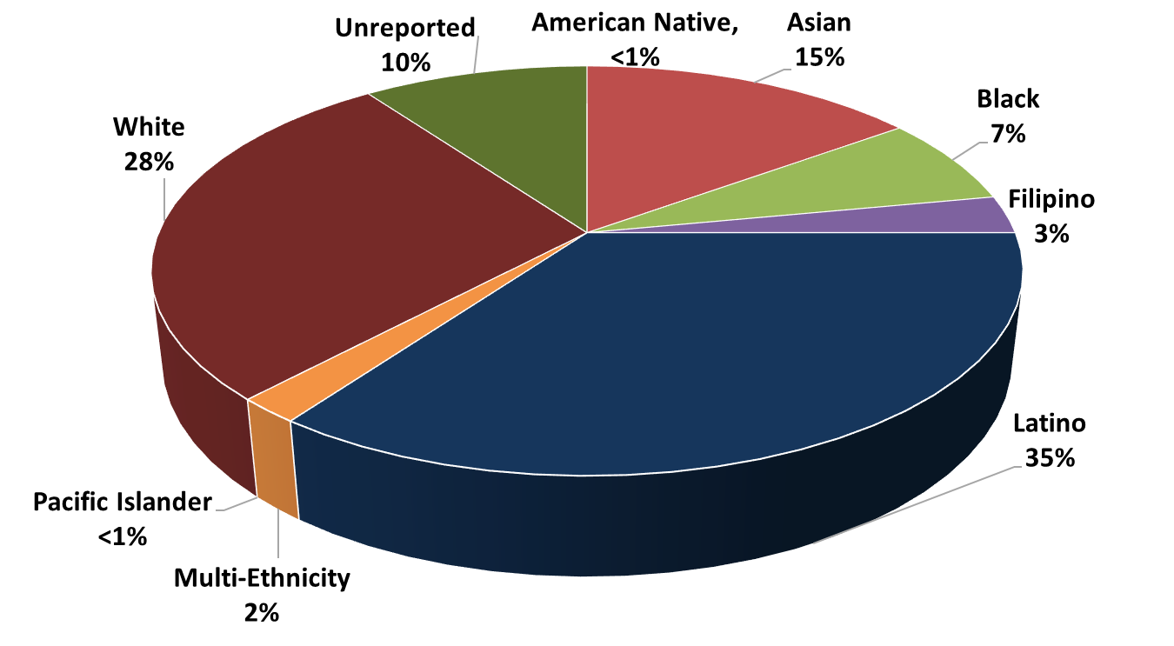
Ethnicity of College of Continuing Education Students Fall 2021

Slide 12
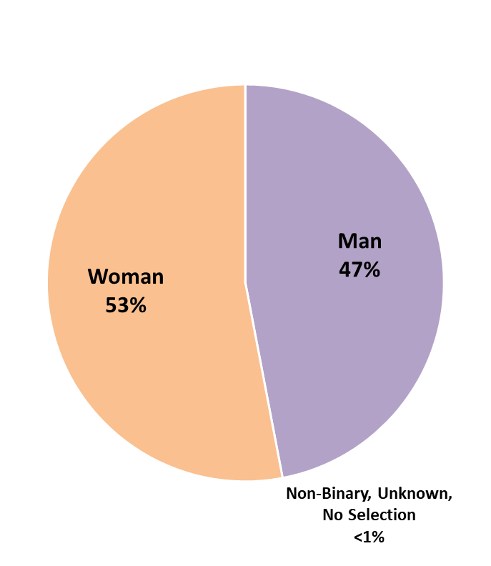
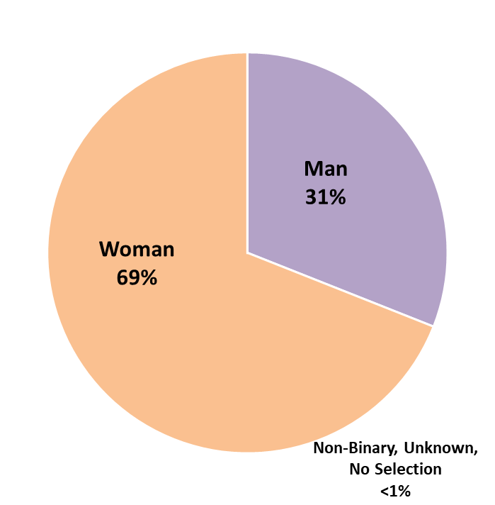
Gender of Credit College and Continuing Education Students
Fall 2021
Credit Colleges
College of Continuing Education

Slide 13

FTES
Full-Time-Equivalent Student
= 15 Units
  1 Student Taking 15 Units
  -Or-
  5 Students Each Taking 1, 3-Unit Course
  In 2022-23, the state $4,840 per FTES for Credit Classes (70%)
  will pay:
  $6,788 per FTES for Special Admit and
  Career Development and College Preparation (CDCP) Non-Credit Classes
  $4,082 per FTES for Other Non-Credit Classes

Slide 14
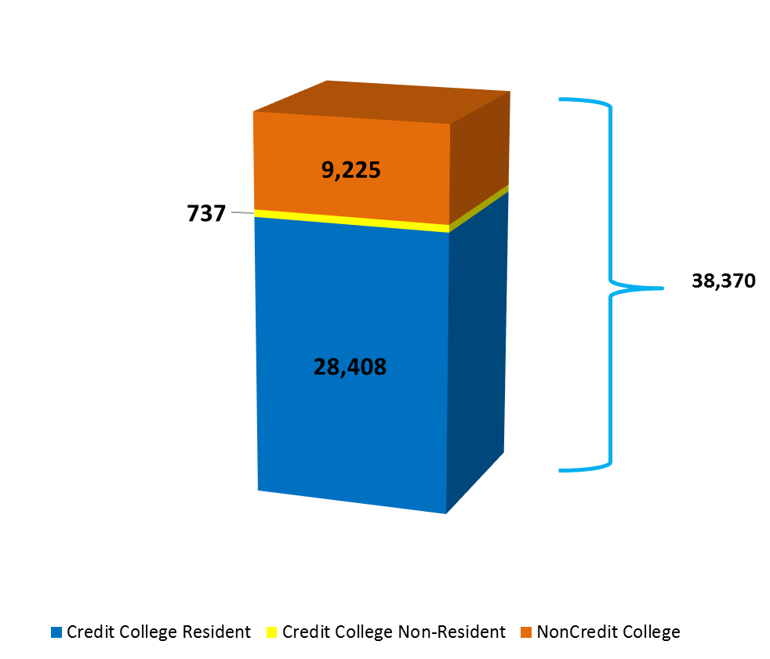
Districtwide Recalculation FTES
2021-2022

Slide 15
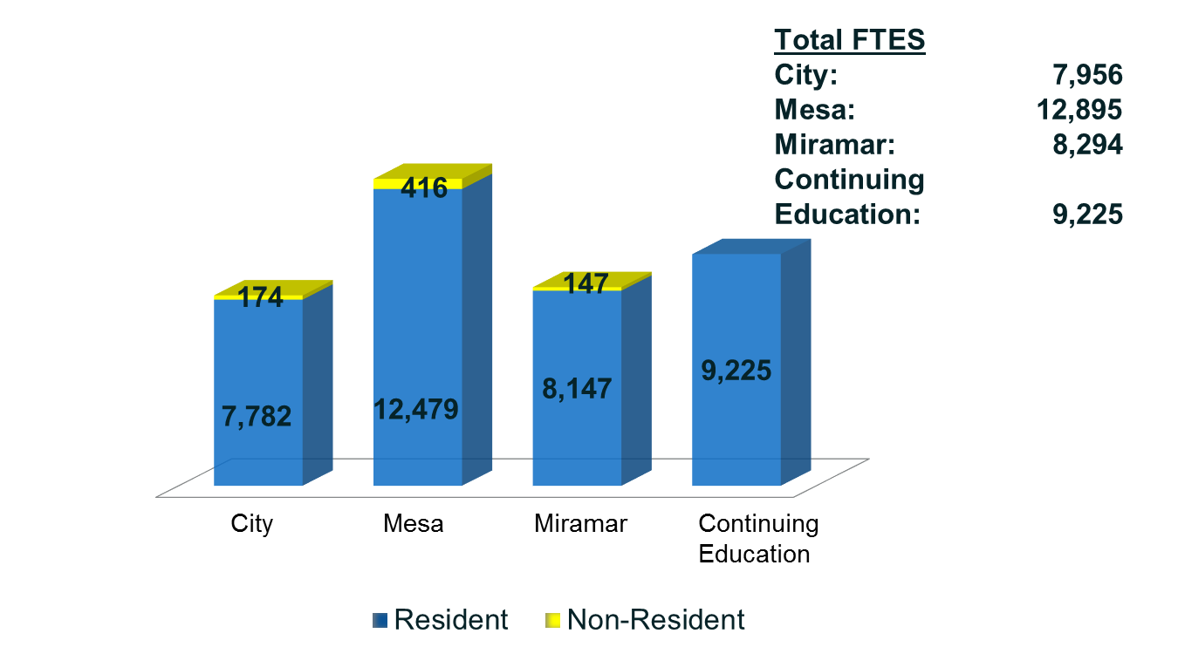
Resident and Non-Resident FTES
2021-2022

Slide 16
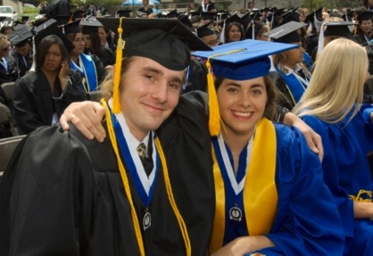
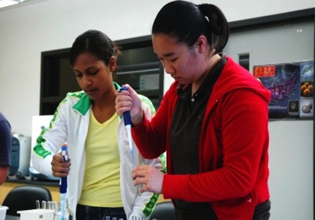
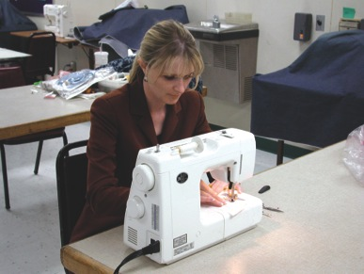
Preliminary Resident FTES Targets
2022-2023
2022-2023 Resident FTES Targets
City College | 8,704
Mesa College | 13,575
Miramar College | 8,670
Continuing Education | 6,820
District Total | 37,769
16

Slide 17
District Overview
and Enrollment
Q and A

Slide 18
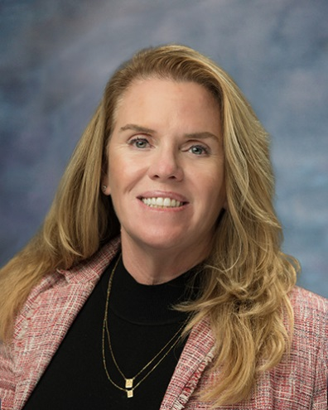
Addressing Student Costs:
The San Diego Promise
Susan Topham, Ed.D.
Vice Chancellor
Educational Services

Slide 19

Enrollment Fee Cost for Students
Resident Credit Classes: | $46 per unit
Non Resident Tuition: | $304 per unit ($350 total per unit)
Baccalaureate Tuition Surcharge: | $84 per unit ($130 total per unit)
Non-Credit Classes: | Free
Community Education Classes: | Variable Fees $5-$20 per Instructional hour
Notes:
* Effective Fall 2018

Slide 20
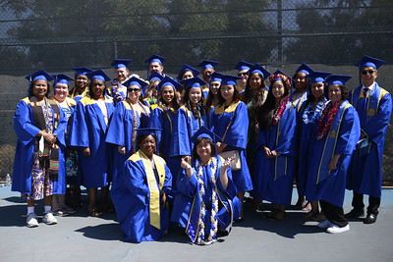
AB 927 (Medina, 2021) Baccalaureate Program
AB 927 (Medina) Baccalaureate Program was signed by the governor on October 8, 2021.
    Makes the 15 pilot programs permanent
    Expands this opportunity to all California community colleges through an approval process in the CCC Chancellor’s Office (up to 30 new programs each year)
    Implements a consultation process to ensure good communication between the California Community
    Colleges, the CSU, and the UC
    systems
    Caps individual college
    baccalaureate programs at 25% of
    all degree programs to ensure
    fidelity to the traditional community
    college mission

Slide 21
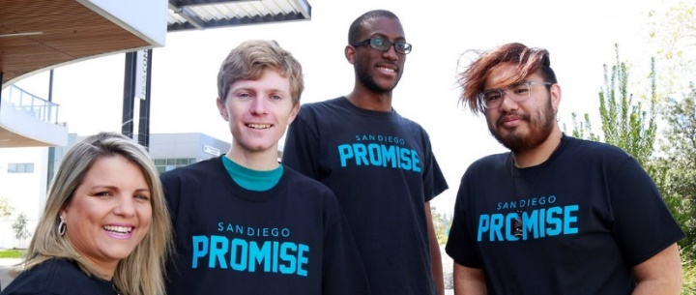
San Diego Promise Program
Enrollment Eligibility:
Must be a recent high school graduate, recently completed high school equivalency (GED or HiSET), or identify with one of the following groups:
  San Diego College of Continuing Education Student
  Foster Youth
  Veteran of U.S. Armed Forces
  Formerly Incarcerated
  Undocumented
Must be a California resident or AB 540 eligible
New State Promise Funding is coming available for returning students.
  *Students who completed college courses in high school are eligible for the San Diego Promise Program
Notes:
The San Diego Promise is a two-year program that pays for enrollment fees for all first-time,
full-time students at City, Mesa, and Miramar Colleges. Students with the greatest financial
need will also receive book grants. The San Diego Promise is intended to ensure that no deserving local students are denied the opportunity to go to college due to lack of resources.

Slide 22
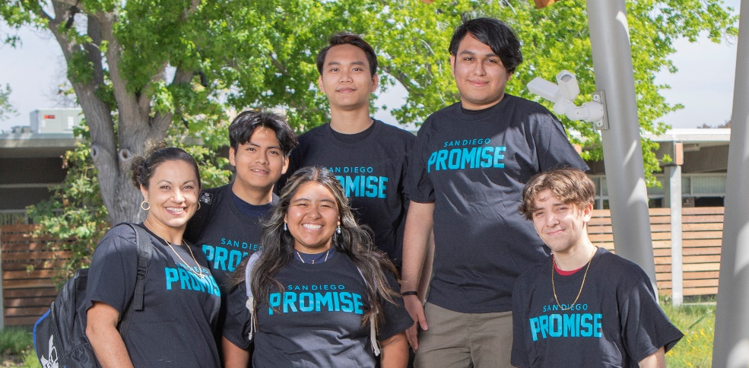
San Diego Promise
2021-22 Participants
 | Fall 2022 | Fall 2021 | Fall 2020 | Fall 2019
Application Submitted | 4,487 | 3,136 | 3,386 | 3,371
Applications that Met Eligibility | 3,069 | 2,165 | 2,521 | N\A
Contracts signed by Year | 2,548 | 1,901 | 2,217 | 2,176
Students Enrolled Fully in the San Diego Promise Program | 2,317 | 1,610 | 1,892 | 1,915
Cohort Year | Total Students
Year #1 2022-2023 | 2,317
Year #2 2021-2022 | 1,107
Total Cohort | 3,424

Slide 23


Open Educational Resources (OER) and Zero Textbook Costs (ZTC)
OER: Resources that reside in the public domain or have been released under an intellectual property license that permits their free use and re-purposing by others.
ZTC: Courses that use digital materials that are free of charge to students and may have a low-cost option for print versions.

Slide 24
Textbook Affordability
Congressman Scott Peters gave his support via a $975,000 grant for the District through the Congressional Community Funding Project to support the buildout of open educational resources.
In 2022 the Districtwide Affordability Committee was rebuilt as the Student Textbook Affordability Committee (STAC).
  Updated the process to collect OER and affordable information
  Investigating a campaign to increase textbook reporting
  OER low textbook cost icon
OER sections had 2% higher success rates across the credit colleges in both Fall 2020 and Fall 2021.
During Fall 2021, 36% of course sections were using low-cost, no-cost, and Open Educational Resources (OER). Combined with other cost-saving measures, these changes have resulted
in a net saving to students of over $3.0 million.
$3,193,126
Total Savings
Districtwide

Slide 25
Basic Needs
SB 129 provided $1,235,503 in categorical funds for all four colleges to establish or expand a Basic Needs Center.
Each college has designated, or is in the process of hiring, a full time Basic Needs Coordinator
Each Basic Needs Center is expanding their comprehensive services, including: food pantry/distribution events, accessible toiletries, clothing closets, technology assistance, housing resources and basic needs referrals

Slide 26
2023-30 District Strategic Plan
Spring 2022: The SDCCD Board of Trustees approved the 2023-2030 District Strategic Plan. This culminated a six-month process that included dozens of meetings, online presentations, and input from roughly 10,000 employees, students, and community members.
Summer 2022: The District Strategic Plan website was created (https://www.sdccd.edu/about/strategic-plan.aspx). The 2023-30 District Strategic Plan is available on the website.
Fall 2022 – Spring 2023: Goal Area Implementation Teams (GAIT) will create work plans and performance measures to assess progress on the implementation of the goals and objectives. A dashboard will be created to display results and progress.

Slide 27
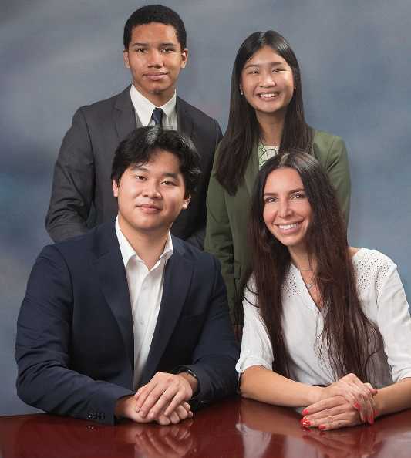
United Student Council
Beginning 2022-23, the United Student Council includes representation from all four colleges
    San Diego City College
    San Diego Mesa College
    San Diego Miramar College
    San Diego College of Continuing Education
San Diego College of Continuing Education ran its
first Student Trustee Election in May 2022
Goals and Focus:
  Looking into how to further support and provide access to
  support housing-insecure students.
  Discussing ways the Associated Student Government can
  provide intentional spaces for engagement with students.
Student Trustees:
Diego Bethea (City College) Phoebe Truong (Mesa College) Allen Kuo (Miramar College) Julia Kogan (College of Continuing Education)

Slide 28
Questions?
Addressing Student Costs
The San Diego Promise
Basic Needs
Q and A

Slide 29
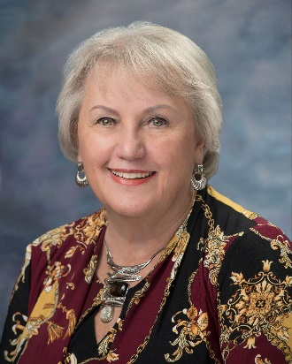
Budget and Finance
Bonnie Ann Dowd, Ed.D.
Executive Vice Chancellor
Business and Technology Services

Slide 30
California Community Colleges
Budget Process
State Budget - Proposition 98
Governor - Legislature
State Board of Governors & System
73
Districts
Local Boards of Trustees & Districts
Federal &
Special Funds
San Diego Community College District
Allocations

Slide 31
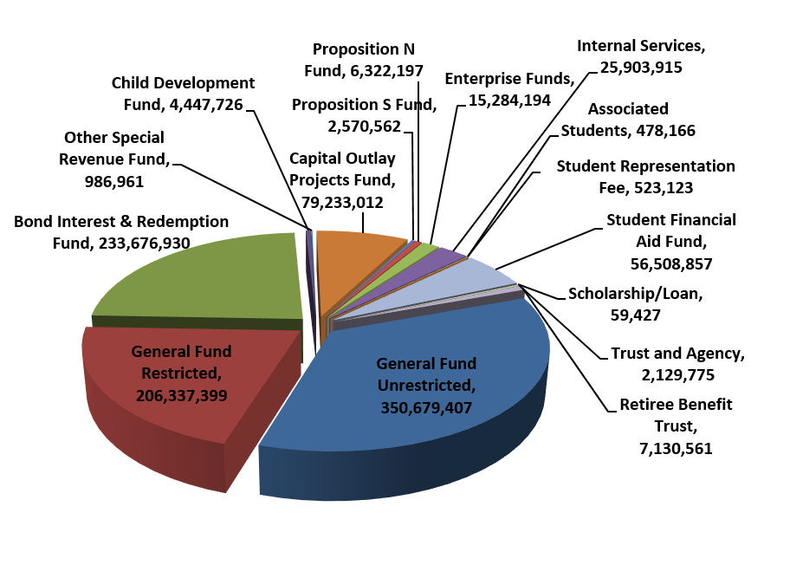

2022-23 Adopted Budget
Approved by Board of Trustees on September 15, 2022
Summary of Fund Allocation
Summary of Operational Allocation
Bond Measures
& Other
354,051,643
Personnel
239,434,552
Benefits*
103,941,046
Operations
294,844,971
Total: $992,272,212
Total: $992,272,212

Slide 32
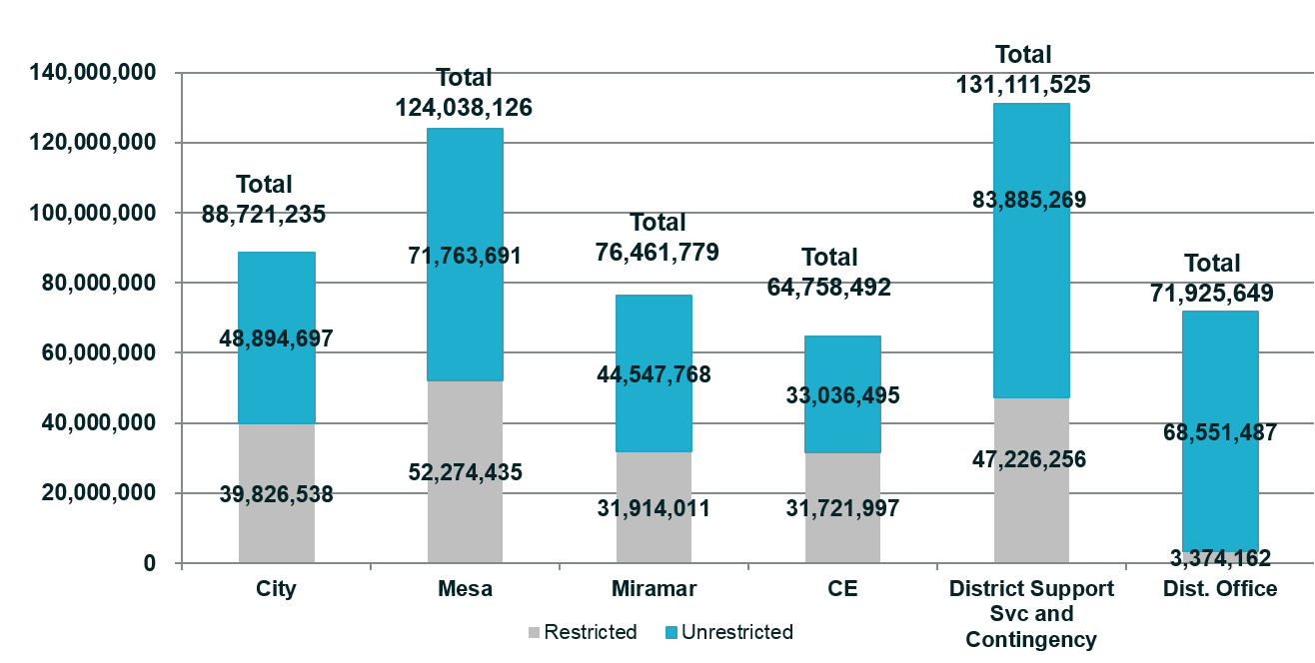
2022-23 Adopted Budget
General Fund Unrestricted & Restricted Allocations
Approved by Board of Trustees on September 15, 2022
Bond Measures
& Other
354,051,643
Note: General Fund Budget for 2022-23 is $557,016,806. The GFU Budget is $350,679,407 and the GFR Budget is $206,337,399.

Slide 33
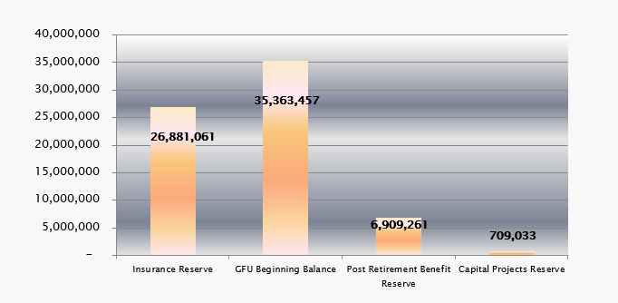
Reserves and GFU Beginning Balance
(actuals) as of June 30, 2022
Insurance Reserve: Support District insurance liabilities.
GFU Beginning Balance: Includes the 5% Cash Reserve of $16,293,125 which per current Board policy requires a minimum of 5% ending fund balance reserve. Total Beginning Fund Balance is $35,363,457.
Post Retirement Health Benefit Trust: CCLC irrevocable trust for retiree health benefits.
Capital Projects Reserve: Facilities Projects other than Propositions S & N.

Slide 34
How the State Funds
Community College Districts
General Fund Unrestricted revenue allocations under Student Centered Funding Formula (SCFF):
    70% based upon Student Enrollment (Based on FTES, Basic, # of credit Colleges and non-credit Centers)
    20% based upon Student Headcount and demonstrated financial need (Supplemental)
    10% based upon one per Student outcome achieved (Success)
  Full-Time-Equivalent Student = 15 units
    1 Student Taking 15 Units OR
    5 Students Each Taking 1, 3-Unit Class
  Hold-Harmless/Stability Protection intended to ensure all districts are provided apportionment revenue earned in the prior year, adjusted for any COLA (cost of living adjustment) included in the state budget
  Emergency Conditions Allowance (ECA) due to COVID-19 to keep districts’ FTES enrollment at pre-pandemic levels

Slide 35

Balancing the Scales to
Ensure Fiscal Stability & Resiliency
Achieve and Maintain a Minimum of two months
of ending fund balance reserve, which is critical
to ensure fiscal resiliency and health.
Focus on achievement of Strategic Plan 2023
goals and objectives.
Identify and receive net (after all expenses)
revenue funding beyond state revenue
apportionment.
Fund long-term liabilities e.g., OPEB (other post
employment benefit obligations).
Align annual operating expenses and revenue to avoid deficit budgeting and spending.
Remain compliant with federal, state and grant requirements and laws including “Unmodified” clean annual audits.
Retain “AAA” District’s bond rating and Reaffirmation of credit and non-credit colleges Accreditation.

Slide 36

Areas That Could Cause the Scales to Become Out of Balance
CalSTRS – CalPERS employer cost*
  FY 2013-14 $14 million
  FY 2022-23 $39.3 million*
Declining enrollment impacts on SCFF’s
calculated FTES, Supplemental and Success
apportionment revenue.
State cash shortfalls due to tax revenue
declines as a result of minor downturns or
significant events e.g., inflation and/or a
recession would impact apportionment revenue
payments.
SCFF “Hold Harmless” protection ends in FY 2024-25; SDCCD is currently estimated to receive $23.9 M in apportionment revenue that is not currently being earned.
Two months of ending fund balance Reserves critical to ensure fiscal resiliency.

Slide 37
Questions?
The Budget
Q and A

Slide 38
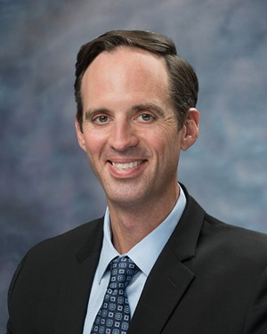
District Office Reorganization
and Technology Services Initiatives
Gregory Smith
Vice Chancellor
People, Culture, and Technology Services

Slide 39

Context
  Ongoing effective, efficient, and equitable operations
  Executive leadership changes
  Response to significant disruptions to normal operations

Slide 40
SDCCD 2023-2030 Strategic Plan
Key Objectives
  Student Success and Wellbeing
  Academic Excellence
  Workforce Development
  Financial Health
  Institutional Resiliency

Slide 41
Guiding Principles
  Achieve strategic goals efficiently, effectively, and equitably
  Create conditions in which classified professionals, supervisors, and managers in District operations can excel
  Create operational efficiencies by aligning connected functions

Slide 42
Overview
  Institutional Innovation and Effectiveness Division (new)
    Expand institutional research, accreditation, strategic planning, and educational technology planning and support functions
  Development and Entrepreneurship Division (new)
    Lead comprehensive, districtwide fundraising and entrepreneurial education programs

Slide 43
Overview (continued)
  Finance and Business Services (formerly BATS)
    Expand capacity for budgeting, accounting, auditing, planning, and managing diverse revenue sources
  Educational Services
    Focus on instructional program and student services support

Slide 44
Overview (continued)
  Operations, Enterprise Services, and Facilities (formerly Facilities Management)
    Align Districtwide operations in facilities services, inventory, health and safety, and enterprise services
  People, Culture, and Technology Services (formerly Human Resources)
    Align Districtwide EEO and Title XI investigation services and management of the ERP system, network services, and cybersecurity

Slide 45
Technology Services Key Priorities
  Cybersecurity Initiatives
  Transition to Cloud Services
  Network Access and Performance
  Classroom and Workstation Equipment Planning and Support
  Staffing Plan
  District Technology Strategic Plan

Slide 46
Questions?
District Office Reorganization
and Technology Services Initiatives
Q and A
46

Slide 47
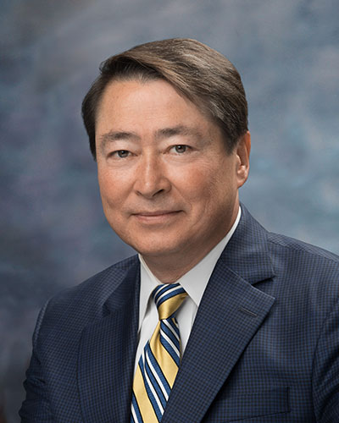
Operations, Enterprise Services,
and Facilities
__________________________________________________________________________________________________________________
Departmental Changes & Initiatives
Housing
2024 Bond
Police Advisory Committee
Joel Peterson
Vice Chancellor
Operations, Enterprise Services, and Facilities

Slide 48


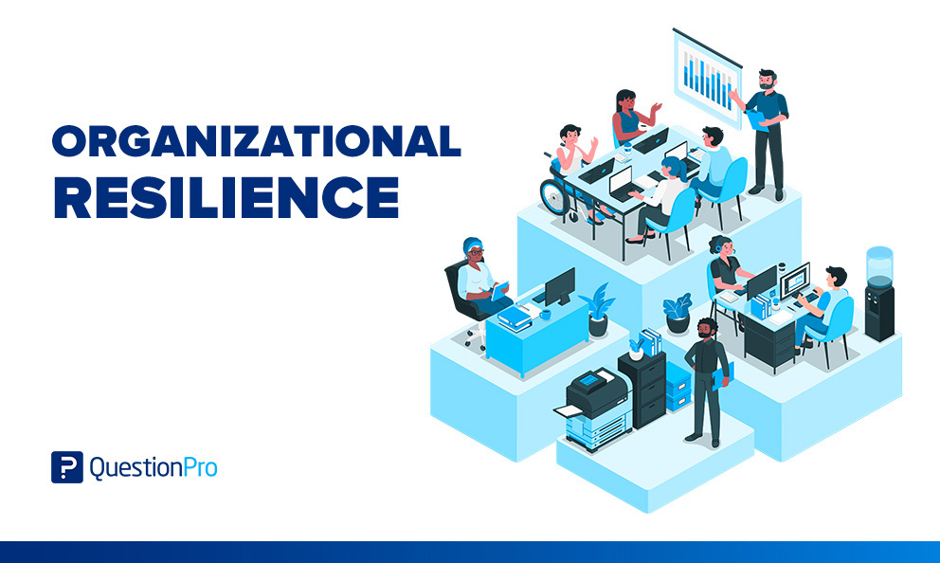
Department Changes & Initiatives
Department Expansion
  Focus on service
    Operations
    Enterprise Services
    Facilities
Department Initiatives
  Diversity, equity, and inclusion
  Sustainability
  Processes, procedures, and platforms
    Institutional and organizational resiliency
  Transparency

Slide 49
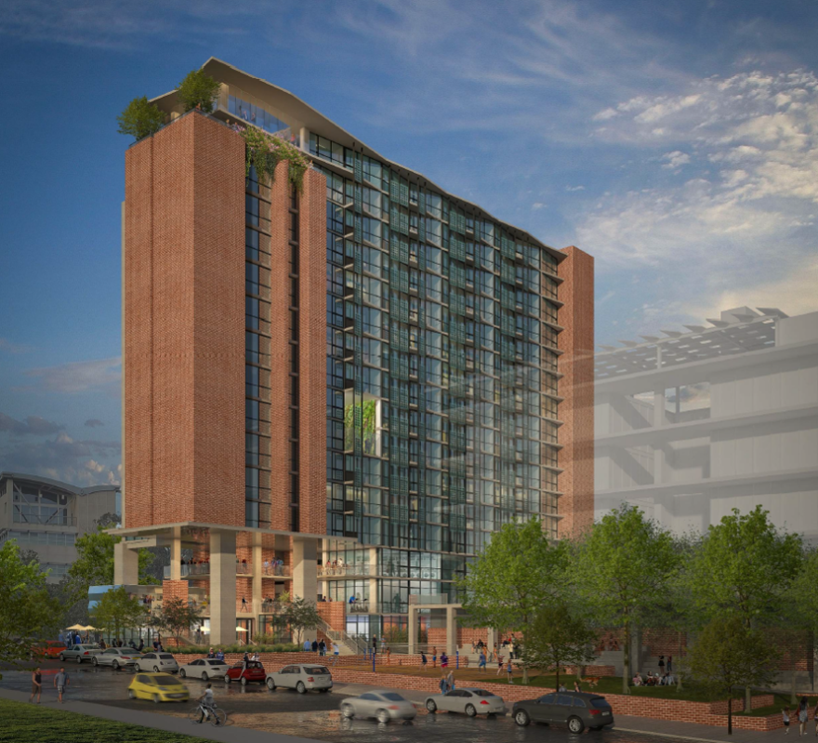
Housing
$344 million City College planning grant
$150K grants for consultants
Demographics and feasibility studies
Affordable student and employee housing
Wrap-around services (e.g., food services, etc.)
Exploration of partnerships
  Aging out foster youth support programs
  City of SD Housing Commission
  Federal tax credits
  Bond program funding

Slide 50

2024 Bond Measure
Targeting November 2024 election
$1.75 - $3.0 billion (polling to help guide amount)
  Project identification, prioritization, costing in progress
  Citizen’s steering committee formation early 2023
  Polling and outreach mid-2023
  Bond detail, ballot and bond measure language development early 2024
  Outreach, communication, and community engagement mid-2024

Slide 51

Police Advisory Committee
Chancellor’s standing advisory committee
established July 2022
    Meets monthly
    Representative of all stakeholders
    Reviews, discusses, comments, and advises on matters of policing, security, safety, and associated policies and practices
Implementation of Recommendations from Board of Trustees Police Review Task Force
    De-escalation initiatives
    Training
    Re-imagining policing and past practices
    Police Department culture
    Outreach, communication, and community engagement

Slide 52
Questions?
Departmental Changes & Initiatives
Housing
2024 Bond
Police Advisory Committee

Slide 53
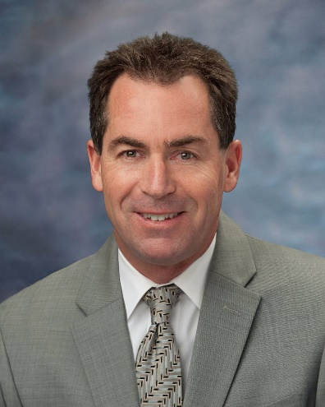
Districtwide Communications and
Public Relations
Jack Beresford,
Director, Communications and Public Relations

Slide 54
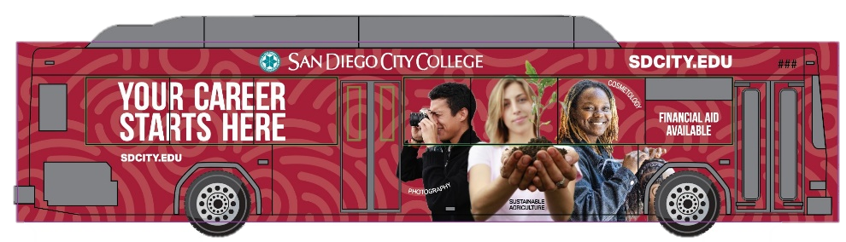



Districtwide Marketing
“Careers Start Here” theme with all four colleges highlighted
  Bus sides, billboards, transit interiors, social media, search and remarketing
  Special focus on military/vets, working moms/adults, men of color, and Promise students
  Campaign runs August 2022-May 2023
  40 million impressions/3,500 conversions

Slide 55
State and Federal
Legislative Advocacy

Slide 56
Questions?
District Communications
and Public Relations
Q and A

Slide 57
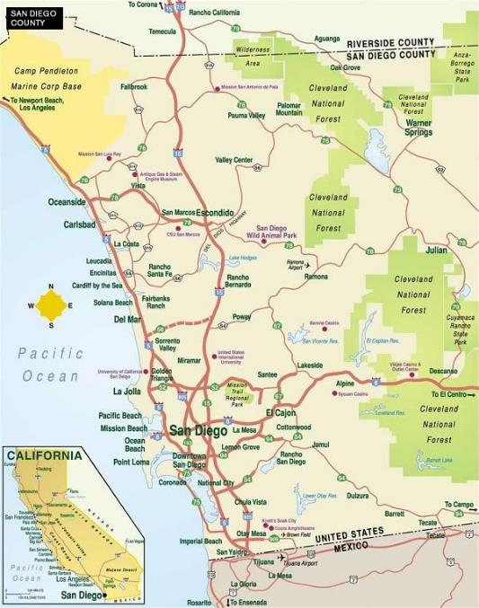
Planning Map for 2022-2023
Adapting to State Budget Challenges
Updating Enrollment Management Plans
Expanding Promise Program
Implementing Facilities Plans and Develop Comprehensive Housing Plan
Examining Alternative Models of Campus Policing
Completing Vice Chancellor Searches
Implementing Districtwide Strategic Plan
Increasing Development and Entrepreneurial Efforts

Slide 58
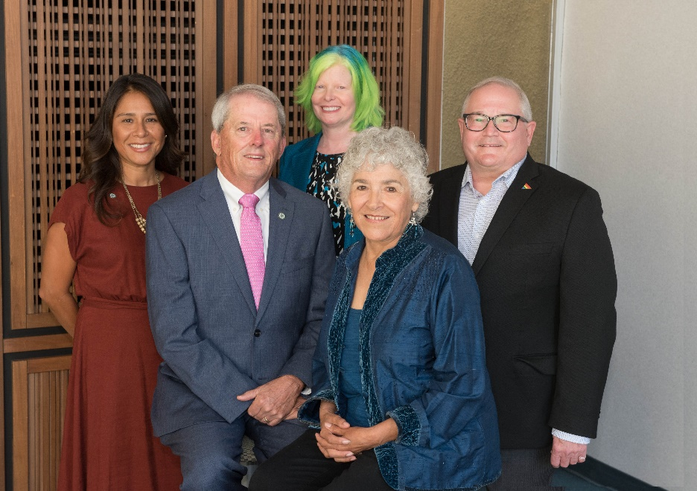
San Diego CCD Leadership Team
Student Trustees
Diego Bethea (City College)
Phoebe Truong (Mesa College)
Allen Kuo (Miramar College)
Julia Kogan (College of Continuing Education)
Board of Trustees
Geysil Arroyo, Craig Milgrim, Dr. Maria Nieto Senour, Mary Graham, Bernie Rhinerson

Slide 59
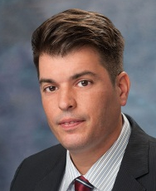
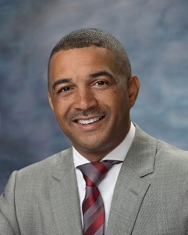
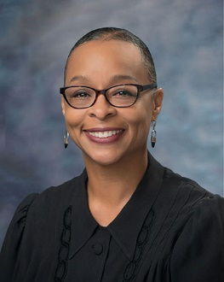
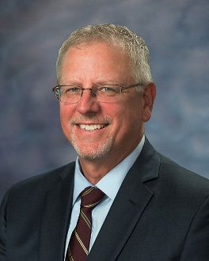
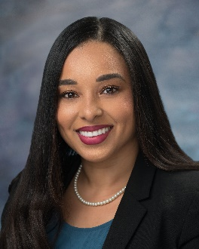

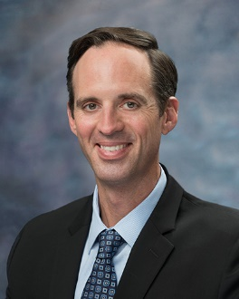



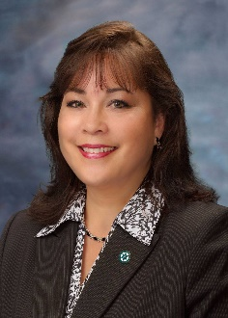
San Diego CCD Leadership Team
Dr. Carlos O. Cortez
Chancellor
Dr. Ricky Shabazz
President
City College
Dr. Ashanti Hands
President
Mesa College
Dr. P. Wesley Lundburg
President
Miramar College
Dr. Tina M. King
President
College of Continuing Education
Dr. Bonnie Dowd
Executive Vice Chancellor
Business and Technology Services
Greg Smith
Vice Chancellor
People, Culture, and Technology Services
Dr. Susan Topham
Vice Chancellor
Educational Services
Dr. Joel Peterson
Vice Chancellor
Educational Services
Jack Beresford
Director
Communications and Public Relations
Margaret Lamb
Executive Assistant to the Chancellor

Slide 60
Questions?
Forum
Q and A

