Slide 1
Highlights from the ASCCC’s Fall Plenary 2022 2022 Fall Plenary Session Program (click for details and slideshows)

Slide 2
General Session 2: Out of a Multitude of Tongues: Academic Freedom and The Importance of Diverse and Inclusive Discourse
….By exercising their right to academic freedom, faculty in virtually every discipline have been able to introduce theories, concepts, and experiences that challenge the long-held traditional and often eurocentric paradigms of higher education to create a more inclusive environment in our learning spaces. Unfortunately, the growing politicization of curriculum threatens academic freedom for all faculty. In this session, we’ll explore the history of Academic Freedom and its relationship to diverse curriculum as well as the recent trends that threaten Academic Freedom. Finally, we’ll explore how academic senates can collaborate with unions and faculty associations to protect academic freedom for all faculty at the local level.
Notes:
Eric

Slide 3
Equity, Curriculum and Academic Freedom
Role of the COR
Instructors must teach to the COR
Use of Academic Freedom to develop COR
Equity in the COR.
Resolution 9.01 Fall 2021
Resolved, That the Academic Senate for California Community Colleges work with the California Community Colleges Chancellor’s Office to revise California Code of Regulations Title 5 including section 55002 titled “Standards and Criteria for Courses” to include a component of culturally responsive curriculum, equity mindedness and anti-racism integrated into the COR that allows for local control on how that requirement is fulfilled;
Role of the Curriculum Committee
Review local Academic Freedom Policy
Provide/Support Academic Freedom Professional Development
Support open conversations about equity and academic freedom.

Slide 4
Academic Freedom Policy Required by Title 5
§ 51023. Faculty.
The governing board of a community college district shall:
(a) adopt a policy statement on academic freedom which shall be made available to faculty;
(b) adopt procedures which are consistent with the provisions of sections 53200-53206, regarding the role of academic senates and faculty councils;
(c) substantially comply with district adopted policy and procedures adopted pursuant to subdivisions (a) and (b).
Notes:
Julie
53200 Definitions—Academic Senate, academic and professional matters
53201 Academic Senate or Faculty Council
53202 Formation; Procedures; Membership
53203 Powers—
53204 protection of due process and collective bargaining
53206 ASCCC

Slide 5
Protecting Academic Freedom: What can Senates do?
Review and revise college governance policies to ensure that academic freedom is protected for all faculty
Provide professional development on the privileges and responsibilities of academic freedom for all faculty, administrators, and board members
Adopt a statement regarding the parameters and practice of academic freedom in a variety of areas such as:
evaluations
the implementation of diverse and innovative pedagogies
curriculum
grading policies
Notes:
Julie

Slide 6
Strengthening Academic Freedom: Recommendations for Local Senates
Local senates should create a statement on academic freedom, in addition to local board policy, that delineates the specific issues and parameters of academic freedom for faculty.
Local senates should provide consistent and ongoing professional development for full- and part-time faculty and senate leaders—curriculum, program review, policy chairs, senators, etc.—in the principles and tenets of academic freedom, including onboarding new faculty.
Local senates should work to review, revise, and strengthen shared governance processes, policies, and procedures in relation to academic freedom so that shared governance protects dissenting opinions in the decision-making process.
Notes:
Julie (and Erik?)

Slide 7
Policies and Collective Bargaining Agreement
Academic Freedom is an area of overlapping purview between the Senate and the Union
In support of academic senates and unions working together, the 2005 AAUP statement goes on to say that “[s]trong senates and strong union chapters can work together to preserve and protect academic freedom on campus. Together, they establish the institutional terrain and precedents on which individual rights are defined, defended, and sometimes adjudicated.”
Recommend the Senate and Union have a joint understanding
Notes:
Erik

Slide 8
Be Prepared
Have the policy and a process in place to resolve violations of academic freedom.
ASCCC Adopted position: Local academic senates should work with union colleagues to develop due process around violations or perceived violations that involve academic freedom issues, including a duly constituted—appointed or elected—faculty committee to review and recommend action.
Possible models for making recommendations to the college president
Academic Senate Academic Freedom committee
Union Academic Freedom committee
Joint Academic Senate and Union Academic Freedom committee
Notes:
Julie

Slide 9
General Session 3: Transforming Institutional Use of Data
Have you ever heard the phrases “I am not a data person” or “That isn’t what I am seeing in my class?" The data presented to us only seems to tell part of the story and it may not represent the individual challenges you have seen your faculty and students tackle every day. Academic senates must be actively engaged in determining what data is being tracked, determining what it really means, and deciding what still needs to be explored to work towards equitable student success.
Notes:
Eric

Slide 10
Limitations of Quantitative Data
When the focus is on the numbers, and the numbers are not contextualized, the focus tends to stray away from instructional programs and equitable student success.
Discussions centering on how to increase enrollment without increasing capacity to support learning.
Earning more money while spending less on instructional and student support programs.
One-size fits all is not an equitable strategy.
Quantitative data are easier to obtain, less expensive to collect and analyze, and can provide quick answers. They can start the conversations.
If too narrowly-focused, or if the data collection methods are not robust, our analysis will be biased.
Notes:
Julie

Slide 11
General Session 4: The Legislative Landscape and You: Using Authentic Voices and Experiences as Impactful Advocacy Efforts
When Sacramento passes legislation, the impact on local colleges is undeniable. Academic senate leaders and faculty are tasked with shaping local implementation, particularly when the legislation involves the 10+1 or academic and professional matters. Consequently, it should be of great importance for faculty to be informed of bills being considered in Sacramento and to strategize advocacy efforts that center the authentic and lived experiences of students and faculty in the stories shared with legislators. Presenters will reflect on a few of the bills signed into law during the 2022 legislative session as well as share strategies for increasing faculty awareness and expanding widespread involvement in local and statewide advocacy.
Notes:
Eric

Slide 12
Collaborate! Utilize Resources
Chancellor’s Office Tracked Legislation
Community College League of California (CCLC) Legislative Actions
ASCCC Legislative Positions and Resolutions
Faculty Association of CCCs (FACCC) Legislative Priorities and Current Legislation
Community College Association (CCA) Legislative and Political Action
California Federation of Teachers (CFT) Legislative Updates
Bill Info (Leginfo)
California Education Code
California Code of Regulations

Slide 13
Find Your Legislators:
Legislation Info & Contacts
Find your California Representatives
Senate
California State Senate
Senate Roster
Senate Committee on Education
Senate Budget and Fiscal Review and Subcommittee 1 on Education
Streaming Info for Senate Floor Sessions and Committee Hearings
Assembly
California Assembly
Assembly Roster
Assembly Committee on Higher Education
Assembly Budget and Subcommittee 2 on Education Finance
Streaming info for Assembly Floor Sessions and Committee Hearings

Slide 14
General Session 5: Aligning General Education Pathways (AB 928)
The requirement by AB 928 (Berman, 2021) for a singular lower division general education pathway for transfer to both UC and CSU has amplified faculty, student, and the public's voices relative to streamlining transfer pathways and general education. Given that curriculum and degree requirements are key components of the 10+1, the ASCCC is collaborating with CSU and UC colleagues to develop the GE pathway as required in AB 928, and has been working with CCC stakeholders to propose aligned pathways for associate degree general education and CCC baccalaureate degree lower division general education. Learn more about the three proposed general education pathways and how they align to better serve students.
Notes:
Eric

Slide 15
AB 928 (Berman, 2021)
Single lower division general education pathway agreement by December 31, 2023 and implementation by 2025-2026.
Only lower division GE pathway to determine transfer eligibility to both the CSU and UC systems
GE pathway to include no more units that those required under the current IGETC pattern as of 7/2/21. This equals 34 units.
The Intersegmental Committee of the Academic Senates (ICAS) shall establish GE pathway by May 31, 2023,
IF NOT… administrative bodies of the CCC, CSU, and UC systems shall establish the GE pathway by December 31, 2023.
Notes:
Stephanie

Slide 16
Intersegmental Committee of Academic Senates (ICAS)
5 members each from:
Academic Senate for California Community Colleges Executive Committee
Academic Senate of the California State University
University of California Academic Senate
ICAS Special Committee on AB 928
Three faculty from each segment – CCC, CSU, UC
Advisory members: articulation officer, student, administrators, and academic senate executive director from each segment
Notes:
Ginni

Slide 17
#1: Proposed GE Pathway – CalGETC
CalGETC Area | Subject | Courses/Units
1 – English Communication | English Composition Critical Thinking and Composition Oral Communication | 1 course (3 units) 1 course (3 units) 1 course (3 units)
2 | Mathematical Concepts and Quantitative Reasoning | 1 course (3 units)
3 – Arts and Humanities | Arts Humanities | 1 course (3 units) 1 course (3 units)
4 | Social and Behavioral Sciences | 2 courses (6 units)
5 | Physical Science Biological Science Laboratory (for Phys/Bio course) | 1 course (3 units) 1 course (3 units) (1 unit)
N/A | Lifelong Learning and Self Development (CSU upper division GE) | Note: the ICAS is discussing making this a graduation requirement
6 | Language other than English (LOTE) (Currently UC only, carries no units)
7 | Ethnic Studies | 1 course (3 units)
 |  | 11 courses (34 units)
Notes:
Ginni

Slide 18
Potential Impacts of New GE Pathway
Consequences of reduction in units from the CSU GE Breadth pattern:
Less 1 course/3 units in Arts and Humanities and
Less 1 course/3 units in Social and Behavioral Sciences
Upper division Lifelong learning requirement
Not met at CCC
Impact on counseling, heath, and other programs at CCC
UC accepts fewer courses for GE than CSU
Reduced student options at CCC: CSU may have more options than CCC
Providing enough Ethnic Studies courses in CCC
Notes:
Ginni

Slide 19
Next Steps to Approving a Singular Lower Division GE Pathway
Academic senates of each system will vet the proposed pathway – CalGETC in fall 2022
After vetting, recommendations from each system academic senate will be forwarded to ICAS - December 2022
Recommendations will be considered by ICAS and augment the proposed CalGETC pathway if possible hopefully by February 2023
ICAS must establish a final Singular Lower Division GE Pathway (CalGETC) by May 31, 2023
Notes:
Ginni

Slide 20
#2: Proposed Associate Degree GE Pathway
1 | English Composition Oral Communication and Critical Thinking | 3 semester/4 quarter units* 3 semester/4 quarter units* | Title 5 §55063(c)(4)(A) and (d)(1) Title 5 §55063(c)(4)(B)
2 | Mathematical Concepts and Quantitative Reasoning | 3 semester/4 quarter units+ | Title 5 §55063(c)(4)(B) and (d)(2)
3 | Arts and Humanities | 3 semester/4 quarter units* | Title 5 §55063(c)(3)
4 | Social and Behavioral Sciences | 3 semester/4 quarter units* | Title 5 §55063(c)(2)
5 | Natural Sciences | 3 semester/4 quarter units* | Title 5 §55063(c)(1)
 | Lifelong Learning and Self Development | optional
6 | Language other than English (LOTE) | optional
7 | Ethnic Studies | 3 semester/4 quarter units* | Title 5 §55063(d)(3) and Resolution F20 09.04
* indicates transfer-level course required
+ indicates transfer-level course required with limited exceptions
Notes:
LaTonya

Slide 21
Proposed GE Pathway for the Associate Degree
Minimum requirements for the local associate degree - colleges would still be able to add requirements
Consistent with requirements for Associate Degree for Transfer
ADT has additional requirements (proposed CalGETC?)
Consistent with current Title 5 regulations
Does not raise or add requirements - transfer-level mathematics NOT required
Unit requirement from 18 to 21
Requirements could still be met by using Credit for Prior Learning or Credit by Exam
Area descriptions could include competencies like what is done for Ethnic Studies
Notes:
LaTonya

Slide 22
#3: Proposed Lower Division GE Pathway for CCC Baccalaureate Degree
1 | English Composition Oral Communication and Critical Thinking | 3 semester/4 quarter units* 3 semester/4 quarter units* | Title 5 §55063(c)(4)(A) and (d)(1) Title 5 §55063(c)(4)(B)
2 | Mathematical Concepts and Quantitative Reasoning | 3 semester/4 quarter units+ | Title 5 §55063(c)(4)(B) and (d)(2)
3 | Arts and Humanities | 3 semester/4 quarter units* | Title 5 §55063(c)(3)
4 | Social and Behavioral Sciences | 3 semester/4 quarter units* | Title 5 §55063(c)(2)
5 | Natural Sciences | 3 semester/4 quarter units* | Title 5 §55063(c)(1)
 | Lifelong Learning and Self Development | optional
6 | Language other than English (LOTE) | optional
7 | Ethnic Studies | 3 semester/4 quarter units* | Title 5 §55063(d)(3)
 | Additional units from areas above | 6 semester/8 quarter units
* indicates transfer-level course required
+ indicates transfer-level course required with limited exceptions
Notes:
Cheryl

Slide 23
The Three Proposed Pathways Together…
CCC Associate Degree GE and CCC Baccalaureate Degree GE likely to have more courses approved than CalGETC
Students that are undecided can start with courses approved for CalGETC and will still meet CCC Associate Degree GE and CCC Baccalaureate Degree GE requirements
All three pathways are aligned and clear
Notes:
Stephanie

Slide 24
Visual Alignment of 3 Proposed GE Patterns
Area | Proposed CalGETC Pathway | Proposed CCC Associate Degree GE Pathway | Proposed CCC Baccalaureate Degree GE Pathway (Lower Division)
1 | English Composition (3/4) Critical Thinking and Composition (3/4) Oral Communication (3/4) | English Composition (3/4) Oral Communication and Critical Thinking (3/4) | English Composition (3/4) Oral Communication and Critical Thinking (3/4)
2 | Mathematical Concepts and Quantitative Reasoning (3/4) Transfer Level | Mathematical Concepts or Quantitative Reasoning (3/4) Transfer or College Level | Mathematical Concepts or Quantitative Reasoning (3/4) Transfer or College Level
3 | Arts (3/4) Humanities (3/4) | Arts and Humanities (3/4) | Arts and Humanities (3/4)
4 | Social and Behavioral Sciences (6/8) | Social and Behavioral Sciences (3/4) | Social and Behavioral Sciences (3/4)
5 | Physical Science (3/4) Biological Science (3/4) Laboratory (for Phys/Bio Science) (1/1) | Natural Sciences (3/4) | Natural Sciences (3/4)
 | Life Long Learning and Self Development Not required (CSU Upper Division GE) | Life Long Learning and Self Development Not required in current title 5 regulations | Life Long Learning and Self Development Not required in current title 5 regulations
6 | Language other than English (LOTE) (Currently UC only, carries no units) | Language other than English (LOTE) Not required in current title 5 regulations | Language other than English (LOTE) Not required in current title 5 regulations
7 | Ethnic Studies (3/4) | Ethnic Studies (3/4) | Ethnic Studies (3/4)
 |  |  | Additional units from above areas (6/8)
Total | 11 courses (34 semester) | Minimum 21 Semester Units | Minimum 27 Semester Units
Notes:
Stephanie

Slide 25
Breakout Session 1: Data-informed Planning, Policy Development, and Decision-Making to Strengthen Students’ Success (with a focus on transfer)
Join us in an interactive session on how to make smarter data-driven decisions through examining research and creating inclusive approaches for advancing student achievement and institutional effectiveness, to informing policy and funding initiatives. In this breakout, we will explore how to use research to make data-informed decisions; discover how bias can impact your data-driven decision-making, and learn how faculty can make better-informed decisions, and empower them to bridge student equity gaps.
Notes:
Eric

Slide 26
Working Together:
Redesigning Transfer Experiences
Historical reporting of transfer
6-year transfer rates
Transfer-ready or transfer-prepared
Traditional view of transfer:
Binary outcome of whether students transferred or not
Refreshed view of transfer:
It’s a continuum
Notes:
Alyssa
Instead of standing here sharing what is or should be the secret sauce to moving from data to action - I am going to share an example of how college used data to engage across the institution to reimagine what transfer could look like for their students based on statewide and local data.
By reimaging transfer as a continuum –examples of taking this idea that transfer is a continuum and that everyone has a role to play to support transfer
And the ways in which they made information accessible and actionable to reimagine and redesign their transfer support structures for students –
from the data they examined to the connections with other major efforts such as guided pathways they connected this work to

Slide 27
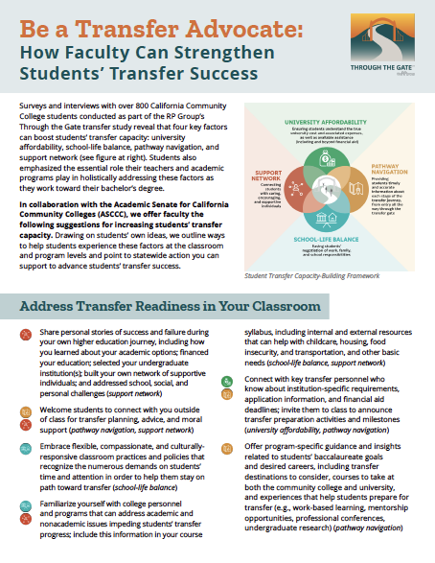
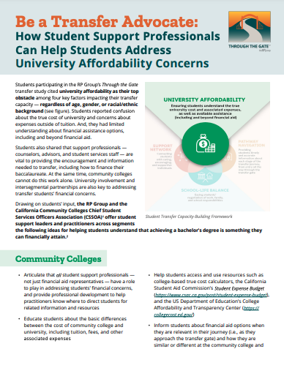
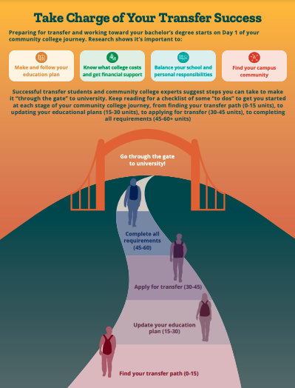
Working Together:
Redesigning Transfer Experiences at the state level
Notes:
Alyssa

Slide 28
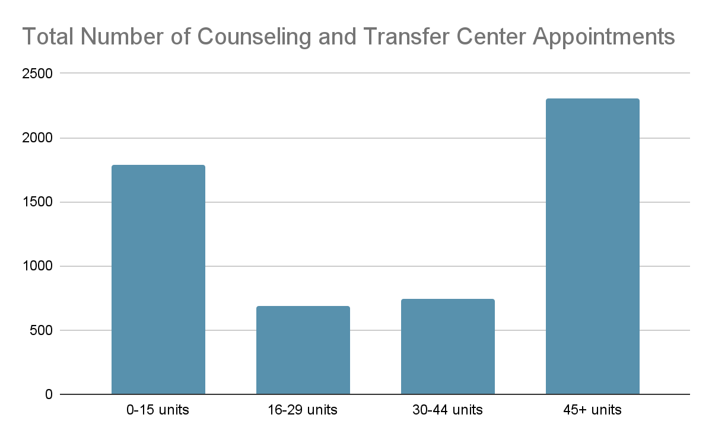
Working Together:
Redesigning Transfer Experiences at the local level
Local Transfer-Related Issues
1,900 students each year with 30+ transferable units
275 students with 72+ units
1,200 students within 3 units of completing a degree
Notes:
Alyssa

Slide 29
Breakout Session 2: The State of Ethnic Studies Education in the California Community Colleges
Ethnic Studies is now an integral and required component of general education in all three California public systems of higher education. Join this session for information and discussion on Ethnic Studies over the last 50 years, the role of academic senates in advancing Ethnic Studies education, the progress in the development of courses and programs in Ethnic Studies, the next steps, and more!
Notes:
Eric

Slide 30
Ethnic Studies Defined
Ethnic Studies consist of the four core areas African American/Black Studies, Asian American Studies Chicana/o/Latina/o Studies, Native American Studies, and Comparative Ethnic Studies.
Ethnic Studies interrogates the relationship of social structure to those of literary and cultural practices, and questions/challenges traditional disciplinary boundaries and assumptions.*
Ethnic Studies situates the experience of people of color in methodological framing that emphasizes both the structural dimensions of race and racism (social, political, and economic inequalities and struggles against them) and the associated cultural dimensions (literary, artistic, musical and other forms of humanistic expression)*
Notes:
Manuel

Slide 31
Committing to Ethnic Studies Education: An Academic and Professional Matter
Title 5 §53200: Academic and professional matters means the following policy development and implementation matters:
Curriculum, including establishing prerequisites and placing courses within disciplines
Degree and certificate requirements
Grading policies
Educational program development
Standards or policies regarding student preparation and success
… 11.
Notes:
Ginni, Manuel

Slide 32
Ethnic Studies Courses and Programs
Ethnic Studies C-ID Course descriptors and Transfer Model Curricula (TMCs) are currently being vetted.
Process started with three Discipline Input Group meetings in Spring 2021.
A Faculty Discipline Review Group consisting of 4 CCC and 4 CSU faculty – one representative from each of the four core disciplines from each segment was established.
Draft C-ID descriptors and 5 TMCs (Ethnic Studies plus the four core disciplines within Ethnic Studies) went to CCC and CSU faculty for feedback.
Faculty feedback is being considered, and if changes are proposed, more vetting will occur.
Notes:
Eric, Carlos

Slide 33
THANK YOU! Resources…
Chancellor’s Office Ethnic Studies webpage
Ethnic Studies TMC on C-ID website – scroll down to bottom of the page
ASCCC Resolution F20 09.03 Ethnic Studies Graduation Requirement
ASCCC Resolution F20 09.04 Clarify and Strengthen Ethnic Studies General Education Requirement
ASCCC Resolution S21 09.07 Defining Ethnic Studies and its Four Core Disciplines
ASCCC Rostrum article: Ethnic Studies: Looking Back; Looking Forward
Notes:
All

Slide 34
General Session 7:Increasing Access to Local Academic Senate Meetings Supports Inclusion, Diversity, and Equity in Faculty Leadership
As representative and decision-making legislated bodies, it is critical that local academic senates and the discussions and decisions made are accessible by all of the college’s faculty, full- and part-time. This is true whether the local academic senate is truly representative, in which faculty members are elected or selected as representatives by departments or divisions, or roles or the local academic senate is a senate-of-the-whole, in which all faculty members are encouraged to engage in academic senate discussions and decisions. As we seek to “Center Authentic Voices and Lived Experiences in 10+1”, please join us in a dialogue around how access to local academic senate meetings can increase the voice of all faculty on academic and professional matters.
Notes:
Eric

Slide 35
Relationship Between Increased Access to Academic Senate Meetings and Inclusion, Diversity & Equity
Access
Inclusion
Diversity
Equity
Making sure that everyone can attend the meeting – space, location, time, communication to all faculty
This leads to increased inclusion = attendance AND participation
Once inclusion is increased and wide open, diversity can be achieved; different types of faculty are present, with differing authentic voices, that can lead to more enriched conversation and decision-making, and academic senate experience that is spread more evenly among faculty that differ in many ways
Increased inclusion and diversity can then lead to increased equity. The idea that every faculty member, regardless of race, gender, sexual orientation/identity, ability/disability has the same opportunity to not only attend, but participate on all levels of the academic senate.

Slide 36
General Session 8: Authentic Leadership: Collaboration Between Administration and Faculty Leaders in the California Community College System
The student experience at our local colleges starts with intentional and deliberate leadership strategies to provide access and unconditional belonging to support students on their academic journey. While perspectives between academic senates and administrators may differ, many strategies for meeting local institutional strategic plans overlap. This session seeks to define collective impact and provide information relevant to using collaborative practices and models between faculty leaders and administrators in order to serve students. Join us to explore collaborative methods to work with administrators and other college stakeholders to provide high-quality programs and services to pursue shared aspirations.
Notes:
Eric

Slide 37
Presenters’ Views on Authentic Leadership
Amber Gillis, ASCCC South Representative: Authentic leadership is cultivating collegial relationships with others through transparency and values-based principles, while simultaneously both acknowledging your own gaps in knowledge or limitations and uplifting the content knowledge and potential of others.
Dr. David Williams, Vice President of Academic Affairs, Solano Community College: Authentic leadership involves being transparent and ethical, respecting and encouraging other viewpoints, and keeping your promises. Lead with love.
Dr. Karen Chow, ASCCC Area B Representative: Authentic leadership looks and sounds like leaders who: 1) listen carefully and echo what people say to ensure they’ve heard them, and value a transparent, inclusive, and equity centered shared governance structure ; 2) explain how and why they make decisions; are open to input about factors constituents would like them to consider, and dialogue openly about whether those factors can be incorporated or not and why; 3) are interested in collaborative problem-solving and give credit and acknowledgement to collaborators; 4) are not afraid to say “I don’t know” and follow up on things they agree to follow up on.
Dr. LaTonya Parker, ASCCC Secretary : Authentic leaders know who they are and lead with a sense of purpose. Their leadership actions are genuine with respect for other cultures and diverse perspectives. They build relationships through intentional engagement. They work collaboratively with others in bringing about transformational change with emotional intelligence.

Slide 38
Leadership Meets Collaboration with Collective Impact
Collective Impact is the commitment of a group of important actors from different sectors and the community to a common agenda for solving a specific social problem at scale.

Slide 39
The Five Conditions of Collective Impact
Common Agenda | All participants have a shared vision for change including a common understanding of the problem and a joint approach to solving it through agreed upon actions.
Shared Measurement | Collecting data and measuring results consistently across all participants ensures efforts remain aligned and participants hold each other accountable.
Mutually Reinforcing Activities | Participant activities must be differentiated while still being coordinated through a mutually reinforcing plan of action.
Continuous Communication | Consistent and open communication is needed across the many players to build trust, assure mutual objectives, and create common motivation.
Backbone Support | Creating and managing collective impact requires a separate organization(s) with staff and a specific set of skills to serve as the backbone for the entire initiative and coordinate participating organizations and agencies.
J. Kania & M. Kramer, 2011

Slide 40
General Session 9: Mission Still Possible
The California Community College mission codified in section 66010.4 of the California Education Code includes both “academic and vocational instruction”. State policies since 2010 have mostly focused on transforming transfer in California community colleges and directing more resources to clarify, support, and strengthen transfer pathways. How has this impacted student and workforce needs? Is the mission of the California community colleges at risk? Join us to hear about the direction of the California Community College mission and strategies to ensure that a focus on all students remains ‘mission still possible’ in the California community colleges.
Notes:
Eric

Slide 41
The Mission of the California Community College System
California Education Code §66010.4
Primary Mission: Academic and Vocational instruction at the lower division level
for older, younger, returning students
grant associate degrees
provide remedial instruction, ESL, noncredit, support services, community services
Primary Mission: Advance economic growth and global competitiveness that contribute to workforce improvement
education,
training, and
services
Notes:
Ginni

Slide 42
12 Years of Initiatives Impacting CCC Educational Programs
2010 | 2012 | 2013 | 2016 | 2017 | 2018 | 2019 | 2021 | 2022
SB 1440 (Padilla) Transfer Associate Degree for Transfer (ADT) | SB 1456 (Lowenthal) Seymour- Campbell Student Success Act of 2012 Education Plans and Success Metrics | SB 440 (Padilla) Student Transfer Achievement Reform Act ADT if a Local Associate Degree | Strong Workforce Program | AB 705 (Irwin) Seymour- Campbell Student Success Act of 2012: Matriculation: assessment Vision for Success System Goals Guided Pathways Open Educational Resources Initiative | Budget Act: Student Centered Funding Formula (SCFF) Calbright | Budget Act: Cradle-to-Career Data System | AB 928 (Berman) Student Transfer Achievement Reform Act of 2021 AB 1111 (Berman) Common Course Numbering AB 927 (Medina) Baccalaureate Degrees Ethnic Studies | AB 1705 (Irwin) Seymour-Campbell Student Success Act of 2012 All students (with limited exceptions) in transfer-level English and math
Notes:
Ginni and Wendy *info in other presentations
Ginni: 1440, 440, (2017), 928, 927, Ethnic Studies
Wendy: 1456, SWP, (2018-2019), 1111, 1705

Slide 43
Impact on Career Education
Focus on Transfer Pathway
Associate Degree for Transfer not the best option for all students
Local degree or UC Transfer Admission Guarantee (TAG) agreements might increase chance for acceptance to CSU/UC of choice
Guided Pathways
First year - core general education (GE) focus inadvertently decreasing enrollment of certain programs
Student Centered Funding Formular (SCFF)
Transfer monetized over certificates
Disincentivizes colleges to focus on ESL, non-credit, CTE, etc.
Incentivizes colleges to enroll students in transfer-level English and mathematics during student’s first year
Open Educational Resources/Zero Textbook Cost (OER/ZTC)
Student search schedule for low-cost options
OER resources more available for common GE courses
Practicum courses may have additional material fees
Notes:
Wendy- affirming CTE

Slide 44
Impact on Career Education
AB 705/AB 1705
Student placement and enrollment in transfer-level mathematics and English (limited exceptions)
AB 1705 “IF not met by transfer-level course”
College Promise/Dual Enrollment
Change from BOG waiver
Focus on full-time students
work/life balance: able to carry 12 units per semester?
AB 928 - Singular GE Pathway and ADT
Auto placement in ADT pathway
Change in GE course taking patterns
CSU practicum vs. IGETC theory
AB 1111 Common Course Numbering
How will CTE courses fit in?
Will student select common courses over local CTE courses?
Notes:
Ginni- affirming CTE

