Slide 1
Institutional Effectiveness,
Guided Pathways &
Equity

Slide 4
Guided Pathways &
Vision for Success
Alignment/Integration of Plans / Framework
Race-Conscious Design
Prioritize DI groups;
USC CUE feedback
Activities → Systemic Design
Leverage existing work and address campus reform

Slide 6
Barriers to Equity (Themes)
Limited resources to directly support efforts to close gaps for DI student groups relative to success metric
Lack of quantitative/qualitative data to determine areas of strength/weakness to support DI student groups (6 success factors;)
Lack of DI representation in staffing (Faculty, Classified Professionals, Administrators) to reflect DI student groups
Limited, targeted professional development on strategies/practices to DI student groups’ success
Lack of structure/programs to support success of DI student groups & limited student engagement opportunities for DI student groups to connect to campus
Limited materials/curriculum/programming related to DI student groups’ history, experiences, culture (courses, materials representative of community)

Slide 7
Institutional Effectiveness,
Guided Pathways
& Equity
ACP Training on DI data
Prioritizing Guided Pathways projects
PIER Committee & Planning
Review Guided Pathways projects currently in progress or closest to action to determine next steps with a focus on specific DI population.
Train ACP Success Teams on Equity Plan metrics & begin discussions on connection between metrics, pillars, and projects.
Working with PIER committee to revise integrated planning framework that centers DEI and integrates with the Educational Master Plan

Slide 8
Equity Metrics & ACPs
Review Equity Metrics
Review DI data

Slide 9
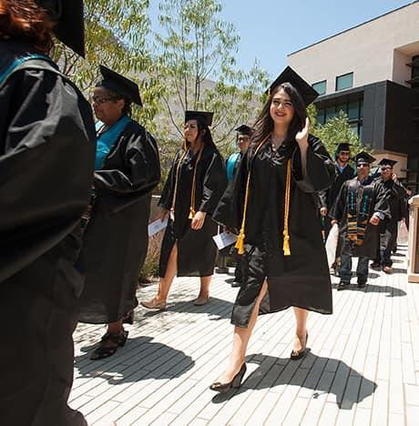
Metrics
Equity
Successful Enrollment
Successful enrollment in first year (Access)
Persistence
Persistence of first-time in college students who enrolled in the subsequent semester.
Completion of Math & English
Completion of BOTH transfer-level math & English in the first year
Transfer to a Four-Year
Transfer to a four-year institution within three-years
Degree/Certificate (Vision for Success Goal)
Attainment of the Vision for Success definition of completion within three years.

Slide 10
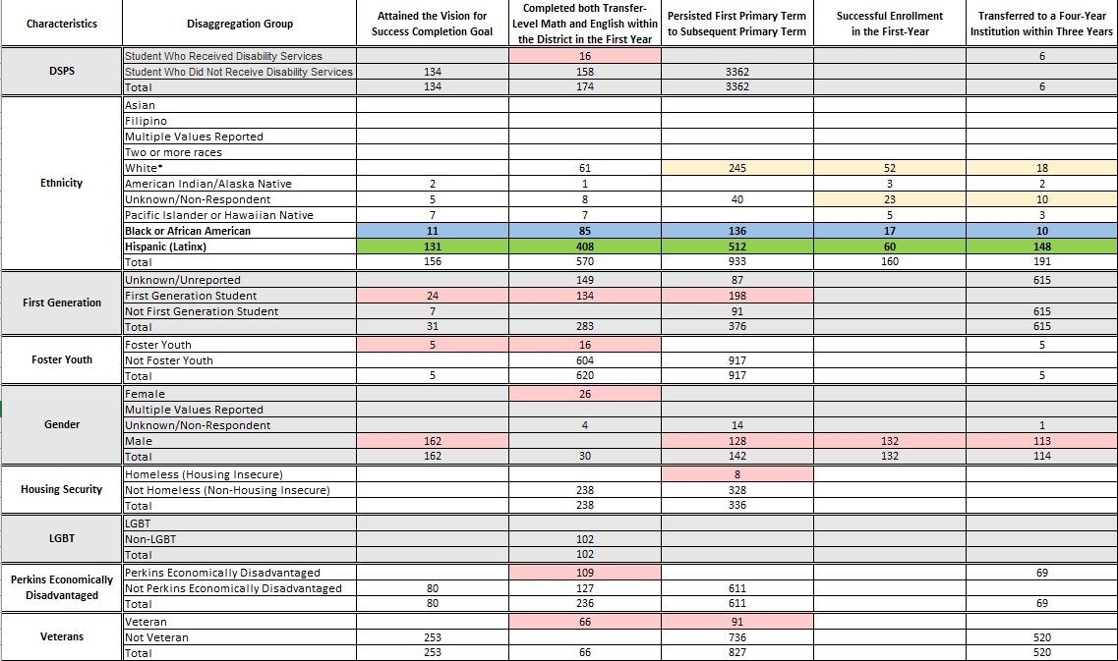

Slide 11
DISPROPORTIONATE IMPACT (DI)

Slide 12
Persistence
from/to
Primary Term
Completion of
Math & English
Transfer to a
Four-Year
Successful
Enrollment
Completion
VSP
Enter the Path
Clarify the Path
Stay on the Path
Ensure learning
SCFF Base Allocation
FTES
SCFF Supplemental
AB 540
Pell Grant
Promise
SCFF Student Success
9+ CTE Units
SCFF Student Success​
Transfer-level Math & English in the ​First-Year​
SCFF Student Success
Associate Degree
For Transfer (ADT)
Transfer
SCFF Student Success
Associate Degree
Credit Certificates
Regional Living Wage

Slide 13
Prioritizing Guided Pathways Projects
Academic & Career Pathways Success Teams
Program Mapper
Light the Fire Courses (Faculty PD)
Onboarding Design Team

Slide 14
BARRIER | EQUITY-MINDED PRACTICE | ACTION | GUIDED PATHWAYS | VISION FOR SUCCESS | Strategic Goal
Lack of qualitative data to determine areas of strength/weakness to support Black/African American students | Review existing data from surveys and focus groups; determine additional data that is needed; further disaggregate data | Review data (quant/qual) specific to metric District Black Student Success workgroup (Fall 2022) District IR (USC –National Assessment of Collegiate Campus Climate) | Enter the Path (Successful enrollment) Clarify the Path Stay on the Path (Persistence) Ensure Learning (Completion VSP; Transfer) | Reduce equity gaps by 40% | Strategic Direction 1 - Systematically update college processes, programs, and practices within a comprehensive equity framework for equity-minded practices in the workplace, the classroom, and support programs/services.

Slide 15
Barrier: Data
GP Project | Lagging Indicators | Leading Indicators | Specific DI Inquiry
ACP Success Teams | Completion (VSP) | Enrollment of 6+ units each semester; completion of transfer math & English in 1 year; | How are we outreaching to our [DI pop] students to engage in the ACPs. How do we create community and sense of belonging? How are ACP teams reviewing DI data to inform practice & design of programs/services?
Onboarding Design | Enrollment in the current year of application | Completed application; applied for financial aid; identified a major/ACP; attended orientation; completed abbreviated Ed Plan | How are we outreaching to our [DI pop] students? Do we reflect the community population we serve? What is Miramar’s image in the [DI pop] community? How are we engaging this community as part of Miramar? What specific/targeted approaches are used for the [DI pop]?
Light the Fire | Persistence from one primary term to the next; career exploration | Completion of comprehensive Ed Plan; Attended Career Center event | How are the Light the Fire courses inclusive of the [DI pop] cultural experiences? Are the courses taught by faculty who reflect the [DI pop]?

Slide 16
PIER Committee & Strategic Planning
Integration of Guided Pathways and Equity into Planning Framework
Review of KPIs
Identifying additional data considerations
Sustainability of efforts over time
Current structure to ideal structure across all divisions

