Slide 1
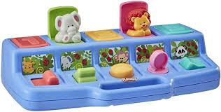
Web Academy for Managers

Slide 2
Procedures
Managers approve content authors in their areas
Content authors must be approved prior to training
Certain high-level pages need special approvals:
Program pages require VPI approval of content authors
Home Page changes/posts requires PIO appoval
Once approved Web Services creates account & access and arranges training

Slide 3
Resources
https://sdmiramar.edu/services/website-services
Information on variety of common tasks
How-to videos
Style guide

Slide 4
How to Navigate Website
Faculty & staff resource home page link
First item (“Resources for Employees”) is general portal
Students can access general portal via “Support for Students” main menu item, and then “All Resources”
Search function
Directory
People
Academic Departments
Service Departments

Slide 5
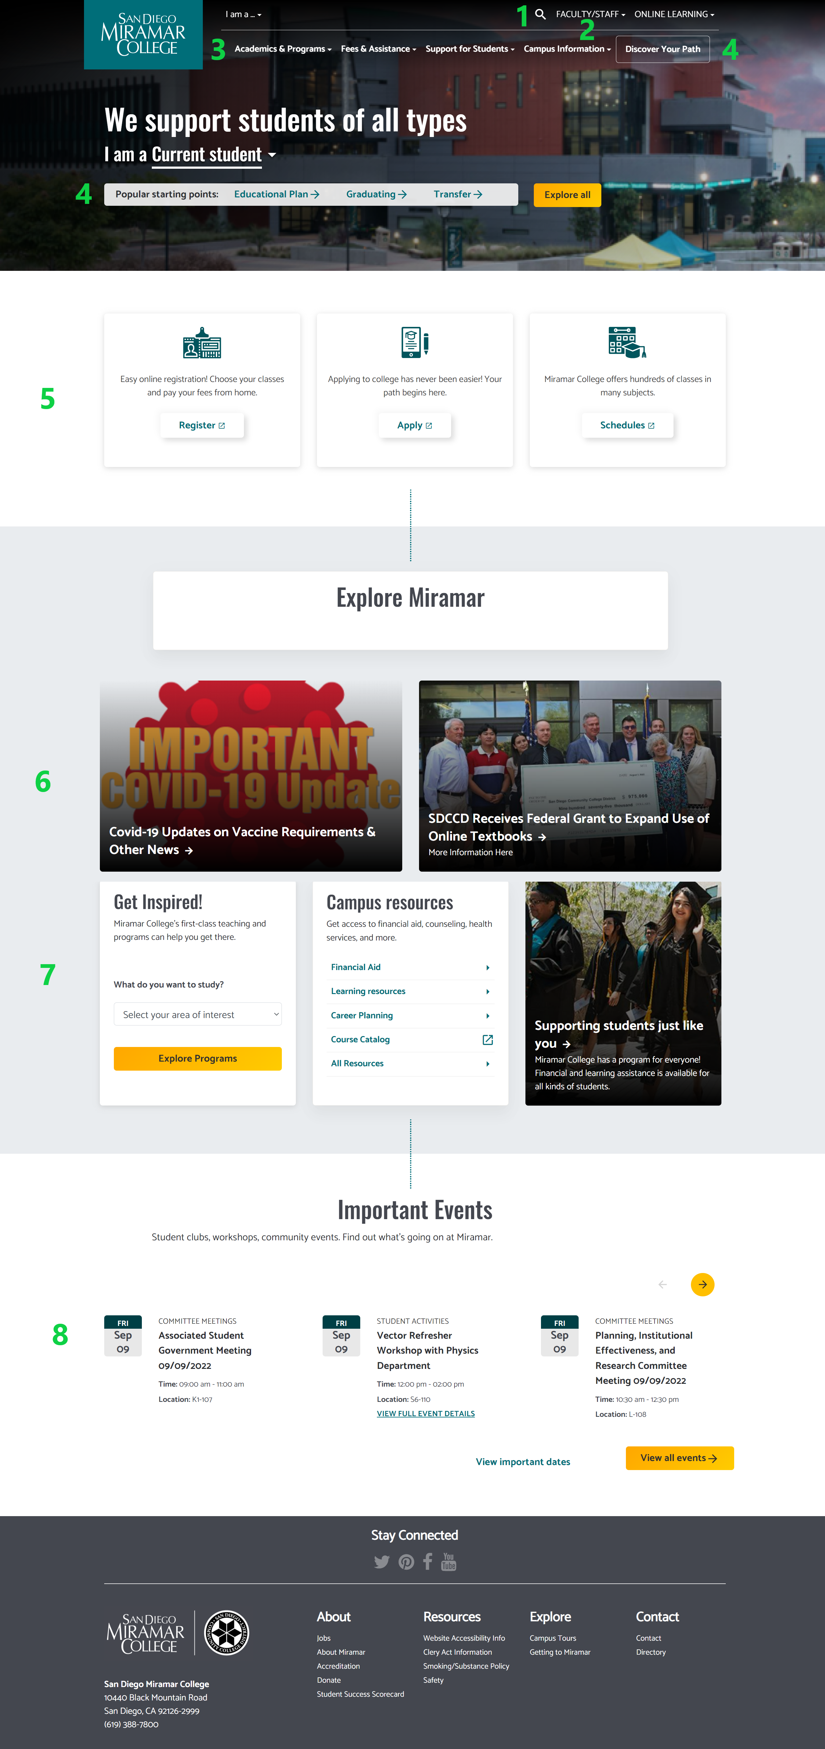
Website functions
Search functionality (click on the Magnifying Glass)
Faculty Staff Resources & quick links next to search
Main Menu (Student Focused)
Pathway Links
Major Calls to Action
Important News Area (Two Stories)
Additional Messaging Triptych
Important Events Calendar (Consider expanding?)

Slide 6
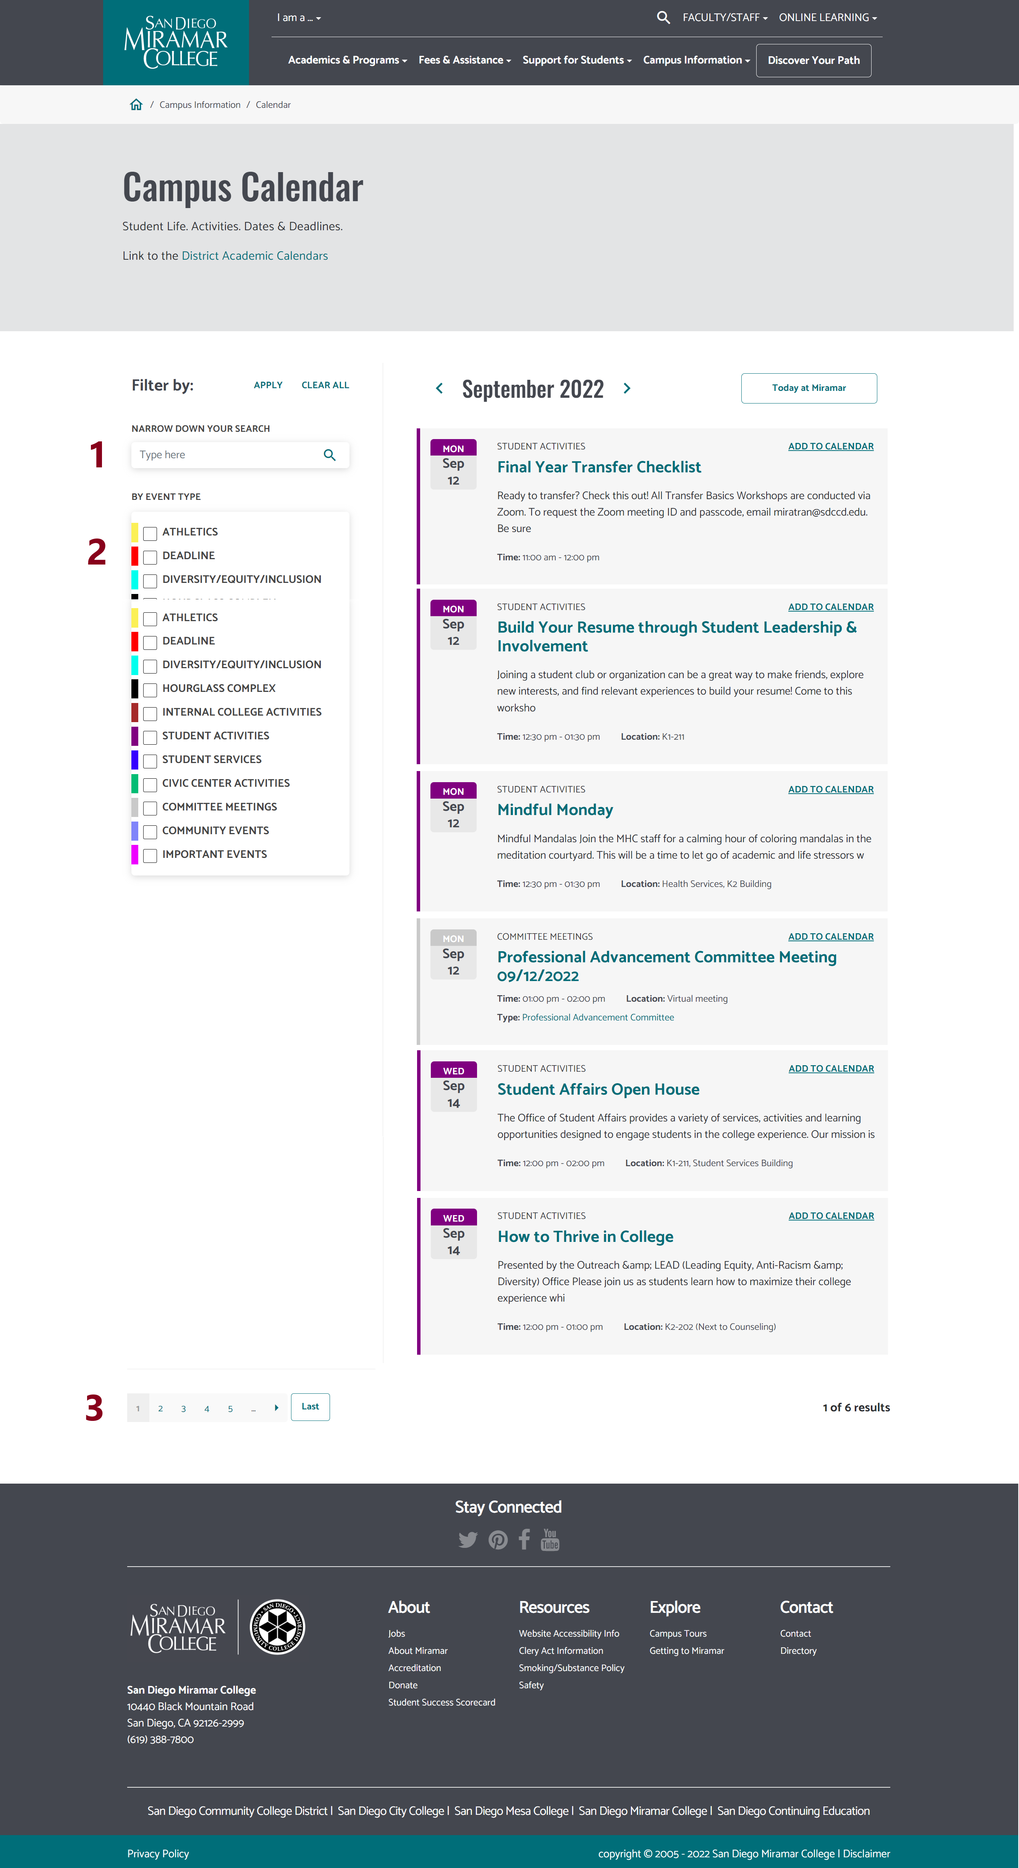
Campus Calendar
Search Function Can search for keywords in calendar events
Categories Filter
Pager (common element)
NOTE: We currently have too many categories.

Slide 7
Current Projects
Enhance calendar functionality
Add 2nd row to homepage for other events?
Departmental Consistination
Web services will be engaging directly with service departments to focus on standards and improvements
Search functionality
Will be implementing closed-taxonomy with departments to enhance search… Experimental. May cause Earth to plunge into the Sun.

Slide 8
Forms
You may not be aware we can implement webforms
We can
Generally, we won't do sensitive information (SSN, Credit Card, etc.)
Form results can be emailed or encrypted/stored for review/download (CSV)
We can train you to do forms, or we can create them for you

Slide 9
Request Fixes
Process:
Content
Content errors, department hours, personnel, etc. handled by department/area staff
Events are handled at the department/school level
Campus directory: Reprographics
Top level Pages can vary
Home page: PIO
Program Pages VPI
General enhancement requests
Discuss directly with Web Services

Slide 10
Website Enhancements
WORK WITH WEB SERVICES FIRST
Many departments are independently engaging with 3rd party vendors for services (chatpots, forms, etc)
Not a "free-for-all", most such services require code injection on our site.
Sometimes people just assume our website doesn't do that, but it almost certainly can
Work with web services first

Slide 11
Ongoing Issues
Communication
Information about processes & features not being shared?
Faculty Staff continue to reach out to Web Services directly for access
Lack of awareness about calendar
Functionality
Large hero images push content “below the fold”
Institutional
No clear top-level guidance on important messaging
Need strategic website messaging/strategy calendar

