Slide 1
Military CPL (MilCPL) and the Military Articulation Platform (MAP)
Giving Our Veterans the Credit They Deserve
PRESENTERS
Samuel Lee, VPAA Norco College
Pedro Campos, ITPI CEO

Slide 2
AGENDA
Sergeant Mora’s Story
Veteran Population at Opportunity
The Credit They Deserve
MAP Initiative Overview
MAP Demo, Status, Innovations
Initiative Next Steps
Meet Mauricio Cano-Cortez
MAP 2022 Cohort
Notes:
100,000 post-secondary completions expected each year, it is projected that at least 40,000 of them will be at the bachelor’s level; 25,000 at the associate level; 17,000 master’s degrees; 10,000 vocational education certificates; and 1,500 doctorate or post-doctorate degrees.

Slide 3
MAP INITIATIVE MISSION
Articulate college courses with ACE credit recommendations, allowing colleges to award up to one year of credit in programs leading to high wage jobs and transfer—making it normal and expected for all U.S. veterans to receive all the credit they deserve and to achieve all their educational goals with existing benefits.
Notes:
100,000 post-secondary completions expected each year, it is projected that at least 40,000 of them will be at the bachelor’s level; 25,000 at the associate level; 17,000 master’s degrees; 10,000 vocational education certificates; and 1,500 doctorate or post-doctorate degrees.

Slide 4
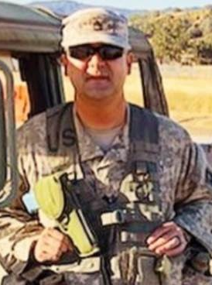
Joey Mora, Army Sergeant 1st Class E7, MOS 95B, 31B, 31E; 19 years active duty, 4 overseas tours, active reservist.
Sergeant First Class Mora was deployed in 2003 for Operation Enduring Freedom. He later completed 3 more tours, which delayed his education. Over the years, he struggled to take classes while working full-time in law enforcement.
All that changed when Mora learned about MAP. In Spring 2021, after a 10-year college journey, he received his AA in Social Behavioral Studies in just 1 year. Mora was our first recipient of 30 MAP credits—demonstrating proof of concept for the MAP Initiative and respect for his many years of training and service.
This year Mora is on to his next mission: transferring to a four-year university for his BA and MS degrees.

Slide 5
THE CREDIT THEY DESERVE
A Rand study estimates that only 1 in 4 veterans believes they receive the college credits they deserve.
57 % of survey attempted, but only 47 % of those were satisfied.
Only 27% felt they got the credit they deserved.
Notes:
100,000 post-secondary completions expected each year, it is projected that at least 40,000 of them will be at the bachelor’s level; 25,000 at the associate level; 17,000 master’s degrees; 10,000 vocational education certificates; and 1,500 doctorate or post-doctorate degrees.

Slide 6
THE CREDIT THEY DESERVE
A 2019 study found that only 44% of surveyed veterans received military credit.
33% didn’t know how many credits they received.
Typical credits: 2 units for PE.
Notes:
100,000 post-secondary completions expected each year, it is projected that at least 40,000 of them will be at the bachelor’s level; 25,000 at the associate level; 17,000 master’s degrees; 10,000 vocational education certificates; and 1,500 doctorate or post-doctorate degrees.

Slide 7
Military to Civilian Transition
Post-9/11 Veterans are more likely to say they struggled with the lack of structure in civilian life, and felt disconnected from family or friends.
Half of post-9/11 veterans say it was “somewhat or very difficult” for them to readjust to civilian life after military service.
45,000 veterans and active-duty personnel committed suicide over the past six years. More than 20 per day.

Slide 8
EQUITY
43% of post-9/11 veterans has a service-connected disability.
Roughly one in ten veterans between the ages of 18 and 34 years lives in poverty. Poverty is even more common among disabled young veterans.
Almost half of homeless veterans were African American in 2008 despite the fact that only 11 percent of veterans overall are African American.
The homeless rate among young veterans is more than double the rate among nonveterans the same age.
One in six post-9/11 veterans is a women. This number will double by 2040.
Notes:
https://www.jec.senate.gov/public/_cache/files/26971be7-ba33-4417-8cbc-c6022e734321/jec-veterans-day-fact-sheet-2016.pdf
22 JEC Democratic staff calculations based on data from the Bureau of Labor Statistics, Employment Situation of Veterans – 2015 Table 3: Employment status of person 25 years and over by veteran status, period of service, and educational attainment, 2014 annual averages (March 22, 2016).

Slide 9
Equity and CPL
Significant equity impact of CPL on completion improvement:
Latinx +24%
Black +14%
Enrolled in community college +25%
Pell recipients +19%
Almost twice the higher ed completion rate for adult learners: 49% vs. 27%
When analyzed in isolation, CPL increases the likelihood of higher ed completion by more than 17% in adult learners
Significantly reduced time to degree compared to similar students without CPL
Notes:
Recognizing Prior Learning in the COVID-19 Era: Helping Displaced Workers and Students One Credit at a Time
Twice the higher ed completion rate for adult learners: 49% vs. 27%
24,512 adult students (ages 25 and older) who earned
PLA credits had a credential completion rate of 49
percent over the seven-and-a-half-year observation
period, compared to 27 percent of adult students with
no PLA credits. This includes completion of bachelor’s
degrees, associate degrees, and certificates.

Slide 10
OPPORTUNITY
18.5M total veterans
7.6M Gulf War era (I and II) veterans
VA projects Post-9/11 Veteran population to be just under 5.1M in 2021, with a median age of 35.
1.7M (33%) of post-9/11 veterans have a BA or higher
2.44M (44%) have attended some college or earned an associate’s degree
1.17M (23%) have not attempted higher education
Notes:
https://www.bls.gov/news.release/pdf/vet.pdf

Slide 11
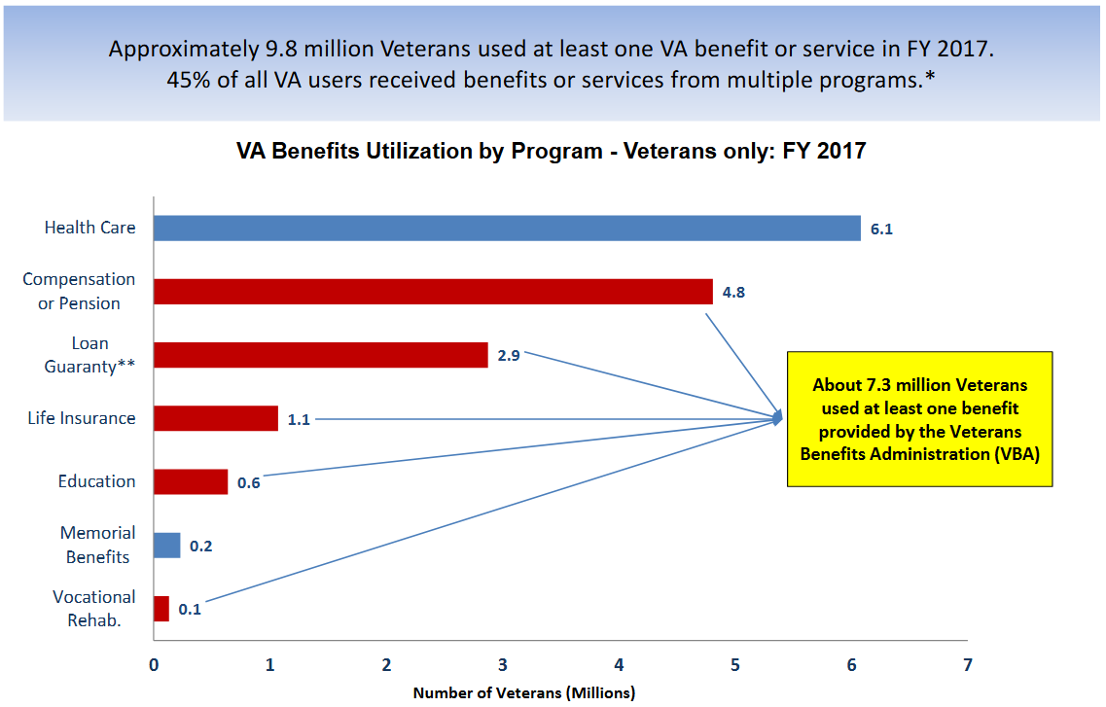
MAP GOAL: Increase Equitable Access, Opportunity, Respect—
Grow and Optimize the Education bar

Slide 12
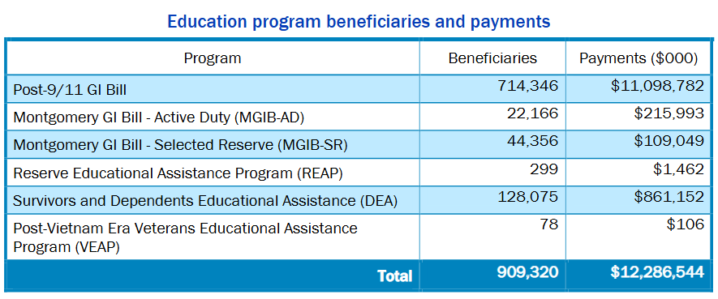
In 2019, 909,320 were pursuing higher education at an average annual per-student cost of $13,512.
Notes:
https://www.benefits.va.gov/REPORTS/abr/docs/2019-abr-v2.pdf

Slide 13
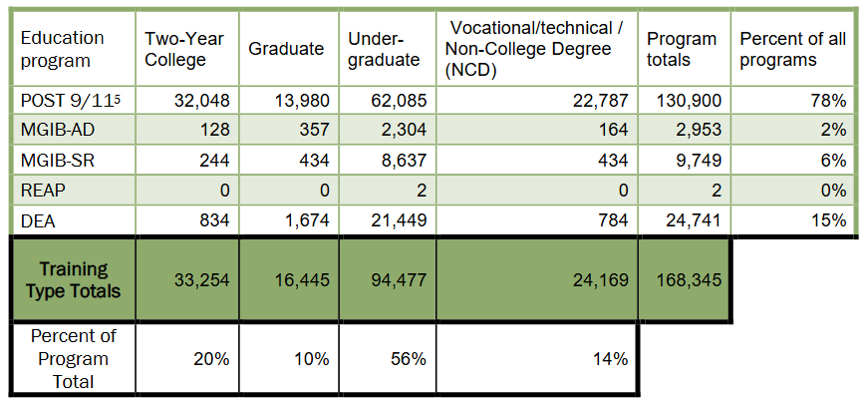
In 2019, 168,000 began their journey in higher education
If all were awarded 30 units (1 year), the savings would be $3.49B (168,000 X $20,971 Norco Annual Benefit)

Slide 14
Top 5 Completions Military Times
28,373 University of Phoenix
19,077 University System of Maryland (most at University College)
18,503 California Community College System (116 colleges)
15,520 American Public Education Inc.
9,642 Education Management Corp. 91,115 TOTAL AT TOP FIVE
University of Phoenix
Grants up to 30 units PLA for AA, but they do not indicate how many or what type until the student enrolls, applies, presents documentation, and begins their studies. The credits appear to be elective and not for specific courses (likely not transferable).
Charges $2400 for 30 units of credit ($150 fee + $75 per unit).
Their articulations are not transparent nor adoptable by other colleges.
Notes:
Eric: Expect veteran 100,000 post-secondary completions expected each year, it is projected that at least 40,000 of them will be at the bachelor’s level; 25,000 at the associate level; 17,000 master’s degrees; 10,000 vocational education certificates; and 1,500 doctorate or post-doctorate degrees.

Slide 15
National Veterans’ Success Tracker (NVEST)

Slide 16
THE BIG GAP
No system to pair, approve, and share credit recommendations and college courses…
ACE Credit Recommendation for 95B – Military Police:
3 hours in Management Principles
College Catalog: MAG-44 3 Units Principles of Management
The Military Articulation Platform (MAP) has been designed to bridge this gap and make articulations shareable with other colleges—all to maximize MilCPL for our veterans and active service members.
Notes:
Garth
Connections: Military Courses with related MOS (allows MOS-based evaluation rather that requiring individual JST)
Faculty Based Decisions: Discipline experts approve/disapprove. If you imagine setting up credit for prior learning for new military recruits going into basic training, you can see how this would not go well with the drill sergeants (faculty). Recruit brings his/her letter that says, “Congratulations, you can skip boot camp because you got an A in high school PE.” We address this in MAP by relying on the ongoing work of ACE to evaluate and add legitimacy to the process and relies on faculty to approve each course equivalency (articulation). We then give faculty to chance to approve/disapprove all articulation recommendations. The Statewide Academic Senate fully supports MAP implementation.
Big Incentives: Outreach is Integrated (Basic Articulations Before Vet Arrival). This is a sustainability strategy. While MAP enabled colleges will be losing credit coursework to prior learning, they will be gaining the student, whom they would not have had were it not for the MAP outreach capabilities. It is critical that MAP contain a reliable database of veteran contact information complete with MOS. This will enable participating colleges to recruit and expand access for veterans in their region. Also with respect to incentives, we believe a scalable solution will emerge from a public private partnership. We are designing MAP at Norco College in partnership with ITPI, a private software designer with deep experience in designing CCC catalog and schedule systems.
Automated and Integrated. Existing ERP and Curriculum system data is used (via API) where possible. The system will become a learning system as it matures through diverse use.
Transparent to Other Colleges – Articulations of colleges can be adopted by peer colleges. This will later be made easier with the integration of CID, CIP, TOP, and TES codes associated with courses and programs. Early adopters will end up doing much of the work and we anticipate common practices to emerge along the way.
Colleges Must Qualify to Access MAP and outreach data. This is important because we do not want to see MAP devolve into a money-making opportunity for recruiters. This is the reason we intend to build in from the beginning a set of minimum guarantees and services MAP Enabled colleges will provide vets. These include:

Slide 17
MAP
Evaluator Pairs in MAP
Faculty Determine Yes/No
ACE Credit Recommendation for 31E - Corrections and Detention Specialist :
3 semester hours
in Management
College Catalog: MAG-44 3 Units Principles of Management
Once an Articulation is validated by faculty, it is stored in MAP and available to any veteran with the same MOS or ACE Course listed on the Joint Services Transcript.
Notes:
Connections: Military Courses with related MOS (allows MOS-based evaluation rather that requiring individual JST)
Faculty Based Decisions: Discipline experts approve/disapprove. If you imagine setting up credit for prior learning for new military recruits going into basic training, you can see how this would not go well with the drill sergeants (faculty). Recruit brings his/her letter that says, “Congratulations, you can skip boot camp because you got an A in high school PE.” We address this in MAP by relying on the ongoing work of ACE to evaluate and add legitimacy to the process and relies on faculty to approve each course equivalency (articulation). We then give faculty to chance to approve/disapprove all articulation recommendations. The Statewide Academic Senate fully supports MAP implementation.
Big Incentives: Outreach is Integrated (Basic Articulations Before Vet Arrival). This is a sustainability strategy. While MAP enabled colleges will be losing credit coursework to prior learning, they will be gaining the student, whom they would not have had were it not for the MAP outreach capabilities. It is critical that MAP contain a reliable database of veteran contact information complete with MOS. This will enable participating colleges to recruit and expand access for veterans in their region.
Automated and Integrated. Existing ERP and Curriculum system data is used (via API) where possible. The system will become a learning system as it matures through diverse use.
Transparent to Other Colleges – Articulations of colleges can be adopted by peer colleges. This will later be made easier with the integration of CID, CIP, TOP, and TES codes associated with courses and programs. Early adopters will end up doing much of the work and we anticipate common practices to emerge along the way.
Colleges Must Qualify to Access MAP and outreach data. This is important because we do not want to see MAP devolve into a money-making opportunity for proprietary school recruiters. This is the reason we intend to build in from the beginning a set of minimum guarantees and services MAP Enabled colleges will provide vets. These include:

Slide 18
MAP OVERVIEW

Slide 19
Early Outcomes
MAP early implementation stages are producing positive results
Established scalable solution for statewide MilCPL articulations
12 Participating colleges
130 Programs of study with articulated credits
34 Veterans awarded with transcripted MAP credit at Norco College
150 plus regional courses have articulated credits
600+ Regional veterans eligible for credit based on approved articulations
662 MAP Articulations approved for listing on the Transfer Evaluation System (TES)
750 plus trained in MilCPL
Ongoing legislative advocacy for CPL/PLA
Established transfer pathways Cal State University partners

Slide 20
Demonstration

Slide 21
MAP Process
Build local knowledge and support for MilCPL/CPL/PLA among constituents, particularly faculty and veterans
Ensure BP/AP on CPL conforms with Title 5 Credit for Prior Learning (CPL) policy regulation § 55050 and CA Ed Code statute 66025.71
Apply to be included in the MAP 2022 cohort
Establish MilCPL team and schedule regular meeting schedule
Upload JSTs of current veterans and analyze for MilCPL opportunities
Select first disciplines to articulate and work with discipline experts on approvals

Slide 22
MAP Initiative & Plans to Scale
Develop full-time MAP team to be housed at the Norco College VRC, within the Riverside Community College District, and to serve all participating CCCs.
Collaborate closely with the CCCCO and partner with state and federal agencies and higher education constituents and systems (e.g., ASCCC, CSU, UC, ACE, NCCRS, VA) to maximize the awarding and transfer of MilCPL/CPL/PLA.
Scale by introducing a new opportunity for a 2022 Cohort (up to 50 colleges) supported by seed funding.

Slide 23
All Forms of CPL
Industry Certifications and Assessments (NCCRS)
Prior Experience Review: Apprenticeship (IBEW example)
Standardized Assessments (AP, CLEP, IB)
High School Course Articulations
Portfolio Review
Credit by Examination

Slide 24
Track and Report CPL Metrics
Required to report to State based on title 5 § 55050.
“Data disaggregated by gender and race/ethnicity including the number of students who received credit for prior learning, the number of credits awarded per student, retention and persistence rates of students earning credit for prior learning, completion data (for certificate, degree, and transfer) for students earning credit for prior learning…”

Slide 25
Common Course Numbering
Common Course Numbering, CID, and crosswalk with ACE/TOP/CIP/SOC
Transparent, adoptable, scalable—all to ensure that all our veterans get all the credit they deserve.
CID | CID TITLE | ACE CR | TOP Code | TOP Code Title | CIP Code | CIP Title | SOC Code
BUS 115 | Business Communication | 3 hours in business communication | 0505.00 | Business Administration | 520201 | Business Administration and Management, General. | 11-1011

Slide 26
FUNDING
2017 $2M Appropriation sponsored by Assemblymember Cervantes for a regional VRC and development of a military CPL platform. Our new VRC grand opening is Nov. 10th.
2018-2021 MAP developed and scaled to region as Project 16 of IEDRC with 12 colleges.
2021 $2M Appropriation to begin scaling MAP statewide. Funding budgeted to cover costs for implementation of the MAP 2022 cohort through Summer 2023.

Slide 27
POTENTIAL FUNDING
Sept. 2021 Additional ongoing funding requested in the 2022-23 CCC System Budget Proposal.
Oct. 2021 MAP team briefed U.S. Veterans Affairs Secretary Denis McDonough and Congressman Mark Takano, Chairman of the House Veterans Affairs Committee on scaling nationwide.
If 2022-2026 state funding request is approved, MAP will be funded to continue scaling to all 116 colleges and to CSUs and UCs.
Federal funding request is underway for national scaling.

Slide 28
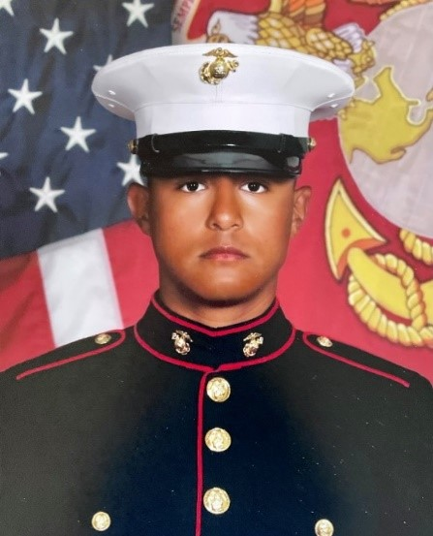
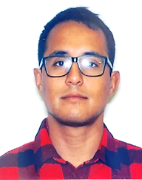
Mauricio Cano-Cortez
Marine Corps Engineer
Corporal (E4) MOS 1371
Goal: Engineering
30 Units MAP Credit
See Mauricio’s Video
Having served 2 tours of duty overseas and 4 years of active duty, Corporal Cano-Cortez is now a Norco College student majoring in Engineering
and club president of Student Veterans of America, Norco Chapter. He was awarded 30 units of MAP credit—saving over a year of study.

Slide 29
Opportunity and Obligation
Opportunity to:
Create a more welcoming college environment by maximizing MilCPL
Increase enrollment by attracting military students who stopped out or never used their benefits
Increase degree awards, retention, and transfer rates
Support key programs through targeted outreach
Obligation to:
Open the door to college wider and do what is right by our veterans and other students.

Slide 30
Advocate
Ask your legislators to support the funding requested in the 2022-23 CCC System Budget Proposal.
Propose SWP projects aimed at Industry and other CPL to add to the articulations beyond MilCPL.
Support potential efforts to partner ASCCC to create statewide articulation recommendations.
Involve your military students in the effort to increase access, completion, and successful transition.
Help the MAP Initiative learn and improve processes through lessons learned at your college.

Slide 31
MAP 2022 Cohort
Selected and starting in January 2022
College catalog and program data is already loaded in MAP
Current funding will support use through FY 2023. the funding included in the budget request next year will support ongoing scaling for the cohort and beyond.
Link to apply is https://register.militaryarticulationplatform.org
Cohort asked to support the Vet Friendly Standards
Dec. Reconvene for team support

Slide 32
Vet Friendly Standards​
​​Statement of “Commitment to Maximize College Credit for Military Training" by Academic Senate, College, District, and Governing Board.
Provide a “Center” where military-connected students can meet, socialize, study, or get academic help. (most CCCs have a VRC)
Agree to Principles of Excellence, 8 Keys to Veterans' Success, and the most recent Defense Department Memorandum of Understanding (CCCs already uphold these).
Reduce or Eliminate out-of-pocket tuition costs for Post-9/11 GI Bill users and, where needed, participate in the Yellow Ribbon program to help make up the difference between tuition costs and GI Bill benefits. At least 4 stars. (CCCs already do this).

Slide 33
Vet Friendly Standards​
Charge at or below TA Cap Rate ($250 per unit for 2021) and keep Average Student Loan Default Rate under 13%. (CCCs already do this)
Provide s​taff support for MilCPL and VRC;
Be regionally accredited (CCCs already are)
Aspire to Best for Vets based on Military Times criteria
Grant IT access to the MAP API Components (Incoming Data Pipelines, Data Source/Transformation, Data Loading/Mapping)
Support VetNet Ally training on campus.

Slide 34
Thank You
For more information about the Military Articulation Platform contact:
Samuel Lee, VPAA Norco College Samuel.Lee@norcocollege.edu
Calvin Klein Gloria, MAP Program Expert, Norco College Calvin.Gloria@norcocollege.edu
Terence Nelson, IEDRC MAP Lead Terence.Nelson@norcocollege.edu
Pedro Campos, CEO ITPI Pedro.Campos@norcocollege.edu
Weston Kilbride, Customer Success Specialist ITPI Weston.Kilbride@norcocollege.edu

Slide 35
Resources
MAP information page: https://learn.militaryarticulationplatform.org
American Council on Education (ACE) Military Guide
American Council on Education (ACE) National Guide
VRC – Norco College (MAP) Military Articulation Platform
National College Credit Recommendation Service (NCCRS)

